Slide 1
Jump-Oriented Programming
Song Yang

Slide 2
Motivation
Defense of ROP:
-There are already ways to defense return-oriented programming by
identifing a specific trait exhibited by return-oriented attacks. Some
enforce the LIFO stack invariant and some detect excessive execution of
the ret instruction.(Anti-ROP defenses)
What should we do to continue to perform code-reuse attack?
-What these techniques have in common is that they all assume that the
attack must use the stack to govern control flow.

Slide 3
New class of code-reuse attack
Change the formmat of ROP (JOP)
-We don't use ret as an ending instruction, instead, we use jmp.
What's the difference?
-In ROP, we use ret as an ending of gadget to chain multiple frames. -In JOP, we use jmp as an ending of gadget.
New problem comes
-the attker aim to make sequence of execution, but with jmp as ending, we can't chain the frames.

Slide 4
Jump Oriented Programming
Jump Oriented Programming consists of three parts:
Dispatcher Gadget: is used to determine which gadget in dispatch table should be execute next
Gadget table: is used to hold gadget address and data
Gadget Catalog: the exact instructions matching each gadget which is in dispatch table

Slide 5
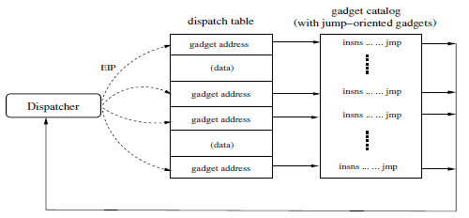
Jump Oriented Programming

Slide 6
Dispatcher gadget
The dispatcher gadget is a specific gadget which plays a critical role in the JOP technique.It essentially maintains a virtual program counter(pc) and executes the JOP program by advancing it through one gadget after another.
How do we decide which gadget should be the dispatcher gadget?

Slide 7
Get Dispatcher gadget
We consider any jump-oriented gadget that carries out the following algorithm as a dispatcher candidate.
pc f(pc);
goto *pc;
pc can be a memory address or register that represents a pointer into
jump-oriented program
Each time the dispatcher gadget is invoked, the pc will be advanced accordingly. Then the dispatcher dereferences it and jumps to the resulting address

Slide 8
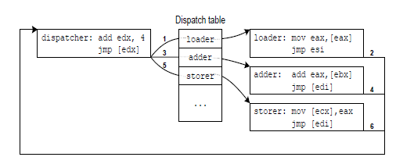
Jump Oriented Programming

Slide 9
Functional Gadgets
The dispatcher gadget itself does not perform any actual work on its own|it exists solely to launch other gadgets, which are functional gadgets.
To maintain control of the execution, all functional gadgets executed by the dispatcher must conclude by jumping back to it, so that the next gadget can be launched

Slide 10
Kinds of different functional gadgets
Loading data
Memory access
Arithmetic and logic
Branching
System calls

Slide 11
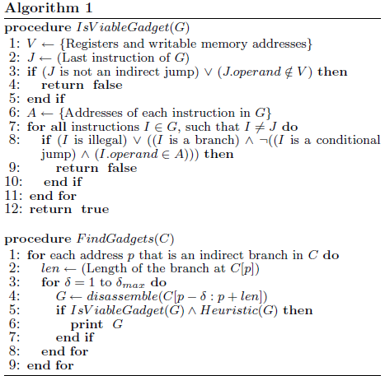
Gadget Discovery

Slide 12
New buffer to launch attack
A setjmp buffer:
The programmer allocates a jmp_buf structure and calls setjmp() with a pointer to this structure at the point in the program where control flow will eventually return. The setjmp() function will store the current CPU state in the jmp_buf object, including the instruction pointer eip and some general-purpose registers. The function returns 0 at this time. Later, the programmer can call longjmp() with the jmp_buf object in order to return control flow back to the point when setjmp() was originally called, bypassing all stack semantics. This function will restore the saved registers and jump to the saved value of eip. At this time, it will be as if setjmp() returns a second time, now with a non-zero return value. If the attacker can overwrite this bu er and a longjmp() is subsequently called, then control flow can be redirected to an initializer gadget to begin the jump-oriented program.

Slide 13
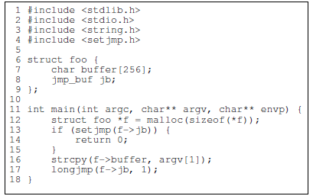
The example vulnerable program

Slide 14
Limitions and futher refinements
Though JOP is capable of arbitrary computation in theory, constructing the attack code manually is more complex.
Two features of the x86 conspire to make gadgets based on jmp and call especially plentiful. We need to consider what if we apply JOP in an alternative platform.(e.g., MIPS).

Slide 15
Thank you

