Slide 1
Security Models
Xinming Ou

Slide 2
Security Policy vs. Security Goals
In a mandatory access control system, the system defines security policy to achieve security goals
Policies cannot be bypassed or changed by users (processes)
How to ensure the policies are defined correctly, i.e., the security goals are actually achieved

Slide 3
Information Flow
When a subject s reads an object o, information flows from o to s.
When a subject s writes to an object o, information flows from s to o.

Slide 4
Information Flow Graph
Information flow graph for a protection state
Directed graph G = (V,E) where: (1) the set of vertices V includes all subjects and objects in the protection state, and (2) the set of directed edges E consists of each read and write information flow in the protection state.

Slide 5
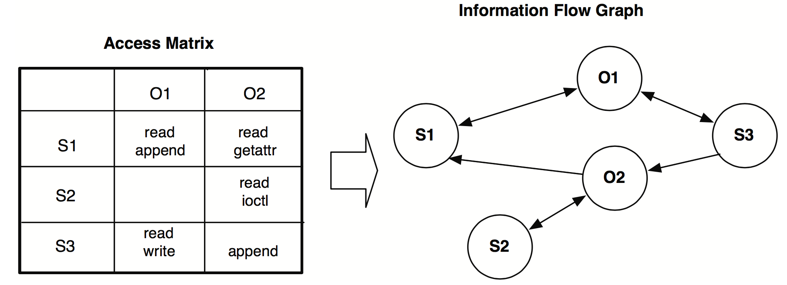
Example
Source: Operating system security, Jaeger’08, Morgan & Claypool

Slide 6
Use Information Flow Graph to Reason about Security Goals
Secrecy
Can data be leaked from one subject/object to another subject/object?
Integrity
Can subject/object of low integrity influence subject/object with high integrity?

Slide 7
Secrecy Model
Goal: prevent unauthorized disclosure of information
Secrecy model ensures that policies defined according to the model will not result in unauthorized disclosure
Only applicable to MAC, not DAC.

Slide 8
Lattice
A lattice is formed by a partial order relations

Slide 9
Example
Some partial order relations:
a
… …
The join operator: least upper bound
b
c
d
e
The dominance relation:

Slide 10
Secrecy Lattice
Top secret
Nodes are called "security class" -- labels assigned to objects and subjects
Partial order represents the “can flow” relation
Secret
Confidential
Unclassified

Slide 11
Bell LaPadula Model
Security labels arranged in linear ordering
Top Secret: highest
Secret
Confidential
Unclassified: lowest
Labels assigned to subjects: security clearance (SC)
Labels assigned to objects: security classification (SC)

Slide 12
BLP Model (MLS)
Simple-Security Property (no read up):
*-Security Property (no write down):

Slide 13
Labeling State
Assignment of labels to subjects and objects happens at the creation time
The label must dominate the label of the creating process
Labels cannot be changed once assigned

Slide 14
Extension of the MLS model
Introduce categories to further differentiate the security class
Security class consists of the sensitivity level (top secret, secret, confidential, unclassified) and zero or more categories.
Secret: MIL
Top secret: ST
Secret: MIL+ST
Top secret: NONE

Slide 15
Extension of the MLS model
All categories form a lattice as well
MIL+ST
MIL
ST
NONE

Slide 16
Extension of the MLS model
Security class has the form of l: c, where l is the sensitivity level and c is the category
Example:
Secret: None Topsecret: MIL
Secret: ST Secret: MIL+ST
Secret: MIL Topsecret: MIL

Slide 17
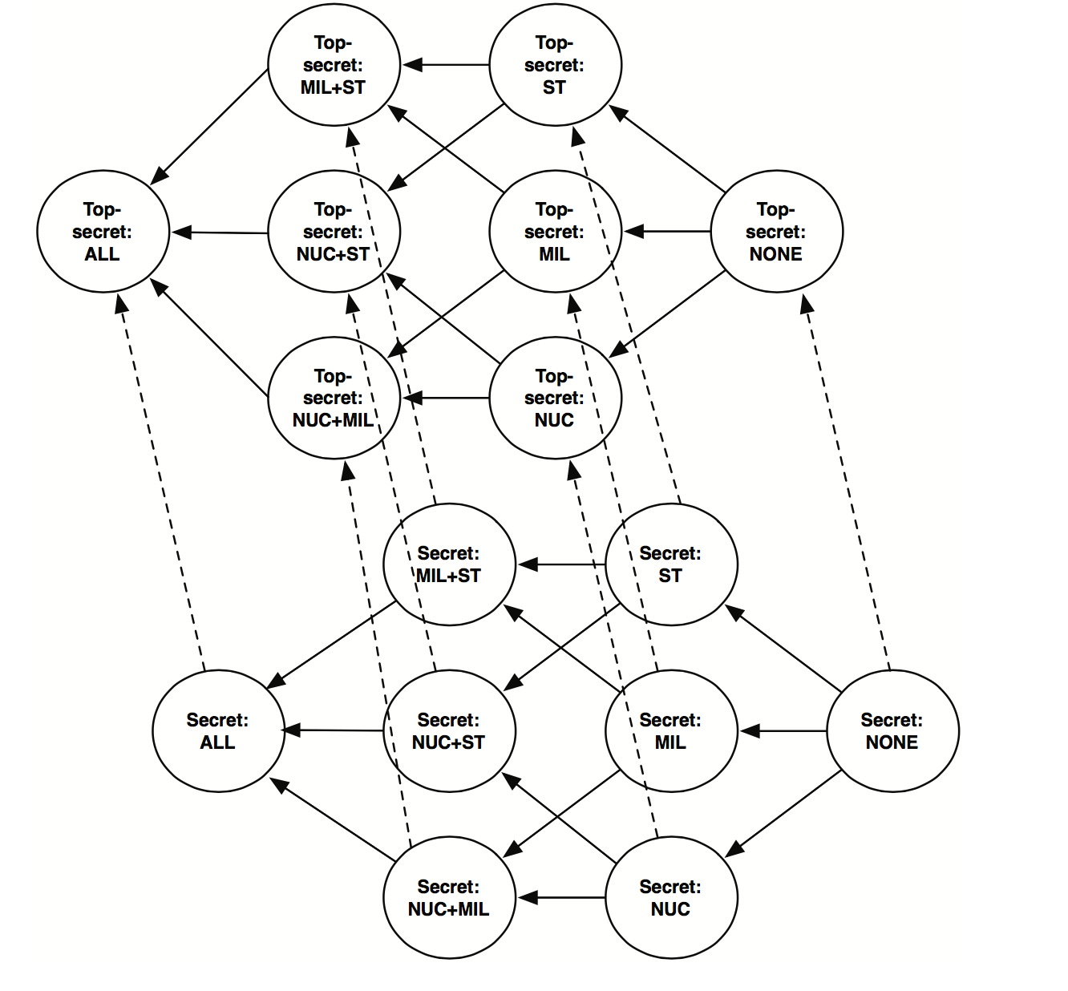

Slide 18
Integrity Model
Goal: Ensure that processes of high integrity do not depend on/are not influenced by those with low integrity
Integrity goal can be mapped to information flows:
Objects with low integrity cannot flow into subjects with high integrity

Slide 19
Biba Integrity Model
Simple-Integrity Property (read up):
*-Security Property (write down):

Slide 20
Integrity Classification
System
E.g.,
Middleware
Application
User

