Slide 1
Android System Security
Xinming Ou

Slide 2
Android System Basics
An open-source operating system for mobile devices (AOSP, led by Google)
Consists of a base operating system (Linux), an application middleware, and a Java SDK.
Available since 2007; first Android phone debut in 2008.
Currently the most popular smart-phone platform

Slide 3
Android System Overview
App
App
App
……
Application Middleware
Linux OS
Hardware

Slide 4
Security Considerations
A smart phone is “mostly” a single-user system
The security goal is primarily to protect the user and his/her data
The security goal also includes that critical functions of the phone shall not be hampered
The apps a phone runs are from manufacturers and app stores
The origin of the apps could be untrustworthy – apps could be vulnerable or outright malicious

Slide 5
Basic Protection – Android Sandbox
Each application runs as a user process in the Linux OS with a unique user ID
At install time, Android gives each package a distinct Linux user ID
Two apps can run under the same user ID if they are signed by the same key
This creates a sandbox for each app, so that Linux isolates applications from each other and from the system.
An app cannot directly access resources owned by another app if they have different user ids.
Notes:
It does not matter how the app is built

Slide 6
However
Apps need to communicate with each other and the system
A restaurant recommender app may need to launch a map app to show a restaurant’s location on map
An email app may need to launch a PDF viewer to open an attachment
A messenger app may need to receive text messages sent to the phone

Slide 7
Android App Components
Each Android app contains one or more components of the following types:
Activity: A GUI screen
Service: background processing
Broadcast Receiver: receives messages from other component
Content Provider: store and share data

Slide 8
An Example
Source: Understanding Android Security, Enck, et al., IEEE Security & Privacy, 09

Slide 9
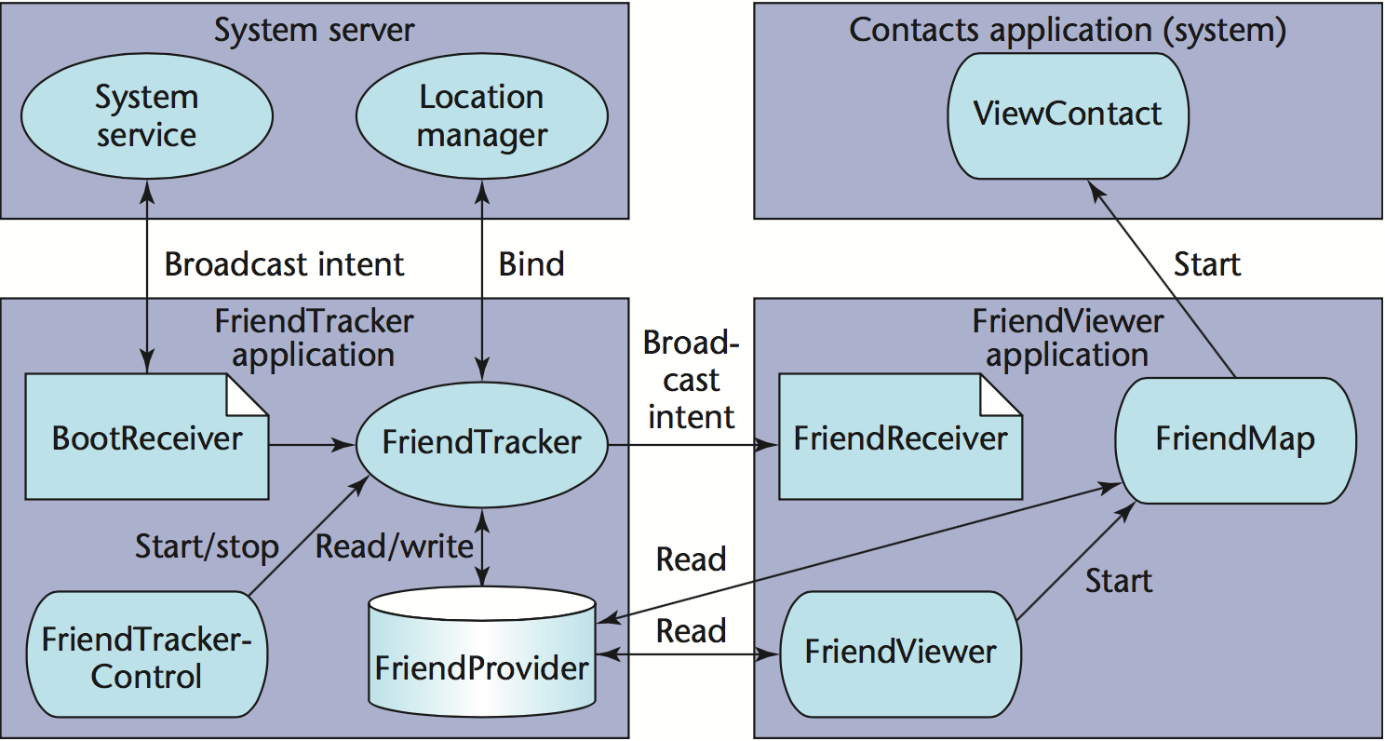
Inter-Component Communication (ICC)
Source: Understanding Android Security, Enck, et al., IEEE Security & Privacy, 09

Slide 10
Security Protection for ICC
An ICC interface is protected in two ways:
A private component cannot be accessed outside of the app
A component can be protected by permissions
A permission is a label defined by the system or app developer to protect an Android component

Slide 11
Android Permission Protection
Source: Understanding Android Security, Enck, et al., IEEE Security & Privacy, 09

Slide 12
Policy Specification
Each Android app package contains a “manifest file” that defines all the components in the app, and the permissions needed to access each component
The manifest file also contains a list of permissions the app requests from the system and/or user

Slide 13
Difficulty in Understanding Policy
Policy can be changed dynamically at runtime, in the app’s code
A message can be sent requiring a specific permission to receive it at runtime
A runtime permission check can be performed to access a component’s public method

Slide 14
Difficulty in Understanding App’s Behaviors
An app, when given a set of permissions, may misuse them to harm other apps and the user.
It is not trivial to understand how an app will use the given permissions

Slide 15
How Android app works
Cellular network, Internet, GPS, etc.
Event
Android System
Input
Event
System event
Find the handler
User
Send intent or Call some callback method
Component C
Component A
Component B
App B
App A

Slide 16
How Android app works
Cellular network, Internet, GPS, etc.
Android System
Find the target
Intent i
Intent i
Intent i
Component C
Component A
Component B
App B
App A

Slide 17
A Motivating Example: Sensitive-SMS App
DataGrabber Activity
Leaker Activity
onCreate(Bundle …){
…
String s1 = getSensitiveData();
Intent i1 = new Intent();
i1.setClass(…, Leaker.class);
i1.putExtra(“key”, s1);
startActivity(i1);
}
onCreate(Bundle …){
…
Intent i2 = getIntent();
String s2 = i2.getStringExtra(“key”);
SmsManager sms =
SmsManager.getDefault();
sms.sendTextMessage(…, s2, …);
}
4
5
2
App
3
Environment of DataGrabber
Environment of Leaker
Intent p1
Intent p2
Android System
Model
1

Slide 18
Problem 1: Data Leakage
source
Collect sensitive data d
sink
Send Intent with d
Comp X.2
ICC
Comp X.1
sink
Data leak
ICC
ICC
Comp X.3
Another App
App X
Notes:
X.1 sends an explicit intent to X.2.
X.2 sends an implicit intent which can possibly reach another app.

Slide 19
Problem 2: Data Injection
Injecting ill-crafted intent
Receive Intent
Send Intent
source
sink
Comp Y.1
Network I/O
Comp Y.2
App Y

