Slide 1
Trusted Infrastructure
Xiaolong Wang, Xinming Ou
Based on Dr. Andrew Martin’s slides from TIW 2013

Slide 2
Problem
We use different devices (smartphone, laptop, tablet, Xbox, router…) and grant them with authority everyday (Gmail/Facebook account, credit card, personal info, etc.)
How it can know if it really did what it said?
By using it we have to explicitly or implicitly trust. But shall we trust it?
Notes:
Do we have the confidence to say we trust it?

Slide 3
Scenario
Install the correct version of gcc package on Linux
Verify md5 compare with md5sum on website
Is this actually making an MD5 of the nominated file?
verifying the package relies on the correct operation of the utility
verifying the verifier relies on the correct operation of the shell ... and the OS
verifying the correct operation of the OS relies on ... lower level stuff
what am I really relying on?
Am I executing /usr/bin/md5sum?
Is the shell behaving as I expect?

Slide 4
What is Trust?
According to RFC4949 “trusted” is
A feeling of certainty (sometimes based on inconclusive evidence) either that the system will not fail or that system meets its specifications (the system does what it claims to do and does not perform unwanted functions).
TCG notion:
An entity can be trusted if it always behave in the expected manner for the intended purpose.
Trust != Secure

Slide 5
Trustworthy System
A system that not only is trusted, but also warrants that trust because the system’s behavior can be validated in some convincing way, such as through formal analysis or code review.

Slide 6
TCB
Think of a system you use. What is the extent of its Trusted Computing Base (TCB)?
Large parts of (or most, or all) of the operating system fall within TCB
The operating system is inherently trusted – it is a great big root of trust.

Slide 7
PC Attack Surface
Pre-boot (BIOS, UEFI)
Firmware, option ROMs
Management functions (SMM, SMI)
OS kernel
Kernel-mode drivers
Application software and drivers
Peripherals
Etc.

Slide 8
Kinds of Solution

Slide 9
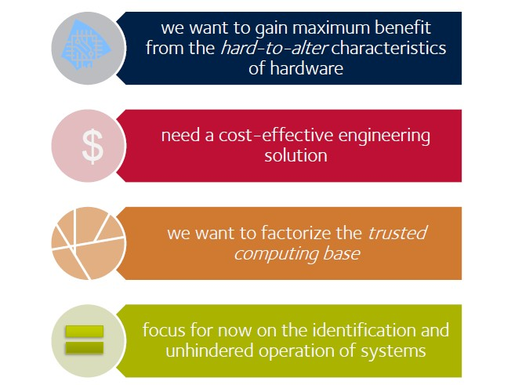
Building Trust in a System

Slide 10
Roots and Chains

Slide 11
Goal
We want to achieve hardware-like trust characteristics in a software programmable system
Implement hardware-based roots of trust
Control secret keys
Control platform identity
Building chains of trust which indicate/manage what software is running
Report platform state reliably
And/or launch only white-listed software

Slide 12
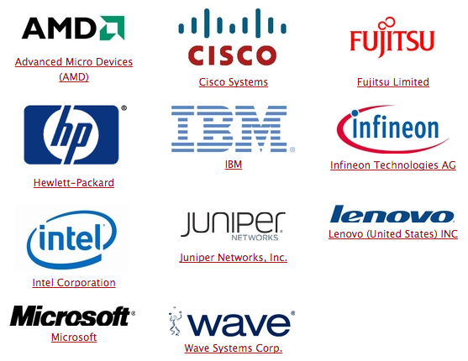
Trusted Computing Group
TCG is a non-profit organization (former TCPA) formed to address the concerns about the lack of security of personal computers connected to the Internet.

Slide 13
TCG Approach

Slide 14
Building a Record of Platform

Slide 15
Remarks
This process gives us a measured boot process
Any component in the chain can gain confidence about the components below/before it by querying the TPM – implies transitive trust in components

Slide 16
Architecture: Roots of Trust

Slide 17
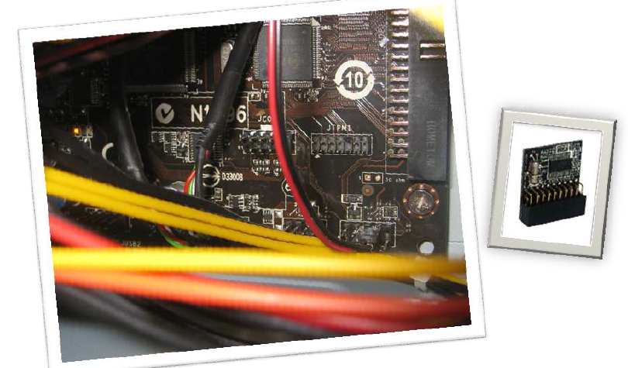
Trusted Platform Module
TPM is a computer chip that can securely store artifacts used to authenticate the platform.
Notes:
That’s all about theory part now is the reality

Slide 18
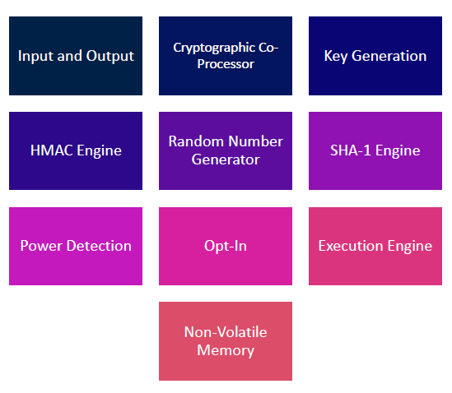
TPM Components
TPM is not an active components, always a responder to a request and never initiates an interrupt

Slide 19
TPM Core Functionality
Non-volatile storage:
Endorsement key (EK)
Storage root key (SRK)
Monotonic counters
Volatile storage:
Other keys, authentication session, configuration registers
Computational functions:
Crypto, genuine random, key generation
Shielded locations:
An area where data is protected against interference from the outside exposure.
Protected Capabilities:
The set of commands with exclusive permission to access shielded location

Slide 20
Trusted Platform Module
TPM is the component at the heart of the vision of Trusted Infrastructure
Root of trust for storage
Root of trust for reporting
Root of trust for measurement*
*(with BIOS or other chipset components)

Slide 21
Role of TPM in Measurement

Slide 22
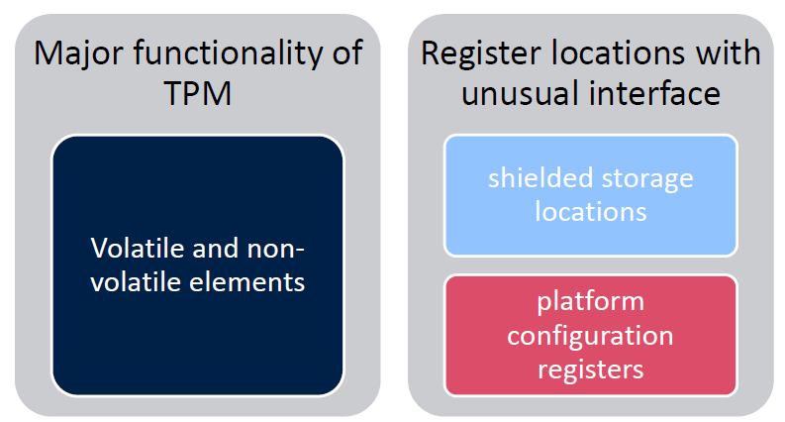
Protected Storage
TPM is a Root of Trust for Storage
Does not store all secrets directly
Store one secret used to protect other secrets

Slide 23
Protected storage (cont.)

Slide 24
TPM Keys
Endorsement key (EK)
Unique platform identity
Created by manufacture in a secure environment
Non-migratable, store inside chip, cannot be remove
Storage root key (SRK)
2048 bit RSA key
Top level element of TPM hierarchy
Created during take ownership
Non-migratable, store inside chip cannot be remove
Storage Keys
RSA keys used to encrypt other elements in the TPM key hierarchy
Created during user initialization
Signature Keys
RSA keys used for signing operating
A leaf in the TPM key hierarchy

Slide 25
Endorsement Key
EK, an RSA key pair composed of a public key and private key
The key TPM uses in its roles as Root of Trust for Reporting
Critical: trust in all keys in the system come down to the trust in EK
The EK is used to recognize a genuine TPM
The EK is used to decrypt information sent to a TPM in the Privacy CA and DAA protocols, and during the installation of an owner in the TPM

Slide 26
Platform Identity and Endorsement
The Endorsement key is held in TPM:
Gives the platform a unique identity
Asserts the platform credentials
Root of Trust for Reporting is intended to substantiate claims
Assurance that it contains a correctly-implemented TPM
Evidence that the embedding of that TPM within the platform conforms to an evaluated design

Slide 27
Storage Root Key (SRK)
The key that the TPM uses in its role as Root of Trust Storage
Used to protect other key and data via encryption
Can protect other storage keys: hierarchy or protection
SRK generated and held in TPM when take ownership
Key blobs can be encrypted for storage in untrusted locations
All other key created by the TPM have their private halves encrypted by the SRK and are stored outside the TPM

Slide 28
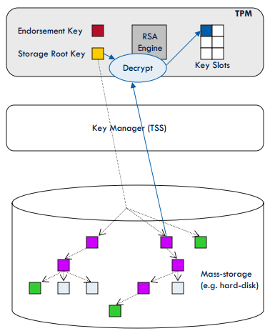
Loading TPM Keys
Load signing key into TPM to use it for signing operation
Establish entire key chain up to SRK
Decrypt private key of storage key using the private SRK
Require SRK usage secret

Slide 29
Attestation Identity Key (AIK)
Solution to privacy problem is to allow platform to have arbitrarily many attestation identity keys
Process of signing these involves EK – so can check platform credential (typically a digital certificate) and a Privacy CA (trusted third party)
In use the AIK has no reference to EK
Each AIK is bound to platform and protected by root of trust for storage
AIK is certified by a privacy CA

Slide 30
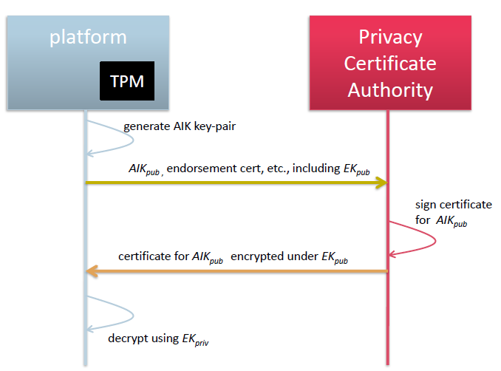
Privacy CA

Slide 31
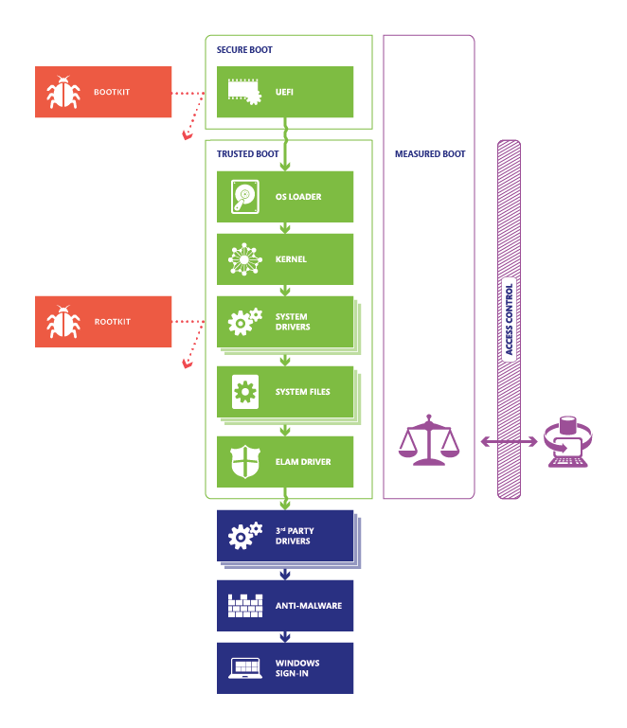
Windows 8 Boot Process
Firmware rootkits. These kits overwrite firmware of the PC’s basic input/output system or other hardware so the rootkit can start before Windows.
Bootkits. These kits replace the operating system’s bootloader (the small piece of software that starts the operating system) so that the PC loads the bootkit before the operating system.
Kernel rootkits. These kits replace a portion of the operating system kernel so the rootkit can start automatically when the operating system loads.
Driver rootkits. These kits pretend to be one of the trusted drivers that Windows uses to communicate with the PC hardware.
Source: Securing the Windows 8 Boot Process

Slide 32
Countermeasures
Secure Boot. PC first verifies that the firmware is digital signed, the firmware examines the bootloader’s digital signature.
Bootloader was signed using a trusted certificate or use has manually approved the bootloader’s digital signature
Trusted Boot. The bootloader verifies the digital signature of the windows 8 kernel before loading it.
And kernel in turn verifies every other component of windows startup process(boot drivers, startup files and ELAM)
ELAM exam non-Microsoft boot drivers and determine whether it is on the list of trusted drivers.
Source: Securing the Windows 8 Boot Process

Slide 33
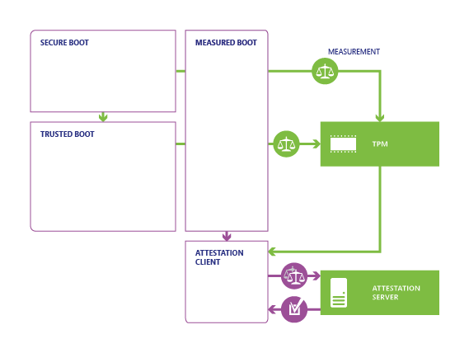
Countermeasures (cont.)
Measured Boot
PC’s UEFI stores in the TPM a hash of the firmware, bootloader, boot drivers, and everything else
2. At the end of the startup process, Widows starts non-Microsoft remote attestation client.
3. TPM uses the server’s key to sign the log record
Source: Securing the Windows 8 Boot Process

Slide 34
Source: Securing the Windows 8 Boot Process

