Slide 1
Heap Overflow Attacks

Slide 2
What is a heap?
Heap is a collection of variable-size memory chunks allocated by the program
e.g., malloc(), free() in C,
creating a new object in Java
creating a new object in Java script
Heap management system controls the allocation, de-allocation, and reclamation of memory chunks.
To do this some meta data is necessary for book-keeping

Slide 3
Heap overflow attacks
What if heap memory is corrupted?
If a buffer is allocated on the heap and overflown, we could overwrite the heap meta data
This can allow us to modify any memory location with any value of our chosen
This could lead to running arbitrary code

Slide 4
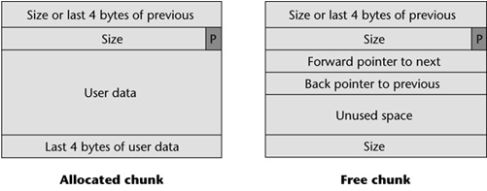
Doug Lea’s malloc and free
P == 1: previous chunk is in use
P == 0: previous chunk is free
Size includes the first two control words

Slide 5
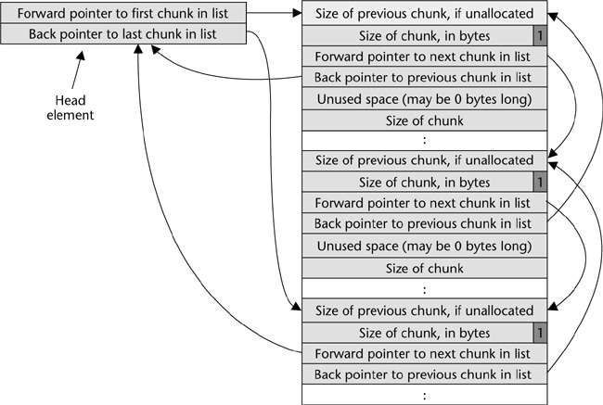
Double-linked free chunk list
struct chunk {
int prev_size;
int size;
struct chunk *fd;
struct chunk *bk;
};

Slide 6
heap.c
#define BUFSIZE 128
int main(int argc, char *argv[])
{
char *a, *b, *c;
if(argc < 2) {
printf("Usage: %s <buffer>\n", argv[0]);
exit(-1);
}
a = (char *) malloc(BUFSIZE);
b = (char *) malloc(BUFSIZE+16);
c = (char *) malloc(BUFSIZE+32);
printf("address of a: %p\n", a);
printf("address of b: %p\n", b);
printf("address of c: %p\n", c);
strcpy(b, "BBBBBBBBBBBBBBBBBBBBBBBBBBBBBBBBBBBBBBBB");
strcpy(c, "CCCCCCCCCCCCCCCCCCCCCCCCCCCCCCCCCCCCC");
strcpy(a, argv[1]);
free(a);
free(b);
free(c);
}

Slide 7
The heap in memory
bin_forward bin_back
prev_free_size=0
Size=0x88
1
char *a
Data (AAAAAAAAAAAAAAAAAAAAA)
free(a)
prev_free_size=0
Size=0x98
1
char *b
Data (BBBBBBBBBBBBBBBBBBBBBB)
prev_free_size=0
Size=0xa8
1
char *c
Data (CCCCCCCCCCCCCCCCCCCCC)

Slide 8
After free(a)
bin_forward bin_back
prev_free_size=0
Size=0x88
1
char *a
forward
free(a)
back
prev_free_size=0x88
Size=0x98
0
char *b
Data (BBBBBBBBBBBBBBBBBBBBBB)
free(b)
prev_free_size=0
Size=0xa8
1
char *c
Data (CCCCCCCCCCCCCCCCCCCCC)

Slide 9
After free(b)
bin_forward bin_back
prev_free_size=0
Size=0x120
1
char *a
forward
free(a)
back
char *b
free(b)
prev_free_size=0x120
Size=136
0
char *c
Data (CCCCCCCCCCCCCCCCCCCCC)

Slide 10
What if “b” was freed first?
bin_forward bin_back
prev_free_size=0
Size=0x88
1
char *a
Data (AAAAAAAAAAAAAAAAAAAAA)
free(a)
prev_free_size=0
Size=0x98
1
char *b
forward
free(b)
back
prev_free_size=0x98
Size=0xa8
0
char *c
Data (CCCCCCCCCCCCCCCCCCCCC)

Slide 11
Then “a” was freed
bin_forward bin_back
prev_free_size=0
Size=0x120
1
char *a
forward
back
char *b
prev_free_size=0x120
Size=0xa8
0
char *c
Data (CCCCCCCCCCCCCCCCCCCCC)

Slide 12
Key Observation
When the chunk (A) to be free’ed is followed by a free chunk (B), chunk B will be unlinked from the free list, and A will be inserted into the free list.
If the heap meta data in B has been corrupted, the unlink operation will be dangerous.
Why?

Slide 13
Remove a chunk from the double-linked free list
unlink(P)
P->fd->bk = P->bk;
P->bk->fd = P->fd;
Will create some trouble for us
P
forward
forward
forward
back
back
back
If the “fd” pointer is corrupted, we can control which memory cell to be modified
If the “bk” pointer is corrupted, we can control what value to put into the memory cell
Overwrite the “forward” field with “where-12”.
Overwrite the “back” field with “what”.

Slide 14
A heap overflow attack
Overwrite a heap memory chunk by running past the allocated space.
Create a fake heap structure that pretends to be a free chunk.
When the current chunk is free()’d, an arbitrary memory overwrite will occur.
We can control the “where” and “what” of the memory overwrite.

Slide 15
The “where”
By modifying certain memory locations, we can modify the EIP and make it point to injected malicious code.
The Global Offset Table (GOT) contains the entry addresses of dynamically linked library functions (e.g. printf, malloc, free, exit, strcpy, etc.)
We can overwrite a GOT entry that will likely be used by the program
$ objdump -R heap
heap: file format elf32-i386
DYNAMIC RELOCATION RECORDS
OFFSET TYPE VALUE
0804975c R_386_GLOB_DAT __gmon_start__
08049744 R_386_JUMP_SLOT malloc
08049748 R_386_JUMP_SLOT __libc_start_main
0804974c R_386_JUMP_SLOT printf
08049750 R_386_JUMP_SLOT exit
08049754 R_386_JUMP_SLOT free
08049758 R_386_JUMP_SLOT strcpy

Slide 16
The “what”
The “what” will be the address of the malicious code we injected into the buffer.
But, P->bk->fd=P->fd will “puncture” our shellcode from bytes 8-12.
Thus the shell code must “jump over” this hole.

Slide 17
Remove a chunk from the double-linked free list
unlink(P)
P->fd->bk = P->bk;
P->bk->fd = P->fd;
Will create some trouble for us
P
forward
forward
forward
back
back
back
If the “fd” pointer is corrupted, we can control which memory cell to be modified
If the “bk” pointer is corrupted, we can control what value to put into the memory cell
Overwrite the “forward” field with “where-12”.
Overwrite the “back” field with “what”.

Slide 18
How to make free() think the chunk after “a” is free
prev_free_size=0
Size=0x88
1
char *a
Data (AAAAAAAAAAAAAAAAAAAAA)
prev_free_size=0
Size=0x98
1
char * b
Data (BBBBBBBBBBBBBBBBBBBBBB)
prev_free_size=0x98
The second next chunk’s “size” word shall be an even number
Size=0xa8
0
char *c
Data (CCCCCCCCCCCCCCCCCCCCC)

Slide 19
Assembled heap-overflow payload
buffer
XXXX
YYYY
This word will be overwritten by the second part of unlink statement
\x90\x90\x90\x90
nop, nop, jmp + 4
ZZZZ
Shellcode…
Shellcode…
fake heap structure
Padding
0xffffffff (-1)
0xffffffff (-1)
GOT_entry - 12
buffer + 8

