Slide 1
Return Oriented Programming
Courtesy of Saumil Shah

Slide 2
Functions
Revisited
• How is a function called?
• What does the stack frame look like?

Slide 3
Calling
• Add two ints x, y
• add(3,4)
a
function
void add(int x, int y)
{
int sum;
sum = x + y;
printf("%d\n", sum);
}
int main()
{
add(3, 4);
}
• What does the calling
frame
look
like?

Slide 4
Stack
frame
for
add(3,4)
frame for add()
return address from add()
call
add
3
4

Slide 5
Return
from
add(3,4)
• add() is about to return.
• RET after epilogue of add().
• Where does ESP point to?
– immediately before the RET
• What does the stack look like?

Slide 6
Before
the
RET
ESP
return address from add()
3
4

Slide 7
After
the
RET
return address from add()
ESP
3
4

Slide 8
Another
• Stack overflow in func1.
• Can we call add(5, 6), instead of running a shellcode?
function
void add(int x, int y)
{
int sum;
sum = x + y;
printf("%d\n", sum);
}
void func1(char *s)
{
char buffer[128];
strcpy(buffer, s);
}
int main()
{
func1(argv[1]);
}

Slide 9
Stack
frame
for
func1()
buffer
return address from func1
s

Slide 10
strcpy(buffer,
s)
uffer
AAAAAAAAAAAAAAAAAA AAAAAAAAAAAAAAAAAA AAAAAAAAAAAAAAAAAA AAAAAAAAAAAAAAAAAA
AAAA
return address from func1
AAAA
s
AAAA
AAAA

Slide 11
Before
the
RET
uffer
AAAAAAAAAAAAAAAAAA AAAAAAAAAAAAAAAAAA AAAAAAAAAAAAAAAAAA AAAAAAAAAAAAAAAAAA
ESP
AAAA
return address from func1
AAAA
s
AAAA
AAAA

Slide 12
After
the
RET
uffer
AAAAAAAAAAAAAAAAAA AAAAAAAAAAAAAAAAAA AAAAAAAAAAAAAAAAAA AAAAAAAAAAAAAAAAAA
AAAA
return address from func1
EIP = 0x41414141
ESP
AAAA
s
AAAA
AAAA

Slide 13
Return to
add()
• Insert a fake frame in the buffer.
• Make func1() return to:
add(01010101,
02020202)

Slide 14
strcpy(buffer,
s)
uffer
AAAAAAAAAAAAAAAAAA AAAAAAAAAAAAAAAAAA AAAAAAAAAAAAAAAAAA AAAAAAAAAAAAAAAAAA
address of add()
return address from func1
return address from add()
s
01010101
02020202

Slide 15
Before func1() returns
uffer
AAAAAAAAAAAAAAAAAA AAAAAAAAAAAAAAAAAA AAAAAAAAAAAAAAAAAA AAAAAAAAAAAAAAAAAA
ESP
address of add()
return address from func1
return address from add()
s
01010101
02020202

Slide 16
Before add() returns
uffer
AAAAAAAAAAAAAAAAAA AAAAAAAAAAAAAAAAAA AAAAAAAAAAAAAAAAAA AAAAAAAAAAAAAAAAAA
address of add()
return address from func1
ESP
return address from add()
s
01010101
02020202

Slide 17
Return
to add()
• By carefully creating a frame...
• ...we can make the program "return to
our
• We
• We our
function".
control the parameters.
also control where to jump to after
function
returns.

Slide 18
Stack
frame
before
add(3,
4)
• Dump the stack:
(gdb) x/10x $esp
0xbffff41c: 0x08048471 0x00000003 0x00000004 0x0804851b
0xbffff42c: 0x00292ff4 0x08048510 0x00000000 0xbffff4b8
return address from add()
0x08048471
param1
3
param2
4

Slide 19
Overflowing
• Overflow func1 and...
func1()
...return to add(01010101,
• Create a fake frame.
• Overwrite stack memory.
02020202)
return from func1
return from add
param1
param2
0x080484bd
0x42424242
0x01010101
0x02020202

Slide 20
ESP
• Where will ESP be after add?
returning from
AAAAAA...140...AAAAAA
080484bd
42424242
01010101
02020202
ESP
• Verify
(gdb) x/64x $esp
0xbffff2e4: 0x01010101 0x02020202 0x00292f00 0x08048510
0xbffff2f4: 0x00000000 0xbffff378 0x00153bd6 0x00000002

Slide 21
Chaining
functions
• After add(01010101, 02020202), we want
to run add(03030303, 04040404).
• How should we set up the frames?
• First, study the frame after add() returns.

Slide 22
Where
does
the
new
frame
go?
AAAAAAAAAAAAAAAAAAAA AAAAAAAAAAAAAAAAAAAA AAAAAAAAAAAAAAAAAAAA
address of add
42424242
address of add
??
01010101
02020202
03030303
04040404

Slide 23
Where
does
the
new frame
go?
• We get only ONE chance at strcpy.
• How do we preserve params 01010101 and 02020202?
• We can only APPEND the second frame below our first frame.
• We have to unwind the first frame before returning to the second frame.
• Answer: Return to ”pop pop ret”!

Slide 24
Chaining
the
frames
AAAAAAAAAAAAAAAAAAAAAAAAAAAAAAA AAAAAAAAAAAAAAAAAAAAAAAAAAAAAAA AAAAAAAAAAAAAAAAAAAAAAAAAAAAAAA
add(01010101, 02020202)
address of add
address of POP/POP/RET
01010101
02020202
add(03030303, 04040404)
address of add
42424242
03030303
04040404

Slide 25
Keeping
ESP
in
control
AAAAAAAAAAAAAAAAAAAAAAAAAAAAAAA AAAAAAAAAAAAAAAAAAAAAAAAAAAAAAA AAAAAAAAAAAAAAAAAAAAAAAAAAAAAAA
Return from func1
ESP
address of add
address of POP/POP/RET
01010101
02020202
address of add
42424242
03030303
04040404

Slide 26
Keeping
ESP
in
control
AAAAAAAAAAAAAAAAAAAAAAAAAAAAAAA AAAAAAAAAAAAAAAAAAAAAAAAAAAAAAA AAAAAAAAAAAAAAAAAAAAAAAAAAAAAAA
Return from func1
address of add
Return to add()
ESP
address of POP/POP/RET
01010101
02020202
address of add
42424242
03030303
04040404

Slide 27
Keeping
ESP
in
control
AAAAAAAAAAAAAAAAAAAAAAAAAAAAAAA AAAAAAAAAAAAAAAAAAAAAAAAAAAAAAA AAAAAAAAAAAAAAAAAAAAAAAAAAAAAAA
Return from func1
address of add
Return to add()
address of POP/POP/RET
ESP
Return to POP/POP/RET
01010101
02020202
address of add
42424242
03030303
04040404

Slide 28
Keeping
ESP
in
control
AAAAAAAAAAAAAAAAAAAAAAAAAAAAAAA AAAAAAAAAAAAAAAAAAAAAAAAAAAAAAA AAAAAAAAAAAAAAAAAAAAAAAAAAAAAAA
Return from func1
address of add
Return to add()
address of POP/POP/RET
Return to POP/POP/RET
01010101
POP
02020202
POP
ESP
address of add
42424242
03030303
04040404

Slide 29
Keeping
ESP
in
control
AAAAAAAAAAAAAAAAAAAAAAAAAAAAAAA AAAAAAAAAAAAAAAAAAAAAAAAAAAAAAA AAAAAAAAAAAAAAAAAAAAAAAAAAAAAAA
Return from func1
address of add
Return to add()
address of POP/POP/RET
Return to POP/POP/RET
01010101
POP
02020202
POP
address of add
RET - Return to add()
ESP
42424242
03030303
04040404

Slide 30
Keeping
ESP
in
control
AAAAAAAAAAAAAAAAAAAAAAAAAAAAAAA AAAAAAAAAAAAAAAAAAAAAAAAAAAAAAA AAAAAAAAAAAAAAAAAAAAAAAAAAAAAAA
Return from func1
address of add
Return to add()
address of POP/POP/RET
Return to POP/POP/RET
01010101
POP
02020202
POP
address of add
RET - Return to add()
42424242
Finally EIP = 0x42424242
ESP
03030303
04040404

Slide 31
Chained
Frames
• Create another buffer overflow payload:
AAAAAA...140...AAAAAA
080484bd
08048422
01010101
02020202
distance
to EIP
address
of add
POP/POP
/RET
param1
param2
080484bd
42424242
03030303
04040404
address
of add
return
from add
param1
param2

Slide 32
It's
all
about ESP!
• ESP is the new EIP.
• ROP involves keeping the ESP moving through the frames on the stack.
• Frames can be chained by returning to proper sequences of instructions that appropriately unwind the parameters from the stack.

Slide 33
Code
Execution
–
The
ROP
Way
• Piece together snippets of code
• Gadgets – primitive operations, to be searched for within the process binary shared libraries.
or
• Every gadget must
end with a RET.

Slide 34
binobj1
f2()
f1() f3()
A RET
RET
D
RET
Execute A, take next card
binobj2
()
C
RET
Execute D, take next card
Execute C, take next card
f5
f4()
Execute B, take next card
RET
binobj3
f7
f6()
Execute D, take next card
()
f8()
B
_{E} RET _{RET}
RET
Execute E, take next card

Slide 35
Thinking in ROP terms
EAX = 0x14
POP EAX; RET
14
Load immediate
POP EAX; RET
ECX = [77ffe0300]
77ffe0300
Read memory
MOV ECX, [EAX]; RET
POP EAX; RET
[08041000] = 0x4000
08041000
Write memory
POP ECX; RET
4000
MOV [EAX], ECX; RET

Slide 36
Thinking in ROP terms
func1(10, 20)
func1
POP/POP/RET
Call function
10
20

Slide 37
Thinking in ROP terms
POP EAX; RET
fptr
(*fptr)(3, 4)
CALL DWORD PTR [EAX]; RET
Call function pointer
10
20
POP EAX; RET
fptr
MOV EAX, [EAX]; RET
CALL EAX; RET
10
20

Slide 38
Gadgets
ROP primitives.
Each gadget corresponds to a “frame” that must be set up on the stack
Must end with a RET!

Slide 39
Generic Techniques
Run arbitrary shellcode.
Difficult to transform entire shellcode to ROP frames.
Common trick: Use ROP to change protection of existing memory to RWX
Works when shellcode is at a predictable location.

Slide 40
Case Study
JNLP overflow on IE8, Windows 7
Java Network Launch Protocol enables applications to be launched on a client desktop that using resources which are hosted on a remote server.
JNLP plug-in for Internet Explorer has a buffer overflow vulnerability
Extra long docbase parameter passed to JNLP.

Slide 41
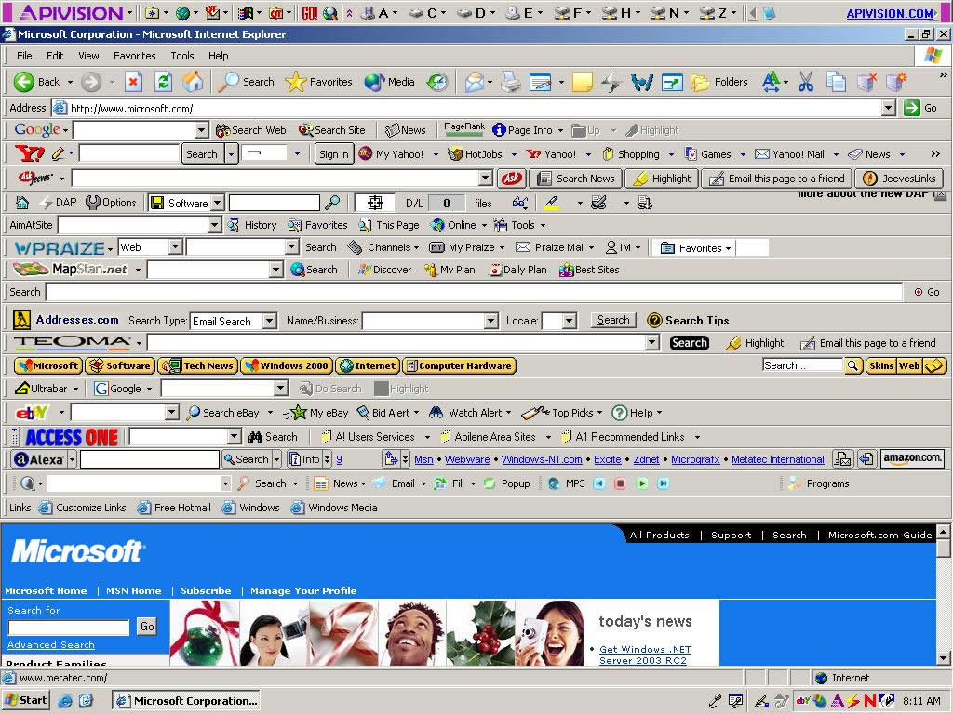
What is a browser?
More Attack Surface!

Slide 42
Browser Architecture
<div> <img> <object> <embed>
<iframe> <body>
<form> <input>
<table> <style> <script>
HTML+CSS
JavaScript
DOM
ActiveX
libraries
Mime types
toolbars
Flash

Slide 43
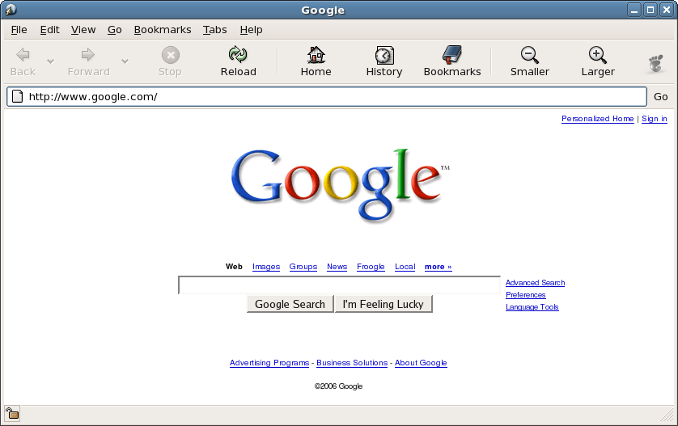
Browser’s “syscalls”
<object CLSID>=XXX-XXXX-XXX
HTML+CSS
JavaScript
DOM
ActiveX
Mime types
QuickTime
libraries
Flash

Slide 44
Browser’s “syscalls”
<object CLSID>=XXX-XXXX-XXX
HTML+CSS
JavaScript
DOM
ActiveX
Mime types
QuickTime
libraries
Flash

Slide 45
Browser’s “syscalls”
<object CLSID>=XXX-XXXX-XXX
HTML+CSS
JavaScript
DOM
ActiveX
Mime types
QuickTime
libraries
Flash

Slide 46
Where are we?
We have a stack overflow.
We control EIP and
We control the memory at [ESP].
Shellcode…where does it go?
…and how do we jump to it?

Slide 47
Browsers vs. other software
Browsers | Other Software
Shellcode pre-loaded via JavaScript | Shellcode part of the payload buffer
For(i=0; i < 1000; i++) {buf +=“A”} | “AAAAAAAAAAAAAAAAAAAAAAAAAAAAAAAAAAAAAAAAAAA…”
Unicode – Null byte (any byte) friendly | Avoid Null bytes and certain characters
Easy to obfuscate – use JavaScript | Difficult to obfuscate – shellcode encoders

Slide 48
Challenges
ROP frames can get very large.
10-20 times the size of classic shellcode.
May not have enough space on the stack.
ROP frames may contain NULL bytes which the target program won’t like.

Slide 49
Heap Spraying
<script>
:
nops = build_large_nosled();
a = new Array();
for(i = 0; i < 50; i++)
a[i] = shellcode + nops;
:
</script>
<html>
:
exploit trigger condition
goes there
:
</html>
Shellcode
NOP sled
Shellcode
NOP sled
Shellcode
NOP sled

Slide 50
Browser Exploit
AAAAAAAAAAAAAAAAAAAAAAAAAAAAAAAAAAAAAAAAAA
address
AAAAAAAA
Notes:
Address = ESP
not EIP

Slide 51
ROP Frames
Converting arbitrary shellcode to ROP is very difficult.
Non-scalable.
We require a generic approach.
A “ROP Stage”:
Load classic shellcode onto heap
Invoke VirtualProtect
Set memory protection to RWX
Return to shellcode.

