Slide 1
Android Permissions Demystified
Adrienne Porter Felt, Erika Chin,
Steve Hanna, Dawn Song, David Wagner
University of California

Slide 2
Outline
A brief Introduction of Android permission system
Detailed description of Android Permission System
Permission system and Permission Enforcement
Permission Testing Methodology
API, Content provider, Intent
Permission Map Result
Coverage
Comparison with Documentation
Application Analysis Tool: Stowaway
API, Content Provider and Intent
Application Analysis Results
Conclusion

Slide 3
Introduction
Android supports third-party applications with an extensive API that provides them with access to phone hardware (e.g., the camera), WiFi and cellular networks, user data, and phone settings.
Access to privacy- and security-relevant parts of Android's rich API is controlled by an install-time application permission system. Each application must declare upfront what permissions it requires, and the user is notified during installation about what permissions it will receive.
User may grant a permission or can cancel the installation process.
Install-time permission system is ineffective if developers routinely request more permissions than they require.
Least or Over-privileged applications expose users to unnecessary permission warnings and increase the impact of a bug or vulnerability.

Slide 4
Android Permission System
Android 2.2 defines 134 permissions
Normal permissions
Dangerous permissions
Signature/System permissions
Permission Enforcement
API
Content Providers
Intent

Slide 5
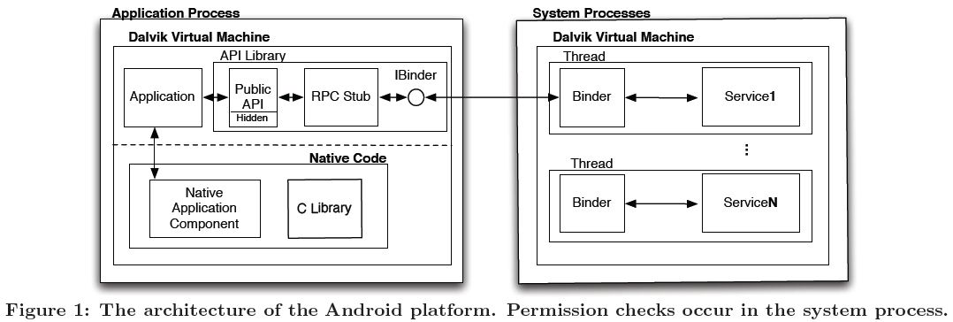
The architecture of the Android platform
1
2
3
1.The application invokes the public API in the library.
2.The library invokes a private interface, also in the library. The private interface is an RPC stub.
3.The RPC stub initiates an RPC request with the system process that asks a system service to perform the desired operation.

Slide 6
Permission Enforcement (API)
Various parts of the system invoke a permission validation mechanism(PVM) to check whether a given application has a specified permission.
There is no centralized policy for checking permissions when an API is called.
When necessary, the API implementation calls the PVM to check that the invoking application has the necessary permissions.

Slide 7
Permission Enforcement
(Content Providers)
System Content Providers are installed as standalone applications, separate from the system process and API library.
They are protected with both static and dynamic permission checks.
Static declarations assign separate read and write permissions to a given Content Provider. By default, these permissions are applied to all resources stored by the Content Provider.
Content Providers can also enforce permissions programmatically.

Slide 8
Permission Enforcement
(Intent)
Android's Intent system is used extensively for inter- and intra-application communication.
To prevent applications from mimicking system Intents, Android (Activity Manager Service)restricts who may send and receive certain Intents.
Some Intents can only be sent by applications with appropriate permissions.
Other system Intents can only be sent by processes whose UID matches the system's.

Slide 9
Android Permission System
The problem
unnecessary use of permissions
The proposed solution
static analysis of API calls
Permission map
identiﬁes permissions for Intents, Content Provides, API calls I
Stowaway tool
determines if an app is over-privileged or not

Slide 10
Permission Testing Methodology （API）
Construct a permission map that identifies the permissions required for each method in the Android API
modified Android 2.2's permission verification mechanism to log permission checks as they occur.
then generated unit test cases for API calls, Content Providers, and Intents.

Slide 11
PERMISSION TESTING METHODOLOGY
Goal: Construct a permission map that identifies the permissions required for each method in the Android API
Android 2.2's permission verification mechanism is used to log permission checks as they occur.
Unit test cases were generated.
Executing these tests allowed to observe the permissions required to interact with system APIs.

Slide 12
Permission Testing Methodology (API)
API calls testing in three phases
Feedback-directed testing
Randoop
Customizable test case generation
Manual verification

Slide 13
Feedback-Directed Testing
Randoop: An auto-mated, feedback-directed, object-oriented test generator for Java.
Randoop was modified to run as an Android application and to log every method it invokes. These modifications to Android log every permission that is checked by the Android permission validation mechanism, which lets us deduce which API calls trigger permission checks.
Randoop's goal is full coverage of the test space.
Notes:
Randoop takes a list of classes as input and
searches the space of possible sequences of methods from
these classes.

Slide 14
Customizable Test Case Generation
A tool was built that accepts a list of method signatures as input, and outputs at least one unit test for each method.
It maintains a pool of default input parameters that can be passed to methods to be called. If multiple values are available for a parameter, then this tool creates multiple unit tests for that method.
It also generates tests using null values if it cannot find a suitable parameter.

Slide 15
Manual Verification
Experimented with the ordering the arguments of the test cases to ensure permission checks were correctly matched to asynchronous API calls and identified the conditions of permission checks.
Every test case both with and without their required permissions in order to identify API calls with multiple or substitutable permission requirements were run.
If a test case throws a security exception without a permission but succeeds with a permission, then we know that the permission map for the method under test is correct.
Notes:
The rest two phases of testing generate a map of the per-
mission checks performed by each method in the API. How-
ever, these results contain three types of inconsistencies.
That’s why manual verification of the correctness of the permission map is done.
Testing The Internet Permission.

Slide 16
Permission Testing Methodology （Content Provider）
Content Provider test application executes query, insert, update, and delete operations on Content Provider URIs associated with the Android system and pre-installed applications.
URI are collected from: android.provider package to determine the core set of Content Providers to test.
Also take URI’s that we discovered during other phases of testing.

Slide 17
Permission Testing Methodology (Intent)
A pair of applications to send and receive Intents were built.
Public API was scrapped to find string constants that could be the contents of an Intent.
In order to test the permissions needed to receive system broadcast Intents, we triggered them.
For all of these tests, whether permission checks occurred and whether the Intents were delivered or received successfully were recorded.

Slide 18
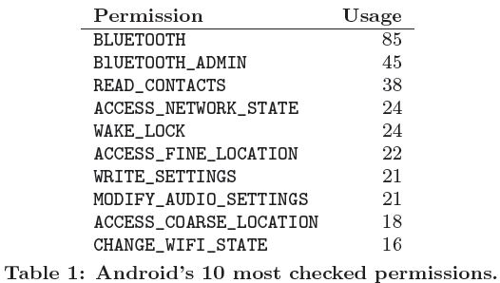
Permission Map Result
attained 85% coverage of the Android API through two phases of testing.
testing identified 1259 API calls with permission checks. Android 2.2 documentation specifies permission requirements for 78 methods.

Slide 19
Comparison With Documentation
In Android 2.2 documentation it was found that it species permission requirements for 78 methods out of 16732 public and private methods.
The documentation additionally lists permissions in several class descriptions, but it is not clear which methods of the classes require the stated permissions.
Of the 78 permission our testing indicates that the doc for 6 API calls is incorrect. These discrepancies may be security errors.
Notes:
Android's documentation of permissions is limited, which is likely due to their lack of a centralized access control policy.

Slide 20
Permissions Distribution
Number of Permissions Checks:
1244 API calls with permission checks, which is 6.45% of all API methods. 816 are methods of normal API classes, and 428 are methods of RPC stubs that are used to communicate with system services. Extra 15 API calls with permission checks were indentified in a supplementary part of the API added by a manufacturer.
Signature/System Permissions:
12% of the normal API calls are protected with Signature/System permissions, and 35% of the RPC stubs are protected with Signature/System permissions.
Unused Permissions:
some permissions are defined by the platform but never used within the API.
Notes:
We examined the Android API to see how many methods
and classes have permission checks.

Slide 21
Application Analysis Tool
Stowaway, which analyzes an Android application and determines the maximum set of permissions it may require.
API calls
It parses the disassembled DEX(Dalvik executable) files and identify all calls to standard API methods.
Content Providers
Stowaway collects all strings that could be used as Content Provider URIs and links those strings to the Content Providers' permission requirements.
Intent
Use ComDroid to detect the sending and receiving of Intents that require permissions.

Slide 22
Application Analysis Results
Applied Stowaway to 940 Android applications to identify the prevalence of over-privilege
Manual Analysis
40 applications were selected from 940, out of which 18 are over privileged.
Automated Analysis
Over-all, Stowaway identified 323 out of 900 applications (35:8%) as having unnecessary permissions.

Slide 23
Common Developer Errors
Permission Name: Developers sometimes request permissions with names that sound related to their applications‘ functionality, even if the permissions are not required.
Related Methods: Applications that use unprotected methods but request permissions that are required for other methods in the same class.
Copy and Paste: Popular message boards contain Android code snippets and advice about permission requirements. Sometimes this information is inaccurate, and developers who copy it will over-privilege their applications.

Slide 24
Conclusion
Development of tools to detect over-privilege in Android applications.
Stowaway, generates the maximum set of permissions needed for an application and compares them to the set of permissions actually requested.
Stowaway was applied to 940 Android applications and found that about one-third of them are over-privileged.
Our results show that applications generally are over-privileged by only a few permissions, and many extra permissions can be attributed to developer confusion.

