Slide 1
System-on-Chip Design
Hao Zheng
Comp Sci & Eng
U of South Florida

Slide 2
Overview
A system-on-chip (SoC): a computing system on a single silicon substrate that integrates both hardware and software.
Hardware packages all necessary electronics for a particular application.
  which implemented by SW running on HW.
Aim for low power and low cost.
  Also more reliable than multi-component sys.

Slide 3
SoC Hardware
Architecture
Often used in embedded application.
How to implement an application on a HW platform executing some SW programs?
source: wiki

Slide 4
Topics
Computational models for HW & SW
System modeling using SystemC
HW/SW partitioning
HW/SW interfacing
High-level synthesis
  Transforming SW to HW implementation
On-chip communication architectures
FPGA prototying, if time allows.

Slide 5
Prerequisites
Working knowledge of C/C++ programming
Solid background in digital logic design
Good understanding of computer organization and architecture

Slide 6
Textbooks
No required textbooks.
References:

Slide 7
Evaluation
6-8 assignments: 60% of final grade
1 final project: 40% of final grade
Final grading scale
Need verifiable proof to make up missing/late assignments

Slide 8
Course Communication
Course site on Canvas @ my.usf.edu
  Download assignments & submit your solutions
  Participate discussions
  Checking grades
www.cse.usf.edu/~zheng/teaching/soc
  Lecture slides
  reading assignments
  Other related material

Slide 9
Embedded Systems
A computing device embedded in a larger system.
Pervasive
98% processors sold annually are used in embedded applications.

Slide 10
Embedded Systems

Slide 11
Embedded Systems: Design Challenges
Power/energy efficient: mobile & battery powered
Highly reliable: Extreme environment (e.g. temperature)
Real-time operations: predictable performance
Highly complex
  E.g. Mercedes Benz E-class
  55 electronic control units
  5 communication busses
Tightly coupled Software & Hardware
Rapid development at low price

Slide 12
Design Complexity Challenges

Slide 13
Design Complexity Challenges
Answer to design complexity challenges:
Move to higher levels of abstraction

Slide 14
Levels of Abstraction: Behavior
Different levels of abstraction represent different modeling details

Slide 15
Levels of Abstraction: Behavior

Slide 16
Levels of Abstraction: Structure
Circuit: network of transistors
Logic: network of basic logic gates
  AND/OR/NOT, latches/FFs, etc.
Processor: network of logic components
  i.e. ALU, MUX, decoders, registers, etc.
  See Figure 1.5 in the Embedded book.
System: network of processors, memories, buses, and other custom processing logic.
    See Figure 1.8 in the Embedded book.

Slide 17
System Behavioral Models
Multiple communicating concurrent processes for HW & SW.
Communication and synchronization.
Embedded book

Slide 18
System Structural Models
Embedded book

Slide 19
SoC Design Flow: A Simplified View
Exploration/
Estimation
System Specification
HW/SW Partitioning
HW Model
SW Program
Synthesis
HW/SW
Co-Verification
Compilation
HW Implementation
Binary Image
HW
Impl.
CPU
System Integration
IF
Mem
Read: section 2.6 – 2.7, Embedded book.

Slide 20
Models of Computation
Formal abstract representations of a system
  various degrees of
    expressive power
    complexity
    Supported features
Examples
  HW: FSM, FSMD, super-state FSMD,
  SW: data flow, control flow, control-data flow, process network,

Slide 21
System Specification: Language Requirements
Formality: formal syntax and semantics
Executability: validation through simulation
Synthesizability:
  Implementation in HW and/or SW
  Support for IP reuse
Modularity
  Hierarchical composition
  Separation of concepts
Simplicity

Slide 22
System-Level Description Languages

Slide 23
Synthesis
Converting a behavioral description to a structural one.
RTL synthesis is well known.
  Cycle accurate model -> logic gate netlist
High-level synthesis: from C to a structural model.
  Still in early stage of adoption.
System synthesis: system behavioral model -> system structural model
  under active research.

Slide 24
System Synthesis
Processes -> CPUs or custom logic
  HW/SW partitioning
Communication -> Buses or NoC
Flow
  Profiling & Estimation
  Component & connection allocation
  Process and channel binding
  Process scheduling
  IF component insertion
  Model refinement

Slide 25
Hardware/Software Co-Design
Definition: HW/SW co-design is the design of cooperating HW components and SW components in a single design effort.
Alternative definition:
HW/SW co-design means meeting system level objectives by exploiting the synergy of HW and SW through concurrent design.

Slide 26
High-Level Synthesis
Embedded book

Slide 27
Concurrency vs Parallelism
Concurrency: independent operations are arranged such that they may be executed simultaneously.
  Simultaneous executions may not be possible.
Parallelism: HW platform can execute multiple operations simultaneously.
  Parallelism is useless if SW does not display concurrency.

Slide 28
System Design Methodology
The Embedded Book, Chapter 2

Slide 29
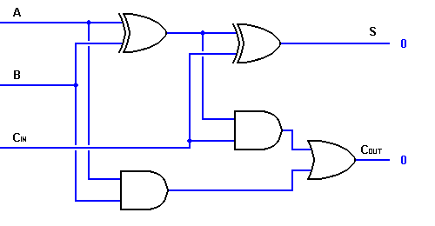
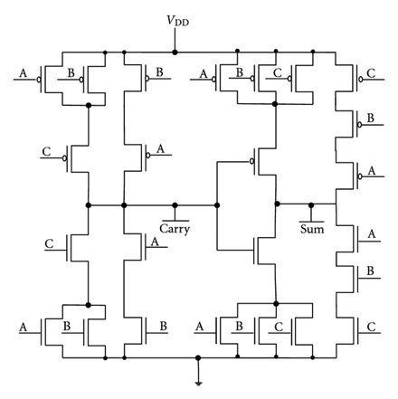
Terminologies
A
+
S
B
Cout
Cin
Specification
Structural Model
Transistor level model
Implementation

Slide 30
Historical Overview
Embedded
book

Slide 31
Bottom-Up Methodology
Embedded book

Slide 32
Top-Down Methodology
Embedded book

Slide 33
Meet-in-the-Middle Methodology
Embedded book

Slide 34
Platform Methodology
Reuse of previous defined platforms
  With well-defined structures and standard components.
Add more components necessary for an application.
  These components are then synthesized.
System implementation is generated by combining the layouts of existing and custom components.
Advantages: faster development, lower cost,

Slide 35
An Example Platform: Xilinx Zynq

Slide 36
Reading Guide
Embedded Book
  Chapter 1, sec 1.1 – 1.5, skip 1.3.1 – 1.3.2
  Chapter 2, skip 2.5
CoDesign Book
  Chapter 1

Slide 37
Backup

Slide 38
A System Level HW Design Flow

