Slide 1
Computer Architecture
A Quantitative Approach, Fifth Edition
EEL 6764 Principles of Computer Architecture
Multiprocessors and
Thread-Level Parallelism
Dr Hao Zheng
Dept of Comp Sci & Eng
U of South Florida

Slide 2
What are Multiprocessors?
Tightly coupled processors
  Controlled by a single OS
  With shared memory space
  Communication done in HW
  Clusters = processors connected by network
    Comm. among different processors coordinated by OSs
Support MIMD execution.
Single Multicore chips, and systems with multiple chips
Multithreading – thread executions interleaved on a single processor
5.1 Introduction

Slide 3
Why Multiprocessors?
Diminishing return from exploiting ILP with rising cost of power and chip area
Easier to replicate cores
Rise of web applications and cloud computing where natural parallelism found in web/data-intensive applications
  Ex. vector operations A*B + C*D
5.1 Introduction

Slide 4
Thread-Level Parallelism (TLP)
Thread-Level parallelism
  multiple running threads – multiple program counters
  exploited through MIMD model
  Targeted for tightly-coupled shared-memory multiprocessors
Types of parallelism
  Tightly coupled – threads collaborating for a single task
  Loosely coupled – multiple programs running independently
5.1 Introduction

Slide 5
Exploiting TLP
Applications should contain abundant concurrency
  For n processors, need n+ independent threads
Identified by programmers or OS
Amount of computation assigned to each thread = grain size
Thread grain size must be large
  To reduce overheads associated with thread execution
5.1 Introduction

Slide 6
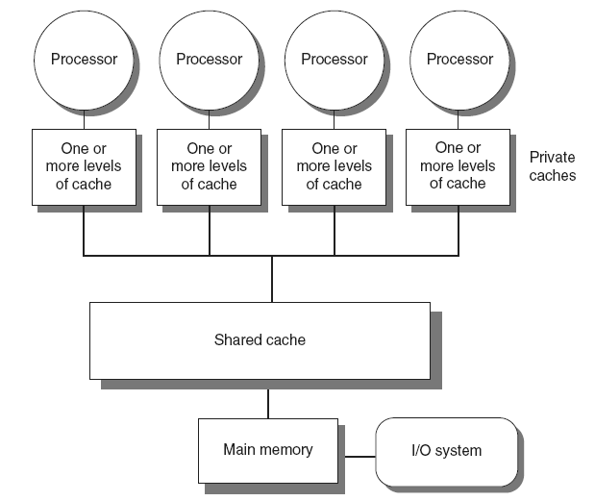
Symmetric multiprocessors (SMP)
Small number of cores (<= 8 cores)
Share single memory with uniform memory latency
Also called UMA MP.
5.1 Introduction
Notes:
Memory sharing by address space; physical memory can be centralized or distributed.

Slide 7
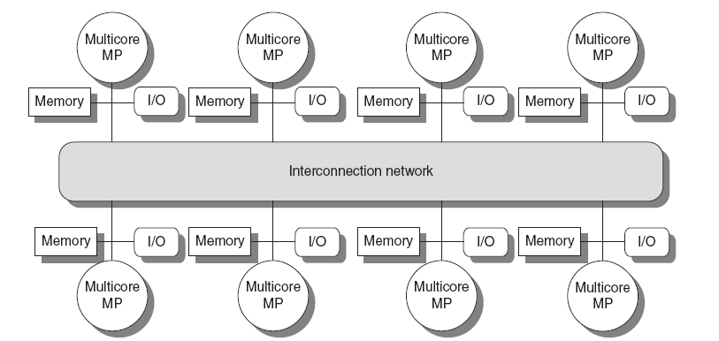
Distributed Shared Memory (DSM)
Memory distributed among processors
Non-uniform memory access/latency (NUMA)
Processors connected via direct (switched) and non-direct (multi-hop) interconnection networks
Long latency to access remote memory.
5.1 Introduction
Notes:
increasing memory access frequency of modern processors -> bottlenecks in memory access and interconnect.
-> limits the number of processors in a multiprocessor
SW needs to be designed to use local memory accesses rather than remote ones.

Slide 8
Challenges – Limited Parallelism
To achieve a speedup of 80 with 100 processors, what fraction of the original code can be sequential?
Achieve linear speedup requires entire program to be parallel!
5.1 Introduction
Notes:
The sequential segment has a large effect on performance gain from a multiprocessor - 0.25% seq code leads to gain of 80 instead of 100.
This problem must be addressed at SW/algorithm level

Slide 9
Challenges – Remote Comm. Cost
Assume remote mem access latency is 100ns. Processors run at 4 GHz, and stall on remote accesses. Ideal CPI = 0.5. Compute speedup of code without comm versus 0.2% instructions require remote mem accesses.
CPI = Ideal CPI + stalls of remote comm
= 0.5 + 0.2% * 400 = 1.3
Speedup = 1.3/0.5 = 2.6
Caching is a technique to reduce latency
5.1 Introduction
Notes:
This problem can be dealt with either at SW/algorithm level or in HW

Slide 10
Centralized Shared-Memory Architecture

Slide 11
Caching
Reduce latency of main memory and remote access
  Also reduce contentions among memory accesses from different processors
There are private & shared caches
Private data: used by a single processor
Shared data: used by multiple processors
  Replicated in multiple private caches
5.2 Centralized Shared-Memory Architectures

Slide 12
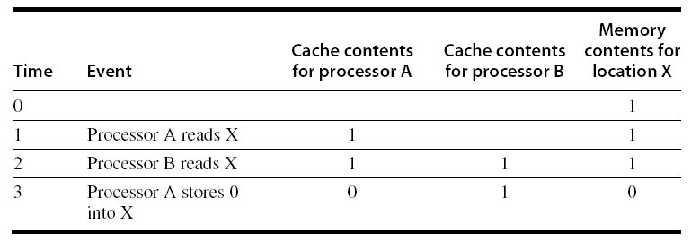
Cache Coherence Problem
Processors may see different values through their private caches
5.2 Centralized Shared-Memory Architectures

Slide 13
Cache Coherence Problem
Processors may see different values through their private caches
5.2 Centralized Shared-Memory Architectures

Slide 14
Cache Coherence Problem
Processors may see different values through their private caches
5.2 Centralized Shared-Memory Architectures

Slide 15
Cache Coherence Problem
Processors may see different values through their private caches
5.2 Centralized Shared-Memory Architectures

Slide 16
Cache Coherence
Coherence – what values returned for reads
  A read by a processor A to a location X that follows a write to X by A returns the value written by A if no other processors write in between
  A read by processor A to location X after a write to X by processor B returns the written value if the read and write are sufficiently separated, and no other writes occur in between
  Writes to the same location are serialized
Consistency – when a written value seen by a read
  Concerns reads & writes to different memory locations from multiple processors
5.2 Centralized Shared-Memory Architectures
Notes:
Consistency: finishing executing a store instruction does not mean the memory location gets the new value right away. -> complicates parallel programming

Slide 17
Enforcing Coherence
Coherent caches provide:
  Migration: movement of data – reduce latency
  Replication: multiple copies of data – reduce latency & memory bandwidth demand
Cache coherence protocols
  Snooping
    Every cache tracks sharing status of each cache block
    Mem requests are broadcast on a bus to all caches
    Writes serialized naturally by a single bus
  Directory based
    Sharing status of each cache block kept in one location
5.2 Centralized Shared-Memory Architectures
Notes:
coherence – data consistency: all copies of data in local caches are kept the same before a next read comes.

Slide 18
Snoopy Coherence Protocols
Write invalidate
  On write, invalidate all other copies
  Use bus itself to serialize
    Write cannot complete until bus access is obtained
Write update
  On write, update all copies
Invariant: blocks in cache are always coherent
5.2 Centralized Shared-Memory Architectures

Slide 19
Snoopy Coherence Protocols
Each cache block is in one of following states
  Invalid (I)
  Shared (S)
  Modified (M) – implies exclusion or not shared
Locating an item when a read miss occurs
  In write-back cache, the updated value must be sent to the requesting processor
Cache lines marked as shared or exclusive/modified
  Only writes to shared lines need an invalidate broadcast
    After this, the line is marked as exclusive
5.2 Centralized Shared-Memory Architectures
Notes:
Each cache line needs to 1 additional bit to track its sharing state.
Write invalidate generated only if the target block is shared.

Slide 20
Snoopy Coherence Protocols
P1
P2
Private
cache
Bus
Shared
cache
x=5
5.2 Centralized Shared-Memory Architectures

Slide 21
Snoopy Coherence Protocols
P1
read X
P2
Private
cache
X=5, S
Bus
Shared
cache
X=5
5.2 Centralized Shared-Memory Architectures

Slide 22
Snoopy Coherence Protocols
read X
P1
P2
Private
cache
X=5, S
X=5, S
Bus
Shared
cache
X=5
5.2 Centralized Shared-Memory Architectures

Slide 23
Snoopy Coherence Protocols
write 0 -> X
P1
P2
Private
cache
X=5, S
X=5, S
Bus
Shared
cache
X=5
5.2 Centralized Shared-Memory Architectures

Slide 24
Snoopy Coherence Protocols
P1
read X
P2
Private
cache
X=0, E
X=5, I
Bus
Shared
cache
X=5
where does P2 find data for X?
5.2 Centralized Shared-Memory Architectures

Slide 25
Snoopy Coherence Protocols
write 0 -> X
P1
write 3 -> X
P2
Private
cache
X=5, S
X=5, S
Bus
Shared
cache
Writes are serialized.
X=5
5.2 Centralized Shared-Memory Architectures
Notes:
Simultaneous writes are serialized, and outcome is non-determinisitc due to arbitration of bus access.

Slide 26
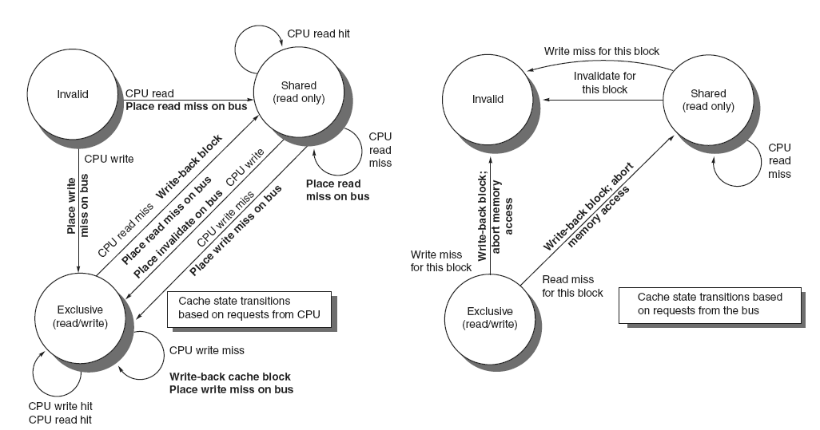
Snoopy Coherence Protocols
State | CPU request | Action
Invalid | read | read miss on bus
Invalid | write | write miss on bus
Shared | read hit | no action
Shared | read miss | read miss on bus
Shared | write hit | invalidate on bus
Shared | write miss | write miss on bus
Exclusive | read/write hit | no action
Exclusive | write miss | write back write miss on bus
Exclusive | read miss | write back read miss on bus
5.2 Centralized Shared-Memory Architectures
Notes:
How are these states encoded using valid and dirty bits? shared = Valid & !Dirty, exclusive = Valid & Dirty
An exclusive cache block is written back on a remote W/R miss

Slide 27
Snoopy Coherence Protocols
State | Bus request | Action
Shared | write miss | invalidate
Shared | invalidate | invalidate
Shared | read miss | no action
Exclusive | write miss | write back
Exclusive | read miss | write back put data on bus
5.2 Centralized Shared-Memory Architectures
Notes:
How are these states encoded using valid and dirty bits? shared = Valid & !Dirty, exclusive = Valid & Dirty
An exclusive cache block is written back on a remote W/R miss

Slide 28
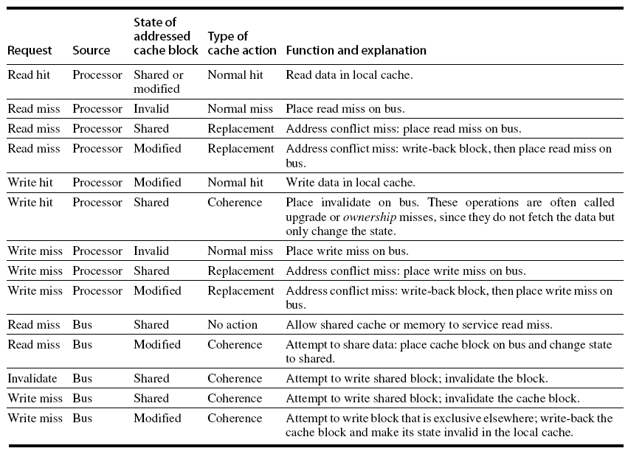
Snoopy Coherence Protocols
5.2 Centralized Shared-Memory Architectures

Slide 29
Snoopy Coherence Protocols
Complications for the basic MSI protocol:
  Operations are not atomic
    E.g. detect miss, acquire bus, receive a response
    Creates possibility of deadlock and races
    One solution: processor that sends invalidate can hold bus until other processors receive the invalidate
Extensions – optimize performance
  Add exclusive (E) state to indicate clean block in only one cache (MESI protocol)
    No need to invalidate on a write to a block in E state.
  MOESI – add Owned (O) state
    Dirty block is in local caches, but not in the shared cache
5.2 Centralized Shared-Memory Architectures

Slide 30
Limitations
Bus or shared cache accesses become bottleneck
  limit #core to 4 – 8
Accesses to private caches also a bottleneck
  handle accesses from core and bus due to snooping
Solution - increase memory bandwidth
  see next slide
5.2 Centralized Shared-Memory Architectures

Slide 31
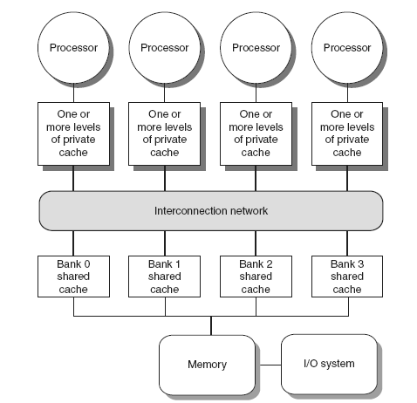
Coherence Protocols: Extensions
Shared memory bus and snooping bandwidth is bottleneck for scaling symmetric multiprocessors
  Use crossbars or point-to-point networks with banked memory
5.2 Centralized Shared-Memory Architectures

Slide 32
Distributed Shared-Memory Architecture
Distributed Shared-Memory Architecture

Slide 33
Directory Protocols
Directory keeps track of every block
  Sharing caches and dirty status of each block
5.4 Distributed Shared-Memory and Directory-Based Coherence

Slide 34
Directory Protocols
Implement in shared L3 cache
  Status bit vector, its size = # cores for each block in L3
5.4 Distributed Shared-Memory and Directory-Based Coherence

Slide 35
Directory Protocols
      Not scalable beyond L3 cache – centralized cache is bottleneck
      Must be implemented in a distributed fashion
        Each distributed memory has a directory
        size = # memory blocks * # nodes
5.4 Distributed Shared-Memory and Directory-Based Coherence

Slide 36
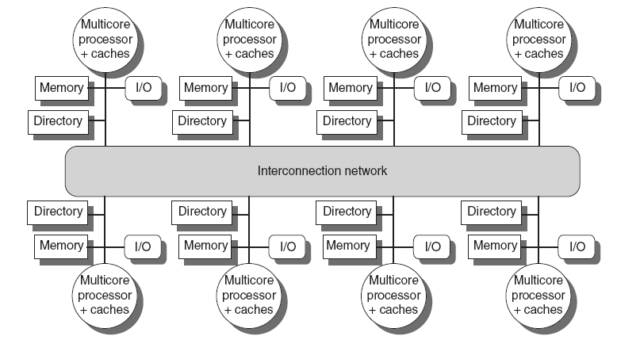
Directory Protocols
Local directory only stores coherence information of cache blocks in local memory
5.4 Distributed Shared-Memory and Directory-Based Coherence

Slide 37
Directory Protocols
Directory maintains block states and sends invalidation messages
  Tracks states of all local memory blocks (simplest sol.)
For each block, maintain state:
  Shared
    One or more nodes have the block cached, value in memory is up-to-date
  Uncached – invalid
  Modified – Exclusive
    Exactly one node has a copy of the cache block, value in memory is out-of-date
    This node is the owner
5.4 Distributed Shared-Memory and Directory-Based Coherence

Slide 38
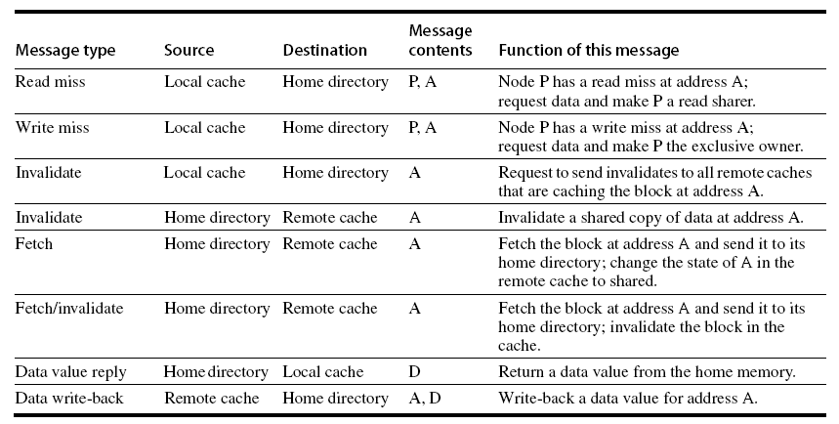
Messages
Local node: source of requests
Remote node: node that has a copy of cached block
Home node: destination of the requests
5.4 Distributed Shared-Memory and Directory-Based Coherence

Slide 39
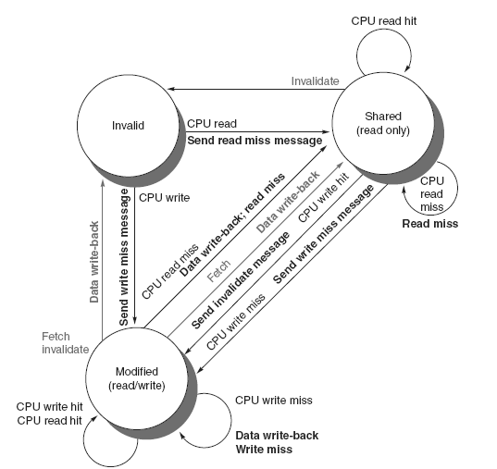
Directory Protocols
Cache controller
5.4 Distributed Shared-Memory and Directory-Based Coherence

Slide 40
Directory Protocols - Directory controller
      Read miss – Requesting node is sent the requested data and is made the only sharing node, block is now shared
      Write miss – The requesting node is sent the requested data, and block is now exclusive
5.4 Distributed Shared-Memory and Directory-Based Coherence

Slide 41
Directory Protocols
Directory controller
      Read miss – The requesting node is sent the requested data from memory, node is added to sharing set
      Write miss – The requesting node is sent the value, all nodes in the sharing set are sent invalidate messages, sharing set only contains requesting node, block is now exclusive
5.4 Distributed Shared-Memory and Directory-Based Coherence

Slide 42
Directory Protocols
Directory controller
      Read miss – ask owner to send data, forward to the requesting node
      Write miss – invalidate owner’s copy
      Data write back
5.4 Distributed Shared-Memory and Directory-Based Coherence

Slide 43
Directory Protocols – Summary
For uncached (Invalid) block:
  Read miss
    Requesting node is sent the requested data and is made the only sharing node, block is now shared
  Write miss
    The requesting node is sent the requested data and becomes the sharing node, block is now exclusive
For shared block:
  Read miss
    The requesting node is sent the requested data from memory, node is added to sharing set
  Write miss
    The requesting node is sent the value, all nodes in the sharing set are sent invalidate messages, sharing set only contains requesting node, block is now exclusive
5.4 Distributed Shared-Memory and Directory-Based Coherence

Slide 44
Directory Protocols – Summary
For exclusive block:
  Read miss
    The owner is sent a data fetch message, block becomes shared, owner sends data to the directory, data written back to memory, sharers set contains old owner and requestor
  Data write back
    Block becomes uncached, sharer set is empty
  Write miss
    Message is sent to old owner to invalidate and send the value to the directory, requestor becomes new owner, block remains exclusive
5.4 Distributed Shared-Memory and Directory-Based Coherence

Slide 45
Directory Protocols – Example
5.4 Distributed Shared-Memory and Directory-Based Coherence

Slide 46
P0,0: read 110
5.4 Distributed Shared-Memory and Directory-Based Coherence

Slide 47
P0,0: write 128 <-- 78
5.4 Distributed Shared-Memory and Directory-Based Coherence

Slide 48
Backup

Slide 49
Models of Memory Consistency
Processor 1:
A=0
…
A=1
if (B==0) …
Processor 2:
B=0
…
B=1
if (A==0) …
Possible for both if to be evaluated as true?
  If so, what could be the cause?
Sequential consistency:
  Result of execution should be the same as long as:
    Accesses on each processor were kept in order
    Accesses on different processors were arbitrarily interleaved
5.6 Models of Memory Consistency: Introduction

Slide 50
Directory Protocols – Example
P1
P2
P3
Interconnect
5.4 Distributed Shared-Memory and Directory-Based Coherence

Slide 51
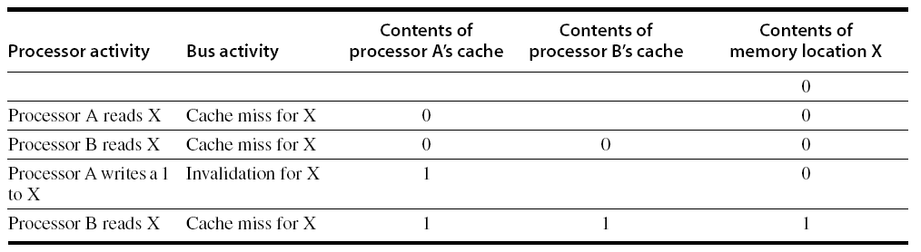
Snoopy Coherence Protocols
Write invalidate
  On write, invalidate all other copies
  Use bus itself to serialize
    Write cannot complete until bus access is obtained
Write update
  On write, update all copies
5.2 Centralized Shared-Memory Architectures

Slide 52
Performance
Coherence influences cache miss rate
  Coherence misses
    True sharing misses
      Write to shared block (transmission of invalidation)
      Read an invalidated block
    False sharing misses
      Read an unmodified word in an invalidated block

Slide 53
Coherence Protocols
AMD Opteron:
  Memory directly connected to each multicore chip in NUMA-like organization
  Implement coherence protocol using point-to-point links
  Use explicit acknowledgements to order operations

Slide 54
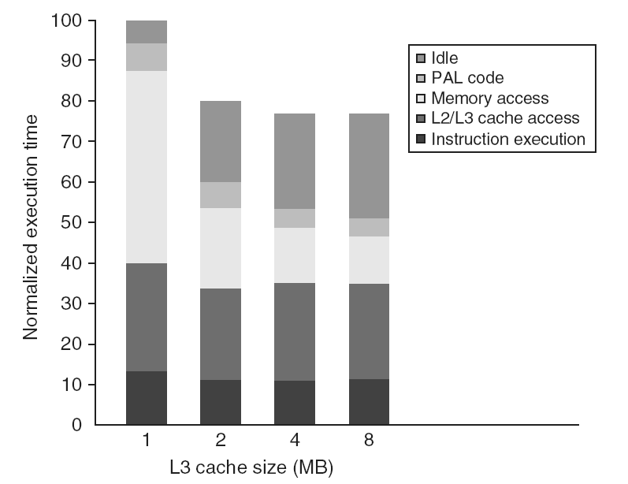
Performance Study: Commercial Workload

Slide 55
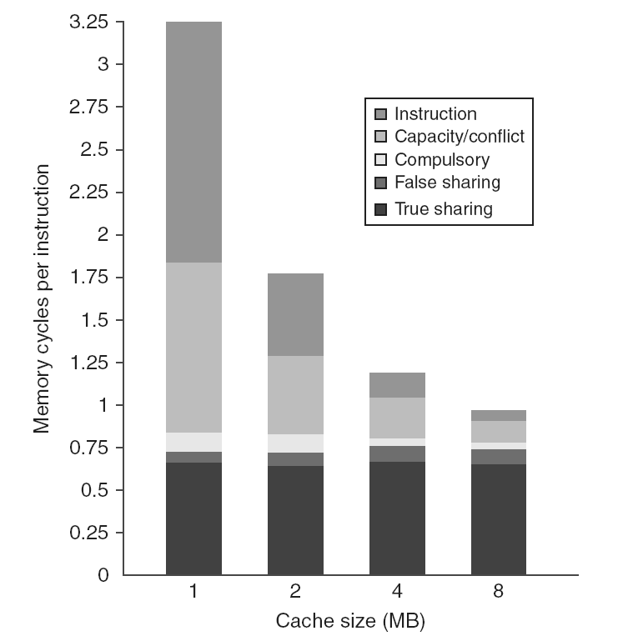
Performance Study: Commercial Workload

Slide 56
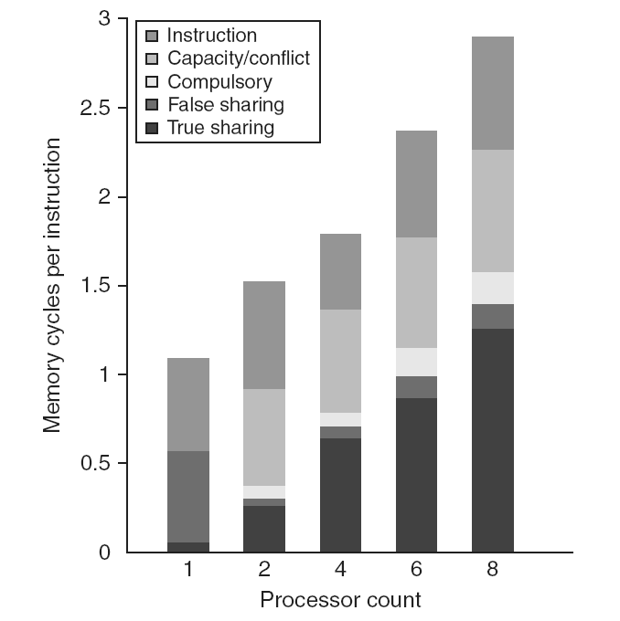
Performance Study: Commercial Workload

Slide 57
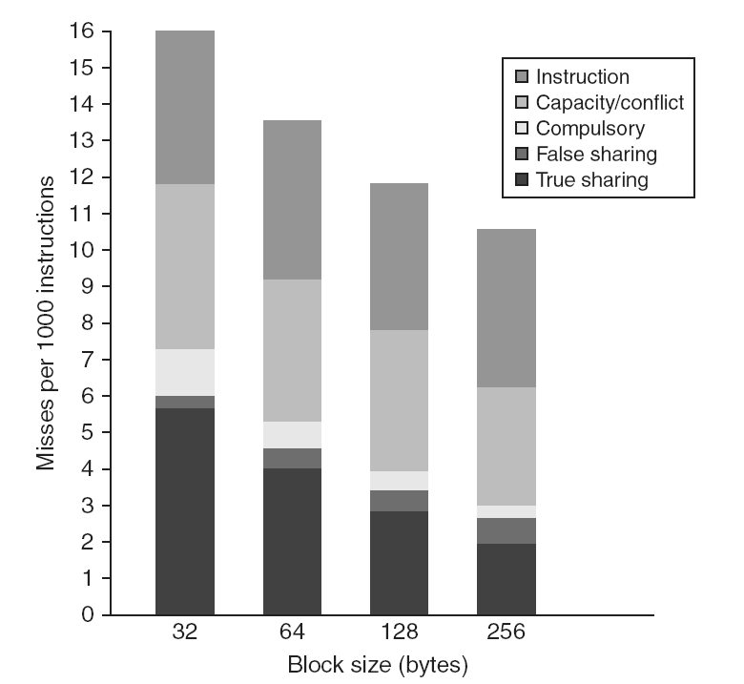
Performance Study: Commercial Workload

Slide 58
Synchronization
Basic building blocks:
  Atomic exchange
    Swaps register with memory location
  Test-and-set
    Sets under condition
  Fetch-and-increment
    Reads original value from memory and increments it in memory
  Requires memory read and write in uninterruptable instruction
  load linked/store conditional
    If the contents of the memory location specified by the load linked are changed before the store conditional to the same address, the store conditional fails

Slide 59
Implementing Locks
Spin lock
  If no coherence:
DADDUI R2,R0,#1
lockit: EXCH R2,0(R1) ;atomic exchange
BNEZ R2,lockit ;already locked?
  If coherence:
lockit: LD R2,0(R1) ;load of lock
BNEZ R2,lockit ;not available-spin
DADDUI R2,R0,#1 ;load locked value
EXCH R2,0(R1) ;swap
BNEZ R2,lockit ;branch if lock wasn’t 0

Slide 60
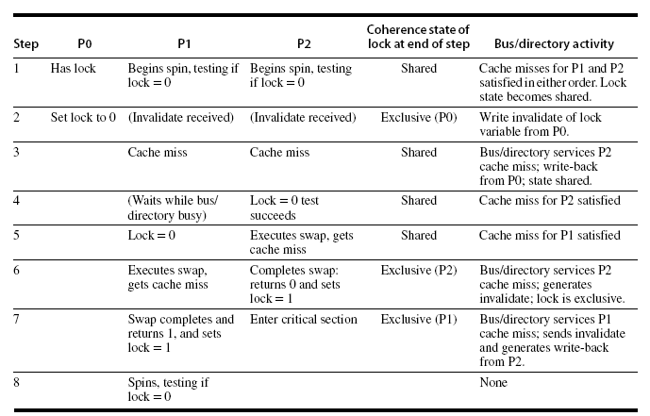
Implementing Locks
Advantage of this scheme: reduces memory traffic

Slide 61
Implementing Locks
To implement, delay completion of all memory accesses until all invalidations caused by the access are completed
  Reduces performance!
Alternatives:
  Program-enforced synchronization to force write on processor to occur before read on the other processor
    Requires synchronization object for A and another for B
      “Unlock” after write
      “Lock” after read

Slide 62
Relaxed Consistency Models
Rules:
  X → Y
    Operation X must complete before operation Y is done
    Sequential consistency requires:
      R → W, R → R, W → R, W → W
  Relax W → R
    “Total store ordering”
  Relax W → W
    “Partial store order”
  Relax R → W and R → R
    “Weak ordering” and “release consistency”

Slide 63
Relaxed Consistency Models
Consistency model is multiprocessor specific
Programmers will often implement explicit synchronization
Speculation gives much of the performance advantage of relaxed models with sequential consistency
  Basic idea: if an invalidation arrives for a result that has not been committed, use speculation recovery

