Slide 1
Computer Architecture
A Quantitative Approach, Fifth Edition
EEL 6764 Principles of Computer Architecture Instruction-Level Parallelism
Dr Hao Zheng
Dept. of Comp Sci & Eng
U of South Florida

Slide 2
Instruction Level Parallelism

Slide 3
Instruction-Level Parallelism
Overlap executions of multiple instructions
When exploiting instruction-level parallelism, goal is to maximize CPI
  Pipeline CPI =
    Ideal pipeline CPI
        + Structural stalls
        + Data hazard stalls
        + Control stalls
Two approaches to exploiting ILP
  Static scheduling
  Dynamic scheduling
3.1 ILP Concepts and Challenges

Slide 4
Dependences
Parallelism with basic block is limited
  Typical size of basic block = 3-6 instructions
  Must optimize across branches
Increase ILP – Loop-Level Parallelism
  Unroll loop statically or dynamically
  Use SIMD (vector processors and GPUs)
Challenges: Data dependency
  Instruction j is data dependent on instruction i if
      Instruction i produces a result that may be used by instruction j
      Instruction j is data dependent on instruction k and instruction k is data dependent on instruction i
Dependent instructions cannot be executed simultaneously
3.1 ILP Concepts and Challenges

Slide 5
Data Dependence
Dependencies are a property of programs
Pipeline organization determines if dependence is detected and if it causes a stall
Data dependence conveys:
  Possibility of a hazard
  Order in which results must be calculated
  Upper bound on exploitable instruction level parallelism
Dependencies that flow through memory locations are difficult to detect
  SD R1, 45(R5)
  LD R2, 90(R7)
3.1 ILP Concepts and Challenges

Slide 6
Name Dependence
Two instructions use the same name but no flow of information
  Not a true data dependence, but is a problem when reordering instructions
  Antidependence: instruction j writes a register or memory location that instruction i reads
    Initial ordering (i before j) must be preserved
  Output dependence: instruction i and instruction j write the same register or memory location
    Ordering must be preserved
To resolve, use renaming techniques
3.1 ILP Concepts and Challenges

Slide 7
Data Hazards
A hazard exists between two dependent instructions that are close in a program such that overlapping their executions would change the order of accesses to the operand involved in the dependence.
Data Hazards
  Read after write (RAW)
  Write after write (WAW)
  Write after read (WAR)
3.1 ILP Concepts and Challenges

Slide 8
Control Dependences
Control Dependence determines ordering of instruction i with respect to a branch instruction
  Instruction control-dependent on a branch cannot be moved before the branch so that its execution is no longer controller by the branch
  An instruction not control-dependent on a branch cannot be moved after the branch so that its execution is controlled by the branch
if p1 { s1; } // s1 control-dependent on p1
if p2 { s2; } // s2 control-dependent on p2
3.1 ILP Concepts and Challenges

Slide 9
Control Dependence – Examples
Example 1:
ADD x2, x3, x4
BEQ x2, x0, L
LD x1, 0(x2)
L: …
LD cannot be move above branch
OR instruction dependent on ADD and SUB
  Cannot move SUB before the branch
Reorder instruction if it does not change program semantics
Example 2:
ADD x1, x2, x3
BEQ x4, x0, L
SUB x1, x5, x6
L: ...
OR x7, x1, x8
3.1 ILP Concepts and Challenges

Slide 10
Control Dependence – Examples (1)
Example 3
ADD x1, x2, x3
BEQ x12, x0, skip
SUB x4, x5, x6
ADD x5, x4, x9
skip: ...
OR x7, x8, x9
Reorder instruction if it does not change program semantics
Example 3: ok to move sub above BEQ
  if x4 is not used after label “skip”
3.1 ILP Concepts and Challenges

Slide 11
3.2 Compiler Techniques for Exposing ILP

Slide 12
Pipeline Scheduling
Separate dependent instruction from the source instruction by the pipeline latency of the source instruction
  Pipeline latency – cycles to separate two dependent instructions to avoid hazards
By inserting NOP (bubbles) – pipeline stalls
By inserting independent instructions - Scheduling
  Statically
  Dynamically
  Scheduling relies on
    ILP in programs
    latencies of functional units
3.2 Basic Compiler Techniques for Exposing ILP

Slide 13
Static Scheduling
Transform and re-arrange the code to reduce pipeline stalls
Example:
  for (i=999; i>=0; i=i-1)
  x[i] = x[i] + s;
Assume branch delay = 1 cycle
3.2 Basic Compiler Techniques for Exposing ILP

Slide 14
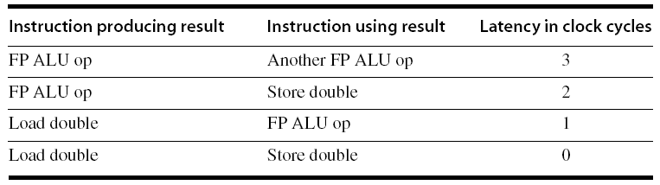
Static Scheduling (1)
Loop: fld f0, 0(x1)
stall
fdd.d f4, f0, f2
stall
stall
fsd f4, 0(x1)
addi x1, x1, -8
bne x1, x2, Loop
3.2 Basic Compiler Techniques for Exposing ILP

Slide 15
Static Scheduling (2)
Loop: fld f0, 0(x1)
addi x1, x1, -8
fdd.d f4, f0, f2
stall
stall
fsd f4, 8(x1)
bne x1, x2, Loop
ILP in basic blocks is limited
Loop unrolling to increase ILP
3.2 Basic Compiler Techniques for Exposing ILP

Slide 16
Loop Unrolling
Unroll by a factor of 4 (assume # elements is divisible by 4)
  Eliminate unnecessary instructions
Loop: L.D F0, 0(R1)
ADD.D F4, F0, F2
S.D F4, 0(R1) ;drop DADDUI & BNE
L.D F6, -8(R1)
ADD.D F8, F6, F2
S.D F8, -8(R1) ;drop DADDUI & BNE
L.D F10, -16(R1)
ADD.D F12, F10, F2
S.D F12,- 16(R1) ;drop DADDUI & BNE
L.D F14, -24(R1)
ADD.D F16, F14, F2
S.D F16, -24(R1)
DADDUI R1, R1, #-32
BNE R1, R2, Loop
Loop: fld f0, 0(x1)
fadd.d f4, f0, f2
fsd f4, 0(R1) ;drop DADDUI & BNE
fld f6, -8(x1)
fadd.d f8, F6, f2
fsd f8, -8(x1) ;drop addi & BNE
fld f0, -16(x1)
fadd.d f12, f0, f2
fsd f12,- 16(x1) ;drop addi & BNE
fld f14, -24(x1)
fadd.d f16, f14, f2
fsd f16, -24(x1)
addi x1, x1, -32
bne x1, x2, Loop
Run in 26 cycles without scheduling
Number of live registers increase vs. original loop
Avoid dependence
Increase ILP
3.2 Basic Compiler Techniques for Exposing ILP

Slide 17
Loop Unrolling/Pipeline Scheduling
Pipeline schedule the unrolled loop
Loop: fld f0, 0(x1)
fld f6, −8(x1)
fld f0, −16(x1)
fld f14, −24(x1)
fadd.d f4, f0, f2
fadd.d f8, f6, f2
fadd.d f12, f0, f2
fadd.d f16, f14, f2
fsd f4, 0(x1)
fsd f8, −8(x1)
fsd f12, 16(x1)
fsd f16, 8(x1)
addi x1, x1, −32
bne x1, x2, Loop
Run in 14 cycles after scheduling
3.5 cycles per iteration
3.2 Basic Compiler Techniques for Exposing ILP

Slide 18
Dealing with Unknown Loop Bound
Number of iterations = n, // n is unknown
Goal: make k copies of the loop body
Solution: generate pair of loops:
  First executes n mod k times of original loop body
  Second executes n / k times of unrolled loop body by k times.
  “Strip mining”
Limitations of Loop unrolling
Cross loop iteration dependence
Code size increase
Register shortfall
3.2 Basic Compiler Techniques for Exposing ILP

Slide 19
3.4 Dynamic Scheduling

Slide 20
Dynamic Scheduling (Section 3.4, 3.5)
In-Order pipeline
  Issue, execution, and completion of instructions follow program order
Pipeline stalls if there is data dependence
But, independent instructions are stalled too.
Static scheduling may not identify some dependences
  e.g. dependencies through memory addresses
DIV.D F0, F2, F4
ADD.D F10 F0, F8
SUB.D F12, F8, F14
3.4 Overcoming Data Hazards with Dynamic Scheduling

Slide 21
Dynamic Scheduling (Section 3.4, 3.5)
Hardware rearrange order of instructions
  To reduce stalls while maintaining data flow and exception
Advantages:
  Compiler doesn’t need to have knowledge of microarchitecture
  Handles cases where dependencies are unknown at compile time
  Tolerate unpredictable delays in memory accesses, FP operations, etc.
Disadvantage:
  Substantial increase in hardware complexity
  Complicates exceptions
3.4 Overcoming Data Hazards with Dynamic Scheduling

Slide 22
Dynamic Scheduling
ID stage is divided into
  Issue – decode instruction, and check for S-hazards
  Read Operands – wait until no D-hazards, then read operands
Instructions pass Issue in-order
They are stalled or bypass each other in Read Operands
  Enter Execute when operands are ready
  Enter Execute out-of-order
3.4 Overcoming Data Hazards with Dynamic Scheduling

Slide 23
Dynamic Scheduling
Dynamic scheduling implies:
  In-order issue
  Out-of-order execution
  Out-of-order completion
Creates the possibility for WAR and WAW hazards
WAR/WAW hazards can be avoided by register renaming
DIV.D F0, F2, F4
ADD.D F6, F0, F8
SUB.D F8, F10, F14
MUL.D F6, F10, F8
3.4 Overcoming Data Hazards with Dynamic Scheduling

Slide 24
Dynamic Scheduling
Tomasulo’s Approach
  Tracks when operands are available
    To eliminate RAW hazards
  Introduces register renaming in hardware
    To eliminate WAW and WAR hazards
3.4 Overcoming Data Hazards with Dynamic Scheduling

Slide 25
Register Renaming
antidependence via F8
DIV.D F0, F2, F4
ADD.D F6, F0, F8
sd f6, 0(x1)
SUB.D F8, F10, F14
MUL.D F6, F10, F8
Output dependence via F6
3.4 Overcoming Data Hazards with Dynamic Scheduling

Slide 26
Register Renaming
Example: assume two additional registers S and T
Now only RAW hazards remain, which must be strictly ordered
DIV.D F0, F2, F4
ADD.D S, F0, F8 ; F6 -> S
sd S, 0(x1) ; F6 -> S
SUB.D T, F10, F14 ; F8 -> T
MUL.D F6, F10, T ; F8 -> T
3.4 Overcoming Data Hazards with Dynamic Scheduling

Slide 27
Tomasulo’s Algorithm – Structure
Reservation stations
3.4 Overcoming Data Hazards with Dynamic Scheduling

Slide 28
Tomasulo’s Algorithm – Structure
Load and store buffers
Contain data and addresses, act like reservation stations
3.4 Overcoming Data Hazards with Dynamic Scheduling

Slide 29
Tomasulo’s Algorithm – Structure
  Instruction queue
  CDB
3.4 Overcoming Data Hazards with Dynamic Scheduling

Slide 30
Register Renaming By Reservation Stations
Reservation stations (RS) buffer
  The instruction opcode
  Buffered operand values (when available)
  Or, reservation station number of instruction providing the operand values (producer instruction)
RS fetches and buffers an operand as soon as it becomes available (not necessarily involving register file)
Pending instructions designate the RS to which they will send their output
Result values broadcast on a result bus, common data bus (CDB)
Only the last output updates the register file
As instructions are issued, the register specifiers are renamed with the reservation station
May be more reservation stations than registers
3.4 Overcoming Data Hazards with Dynamic Scheduling

Slide 31
Tomasulo’s Algorithm – Issue
Get next instruction from FIFO queue
If available RS, issue the instruction to the RS with operand values if available
If operand values not available, stall the instruction
Renaming in this step
3.4 Overcoming Data Hazards with Dynamic Scheduling

Slide 32
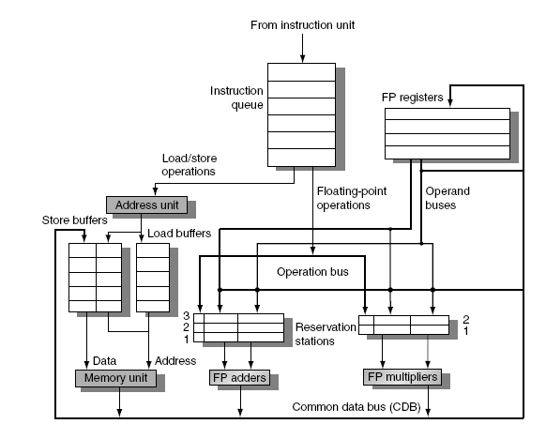
Tomasulo’s Algorithm – Execute
    When operand becomes available, store it in any reservation stations waiting for it
    When all operands are ready, issue the instruction
3.4 Overcoming Data Hazards with Dynamic Scheduling

Slide 33
Tomasulo’s Algorithm – Execute (1)
    Loads and store maintained in program order through effective address
    No instruction allowed to initiate execution until all branches that proceed it in program order have completed
3.4 Overcoming Data Hazards with Dynamic Scheduling

Slide 34
Tomasulo’s Algorithm – Write Result
    Write result on CDB into reservation stations and store buffers
      Stores must wait until address and value are received
(rs#, result)
3.4 Overcoming Data Hazards with Dynamic Scheduling

Slide 35
Tomasulo’s Algorithm – Some Notes
Each RS has an unique ID
Each register is tagged with RS#
  Will be updated by instruction in RS#
Each RS, store buffer tagged with RS# for unavailable operands
  Tags refer to FUs or buffers that produce operands
  Tags = producer ID
FUs or memory (producer) put (RS#, results) on CDB
RS, registers, store buffers (consumer) monitor the CDB,
  Get the data where its tag matches tag on CDB
Forwarding through broadcast on CDB
3.4 Overcoming Data Hazards with Dynamic Scheduling

Slide 36
Example
3.4 Overcoming Data Hazards with Dynamic Scheduling

Slide 37
Reservation Station Fields
Op – inst opcode
Qj, Qk – RS that produce the operands
Vj, Vk – operand values
A – hold memory address for load/store
Qi – RS whose output should be stored into this register
3.4 Overcoming Data Hazards with Dynamic Scheduling

Slide 38
Latencies of FUs
Load = 1 cycle
Add/sub = 2 cycles
Mult = 6 cycles
Div = 12 cycles
3.4 Overcoming Data Hazards with Dynamic Scheduling
Notes:
Execute Write Result
Loads calculating effective address, write M-data into Reg
reading memory.
Writes cal. Effective M-addr wr M-data into M.

Slide 39
3.4 Overcoming Data Hazards with Dynamic Scheduling
Notes:
Execute Write Result
Loads calculating effective address, write M-data into Reg
reading memory.
Writes cal. Effective M-addr wr M-data into M.

Slide 40
A Loop Example
Loop: fld f0, 0(x1)
fmul f4, f0, f2
fsd f4, 0(x1)
addi x1, x1, -8
bne x1, x2, Loop
f#: FP registers
x#: integer registers
Assume predict-taken for loop unrolling
3.5 Dynamic Scheduling: Examples and Algorithm
Notes:
Simulate it on Excel worksheet

Slide 41
3.5 Dynamic Scheduling: Examples and Algorithm
Notes:
Execute Write Result
Loads calculating effective address, write M-data into Reg
reading memory.
Writes cal. Effective M-addr wr M-data into M.

Slide 42
Ordering of Load and Store
If load and store accesses different memory, they can be re-ordered
Otherwise, reordering causes WAW/RAW hazards
Consider load is next to issue
  Computer effective address for load
  Check the A field in all store buffers for match
  Hold load if a match is found
Store is handled similarly
  Check both load and store buffers
sd f1, XXX
ld f2, XXX
ld f1, XXX
sd f2, XXX
sd f1, XXX
sd f2, XXX
3.5 Dynamic Scheduling: Examples and Algorithm

Slide 43
Tomasulo’s Algorithm – Summary
Rename registers to RS
  To eliminates WAW and WAR hazards
Buffer RS # for operands currently unavailable
  To eliminate RAW hazards
Tolerate unpredictable delays of mem hierarchy
  Allow instructions to execute while waiting for cache misses
Achieve high performance w/o compiler optimization
HW complexity increases substantially
  Increase area and power
3.5 Dynamic Scheduling: Examples and Algorithm

Slide 44
3.6 Hardware-Based Speculation

Slide 45
Hardware-Based Speculation
Combine dynamic scheduling and branch prediction
Execute instructions along predicted execution paths but only commit the results if prediction was correct
  Speculative execution
Instruction commit: allowing an instruction to update the register/mem when instruction is no longer speculative
  i.e. branch prediction is correct.
Instruction execute out-of-order, commit in-order
Need an additional piece of hardware to prevent any irrevocable action until an instruction commits
  I.e. updating state or taking an execution
3.6 Hardware-Based Speculation
Notes:
Need to cross basic blocks to find more ILP
Static scheduling uses loop unrolling.
Tomasulo’s algorithm does not execute instructions across basic blocks. Instructions can be executed only after proceeding branch resolved.

Slide 46
Reorder Buffer
Reorder buffer (ROB) – holds the result of instruction between completion and commit
Four fields:
  Instruction type: branch/store/register
  Destination field: register number/memory address
  Value field: output value
  Ready field: completed execution?
Source operands are in
  Registers <– committed instructions
  ROB <– instructions that complete execution before commt
Modify reservation stations:
  Operand sources (Qj or Qk) are now ROB entries instead of RS#
3.6 Hardware-Based Speculation

Slide 47
Reorder Buffer
ROB and store buffer are merged
Values to registers/memory are not written until an instruction commits
On mis-prediction:
  Speculated entries in ROB are cleared
Exceptions:
  Not recognized until it is ready to commit
3.6 Hardware-Based Speculation

Slide 48
Combined w store buffers – A queue
3.6 Hardware-Based Speculation

Slide 49
Issue an instruction if there is an empty RS and ROB. Stall otherwise.
Send the operands to RS if they are available or ROB# if not.
Tag the instruction result with the ROB# for the destination register
(ROB#, value)
3.6 Hardware-Based Speculation

Slide 50
Issue
Execute – start after both operands are available.
Results are tagged with ROB#
(ROB#, value)
3.6 Hardware-Based Speculation

Slide 51
Issue
Execute – start after both operands are available.
Write Result – result put on CDB and goes to ROB and RS
Any RS or ROB entry expecting a result with ROB# will grab value when <ROB#, value> is put on CDB
(ROB#, value)
3.6 Hardware-Based Speculation

Slide 52
Issue
Execute
Write Result
Commit – write result of instruction at the head of ROB
If the instruction is NOT branch, update M/Reg with the value in ROB
If the head of ROB is a mis-predicted branch, flush ROB, and restart from the branch target.
Otherwise, commit as normal.
(ROB#, value)
3.6 Hardware-Based Speculation

Slide 53
3.6 Hardware-Based Speculation
Notes:
SUB completed before MULT, but commits after MULT in order.
Dest field in RS used for tagging values produced by FU. Also note register status field.
Exception handling: if MULT causes an exception, it’s handled when MULT reaches the head of ROB

Slide 54
A Loop Example
3.6 Hardware-Based Speculation
Notes:
If 1st BNE is mis-predicted, the ROB is flushed when that BNE reaches the head of ROB, and processor continues from the calculated branch target.
Instructions in ROB 6-10 are executed speculatively.

Slide 55
Hazards Through Memory
No WAW/WAR hazards by
  In-order commit to update reg/memory
Store updates MEM in commit, while load reads MEM in execute
Avoid RAW hazards through MEM by
  Not allowing a load to read Mem if its A field matches the destination field of any active ROB entry for a store, and
  Maintaining the program order of effective address computation of a load wrt all earlier stores.
sd f1, XXX
ld f2, XXX
3.6 Hardware-Based Speculation

Slide 56
Hardware Speculation – Summary
Out-of-order execution, in-order commit
On branch mis-prediction, flush ROB, and processor restart from the branch target.
  Instructions before the branch are completed as normal
Branch prediction has higher importance.
  Impact of mis-prediction is higher
Instruction exception is delayed until instruction commit
  Allow precise exception
WAW/WAR hazards are eliminated by in-order commit
No RAW hazards with additional control
3.6 Hardware-Based Speculation

Slide 57
Multiple Issue
3.7 -- 3.8 Multiple Issue

Slide 58
Multiple Issue and Static Scheduling
To achieve CPI < 1, need to complete multiple instructions per clock
Solutions:
  Statically scheduled superscalar processors
  VLIW (very long instruction word) processors
  dynamically scheduled superscalar processors
3.7 Multiple Issue & Static Scheduling

Slide 59
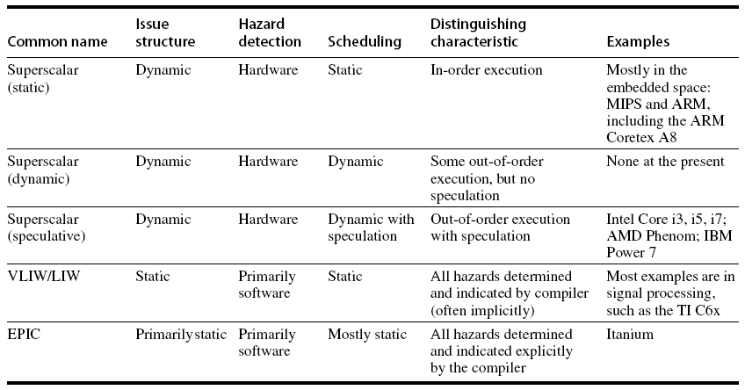
Multiple Issue
3.7 Multiple Issue & Static Scheduling

Slide 60
VLIW Processors
Package multiple operations into one instruction
Example VLIW processor:
  One integer instruction (or branch)
  Two independent floating-point operations
  Two independent memory references
Must be enough parallelism in code to fill the available slots
  loop unrolling is a major technique
3.7 Multiple Issue & Static Scheduling

Slide 61
VLIW Processors
Disadvantages:
  Statically finding parallelism – loop unrolling
  Single code size increase
  No hazard detection hardware
  Binary code compatibility
3.7 Multiple Issue & Static Scheduling

Slide 62
Dynamic Scheduling, Multiple Issue, and Speculation
Modern microarchitectures:
  Dynamic scheduling + multiple issue + speculation
Two approaches:
  Assign reservation stations and update pipeline control table in half clock cycles
    Only supports 2 instructions/clock
  Design logic to handle any possible dependencies between the instructions
  Hybrid approaches
Issue logic can become bottleneck
  see fig. 3.22 for issue logic for (FP load + FP op)
3.8 Multiple Issue & Dynamic Scheduling

Slide 63
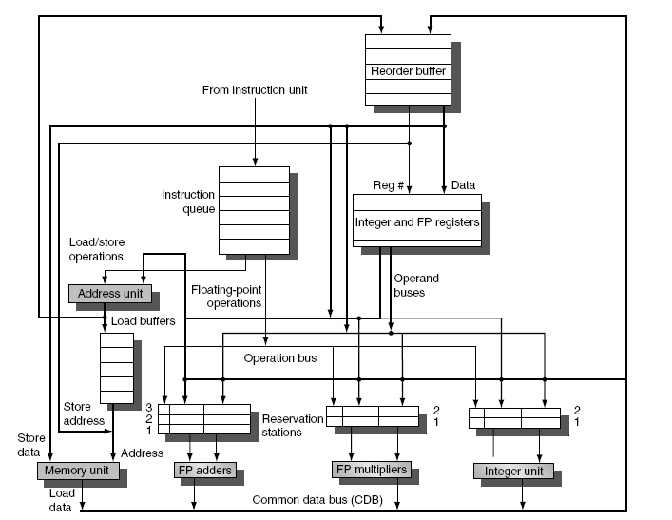
Overview of Design
Multiple FUs (integer and FP)
An instruction issued for each FU
Instructions issued in-order
RS and ROB updated for all issued instructions
3.8 Multiple Issue & Dynamic Scheduling

Slide 64
Multiple Issue
Limit the number of instructions of a given class that can be issued in a “bundle”, and pre-allocate RS and ROB
  I.e. on FP, one integer, one load, one store
Examine all the dependencies among the instructions in the bundle
If dependencies exist in bundle, encode them in reservation stations
Also need multiple completion/commit
  easier – dependencies among issued instructions resolved
3.8 Multiple Issue & Dynamic Scheduling

Slide 65
Example
Loop: ld x2, 0(x1) ;R2=array element
addi x2, x2, 1 ;increment R2
sd x2, 0(x1) ;store result
addi x1, x1, 8 ;increment pointer
bne x2, x3, loop ;branch if not last element
What happens when issue both?
ld x2, 0(x1)
addi x2, x2, 1
3.8 Multiple Issue & Dynamic Scheduling

Slide 66
Example – Mult-Issue, No Speculation
3.8 Multiple Issue & Dynamic Scheduling

Slide 67
Example – Mult-Issue w Speculation
3.8 Multiple Issue & Dynamic Scheduling

Slide 68
Multithreading
3.11 Multithreading

Slide 69
Limitations of ILP
Program structure – limited ILP
WAW/WAR hazards through memory
Memory bandwidth and latency
  Pipeline cannot hide latency to access off-chip cache/mem.
  Remember “memory wall”?
Impacts of wide issue width
  Logic complexity ↑
  Clock rate ↓
  Power ↑
Size of ROB and RS
  Purpose of ROB & RS?
3.10 Limitations of ILP

Slide 70
Multithreading
Exploiting thread-level parallelism to improve uniprocessor throughput
Multiprocessing and multithreading in Chapter 5
Thread-level parallelism (TLP) exists abundantly
  A property of applications,
  eg. online transaction processing, SC, web applications,
Multithreading allows multiple threads to share a processor without process switch
  Each thread is independently controlled by OS
  With duplicate private state (reg, PC, etc) for each thread
  Share FUs and memory, etc
3.12 Multithreading: Exploiting Thread-Level Parallelism
Notes:
Multithreading is HW organization supporting execution of multiple threads
-- Each thread has private PC and Reg
-- FUs and memory are shared among threads.

Slide 71
Multithreading Approaches
3.12 Multithreading: Exploiting Thread-Level Parallelism

Slide 72
Effectiveness of SMT
3.12 Multithreading: Exploiting Thread-Level Parallelism

Slide 73
Backup

Slide 74
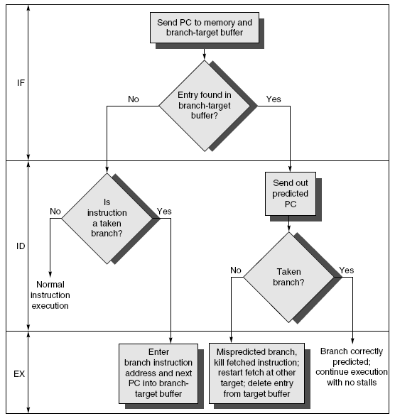
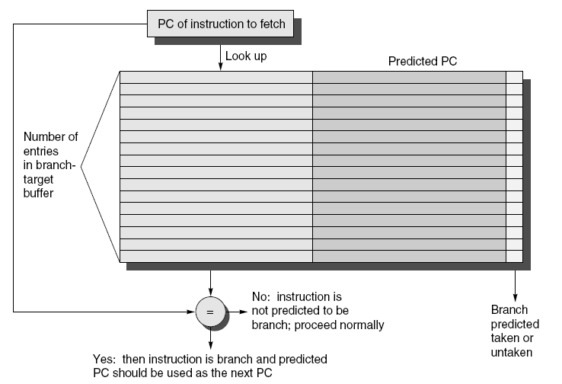
Branch-Target Buffer
Need high instruction bandwidth!
  Branch-Target buffers
    Next PC prediction buffer, indexed by current PC
Adv. Techniques for Instruction Delivery and Speculation

Slide 75
Branch Folding
Optimization:
  Larger branch-target buffer
  Add target instruction into buffer to deal with longer decoding time required by larger buffer
  “Branch folding”
Adv. Techniques for Instruction Delivery and Speculation

Slide 76
Return Address Predictor
Most unconditional branches come from function returns
The same procedure can be called from multiple sites
  Causes the buffer to potentially forget about the return address from previous calls
Create return address buffer organized as a stack
Adv. Techniques for Instruction Delivery and Speculation

Slide 77
Integrated Instruction Fetch Unit
Design monolithic unit that performs:
  Branch prediction
  Instruction prefetch
    Fetch ahead
  Instruction memory access and buffering
    Deal with crossing cache lines
Adv. Techniques for Instruction Delivery and Speculation

Slide 78
Register Renaming
Register renaming vs. reorder buffers
  Instead of virtual registers from reservation stations and reorder buffer, create a single register pool
    Contains visible registers and virtual registers
  Use hardware-based map to rename registers during issue
  WAW and WAR hazards are avoided
  Speculation recovery occurs by copying during commit
  Still need a ROB-like queue to update table in order
  Simplifies commit:
    Record that mapping between architectural register and physical register is no longer speculative
    Free up physical register used to hold older value
    In other words: SWAP physical registers on commit
  Physical register de-allocation is more difficult
Adv. Techniques for Instruction Delivery and Speculation

Slide 79
Integrated Issue and Renaming
Combining instruction issue with register renaming:
  Issue logic pre-reserves enough physical registers for the bundle (fixed number?)
  Issue logic finds dependencies within bundle, maps registers as necessary
  Issue logic finds dependencies between current bundle and already in-flight bundles, maps registers as necessary
Adv. Techniques for Instruction Delivery and Speculation

Slide 80
How Much?
How much to speculate
  Mis-speculation degrades performance and power relative to no speculation
    May cause additional misses (cache, TLB)
  Prevent speculative code from causing higher costing misses (e.g. L2)
Speculating through multiple branches
  Complicates speculation recovery
  No processor can resolve multiple branches per cycle
Adv. Techniques for Instruction Delivery and Speculation

Slide 81
Energy Efficiency
Speculation and energy efficiency
  Note: speculation is only energy efficient when it significantly improves performance
Value prediction
  Uses:
    Loads that load from a constant pool
    Instruction that produces a value from a small set of values
  Not been incorporated into modern processors
  Similar idea--address aliasing prediction--is used on some processors
Adv. Techniques for Instruction Delivery and Speculation

Slide 82
Branch Prediction
Basic 2-bit predictor:
  For each branch:
    Predict taken or not taken
    If the prediction is wrong two consecutive times, change prediction
Correlating predictor:
  Multiple 2-bit predictors for each branch
  One for each possible combination of outcomes of preceding n branches
Local predictor:
  Multiple 2-bit predictors for each branch
  One for each possible combination of outcomes for the last n occurrences of this branch
Tournament predictor:
  Combine correlating predictor with local predictor

Slide 83
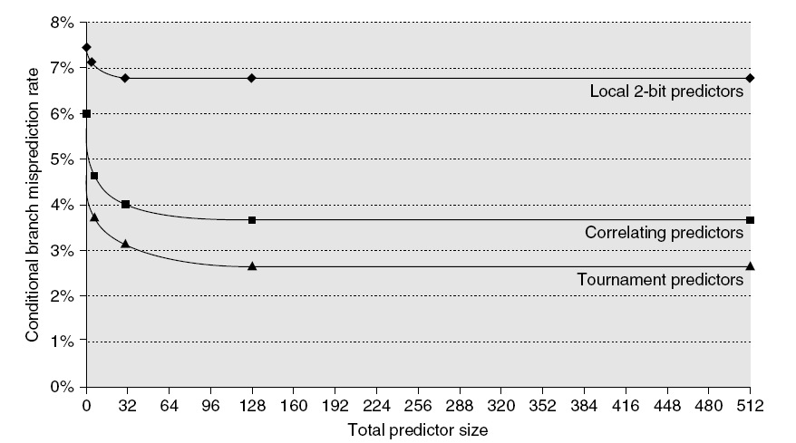
Branch Prediction Performance
Branch Prediction
Branch predictor performance

