Slide 1
EEL 6764 Principles of Computer Architecture
Instruction Set Principles
Dr Hao Zheng
Computer Sci. & Eng.
U of South Florida

Slide 2
Reading
Computer Architecture: A Quantitative Approach
  Appendix A
Computer Organization and Design: The Hardware/Software Interface
  Chapter 2

Slide 3
Abstractions
Abstraction helps us deal with complexity
  Hide lower-level detail
Instruction set architecture (ISA)
  The hardware/software interface
  Defines storage, operations, etc
Implementation
  The details underlying the interface
  An ISA can have multiple implementations
Problem
Algorithm
Program/Language
User
Runtime System
(VM, OS, MM)
ISA
Microarchitecture
Logic
Circuits
Electrons
A.1 Introduction

Slide 4
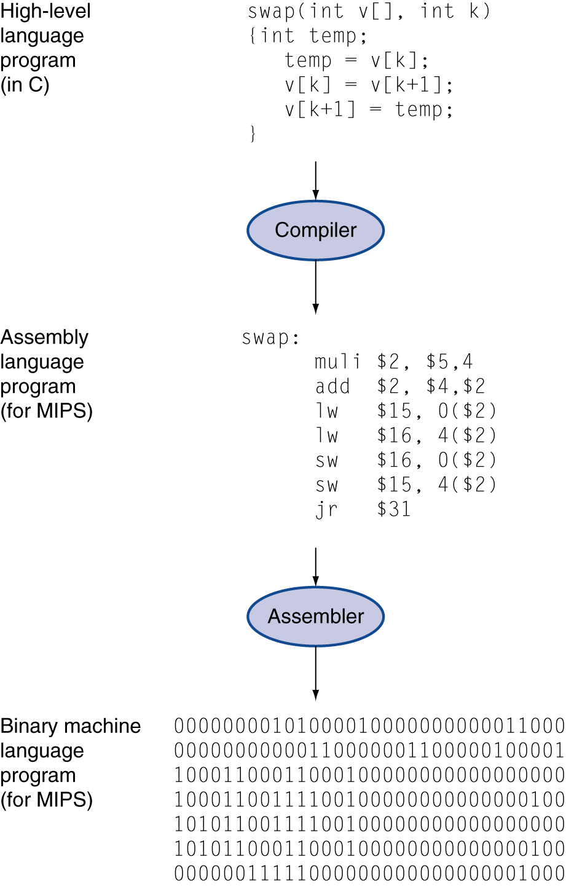
Levels of Program Code
High-level language
  Level of abstraction closer to problem domain
  Provides for productivity and portability
Assembly language
  Textual representation of instructions
Hardware representation
  Machine code - Binary digits (bits)
  Encoded instructions and data
Compiler
  Translate HL prgm to assembly
Assembler
  Translate assembly to machine code
A.1 Introduction

Slide 5
Program Execution Model
A computer is just a FSM
  States stored in registers, memory, PC, etc
  States changed by instruction execution
An instruction is executed in
  Fetch an instruction into CPU from memory
  Decode it to generate control signals
  Execute it (add, mult, etc)
  Write back output to reg or memory
Programs and data coexist in memory
  How to distinguish program from data?
Fetch
Decode
Execute
Writeback
A.1 Introduction

Slide 6
What Makes a Good ISA?
Programmability
  Who does assembly programming these days?
Performance/Implementability
  Easy to design high-performance implementations?
  Easy to design low-power implementations?
  Easy to design low-cost implementations?
Compatibility
  Easy to maintain as languages, programs evolve
  x86 (IA32) generations: 8086, 286, 386, 486, Pentium, Pentium-II, Pentium-III, Pentium4, Core2, Core i7, ...
A.1 Introduction
Notes:
Programmability: less important as compiler can produce code with higher quality.
X86: X86 compatible instructions that are translated into MIPS-like operations internal for performance.

Slide 7
Performance
Execution time = IC * CPI * cycle time
IC: instructions executed to finish program
  Determined by program, compiler, ISA
CPI: number of cycles needed for each instruction
  Determined by compiler, ISA, u-architecture
Cycle time: inverse of clock frequency
  Determined by u-architecture & technology
Ideally optimize all three
  Their optimizations often against each other
  Compiler plays a significant role
A.1 Introduction

Slide 8
Instruction Granularity
CISC (Complex Instruction Set Computing) ISAs
  Big heavyweight instructions (lots of work per instruction)
  Low “inst/program” (IC)
  Higher “cycles/inst” and “seconds/cycle” (CPI)
    We have the technology to get around this problem
RISC (Reduced Instruction Set Computer) ISAs
  Minimalist approach to an ISA: simple inst only
  Low “cycles/inst” and “seconds/cycle”
  Higher “inst/program”, but hopefully not as much
    Rely on compiler optimizations
A.1 Introduction

Slide 9
Classifying Architectures
One important classification scheme is by the type of addressing modes supported.
Stack architecture: Operands implicitly on top of a stack. (Early machines, Intel floating-point.)
Accumulator architecture: One operand is implicitly an accumulator (a special register).
  early machines
General-purpose register arch.: Operands may be any of a large (typically 10s-100s) # of registers.
  Register-memory architectures: One op may be memory.
  Load-store architectures: All ops are registers, except in special load and store instructions.
A.2 ISA Classification

Slide 10
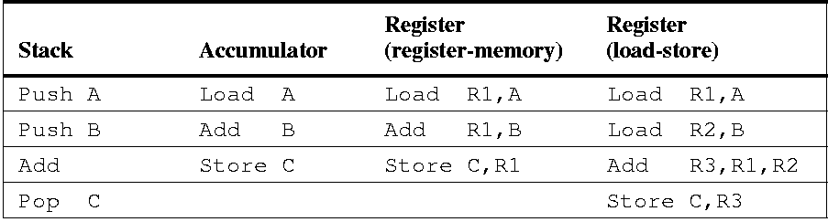
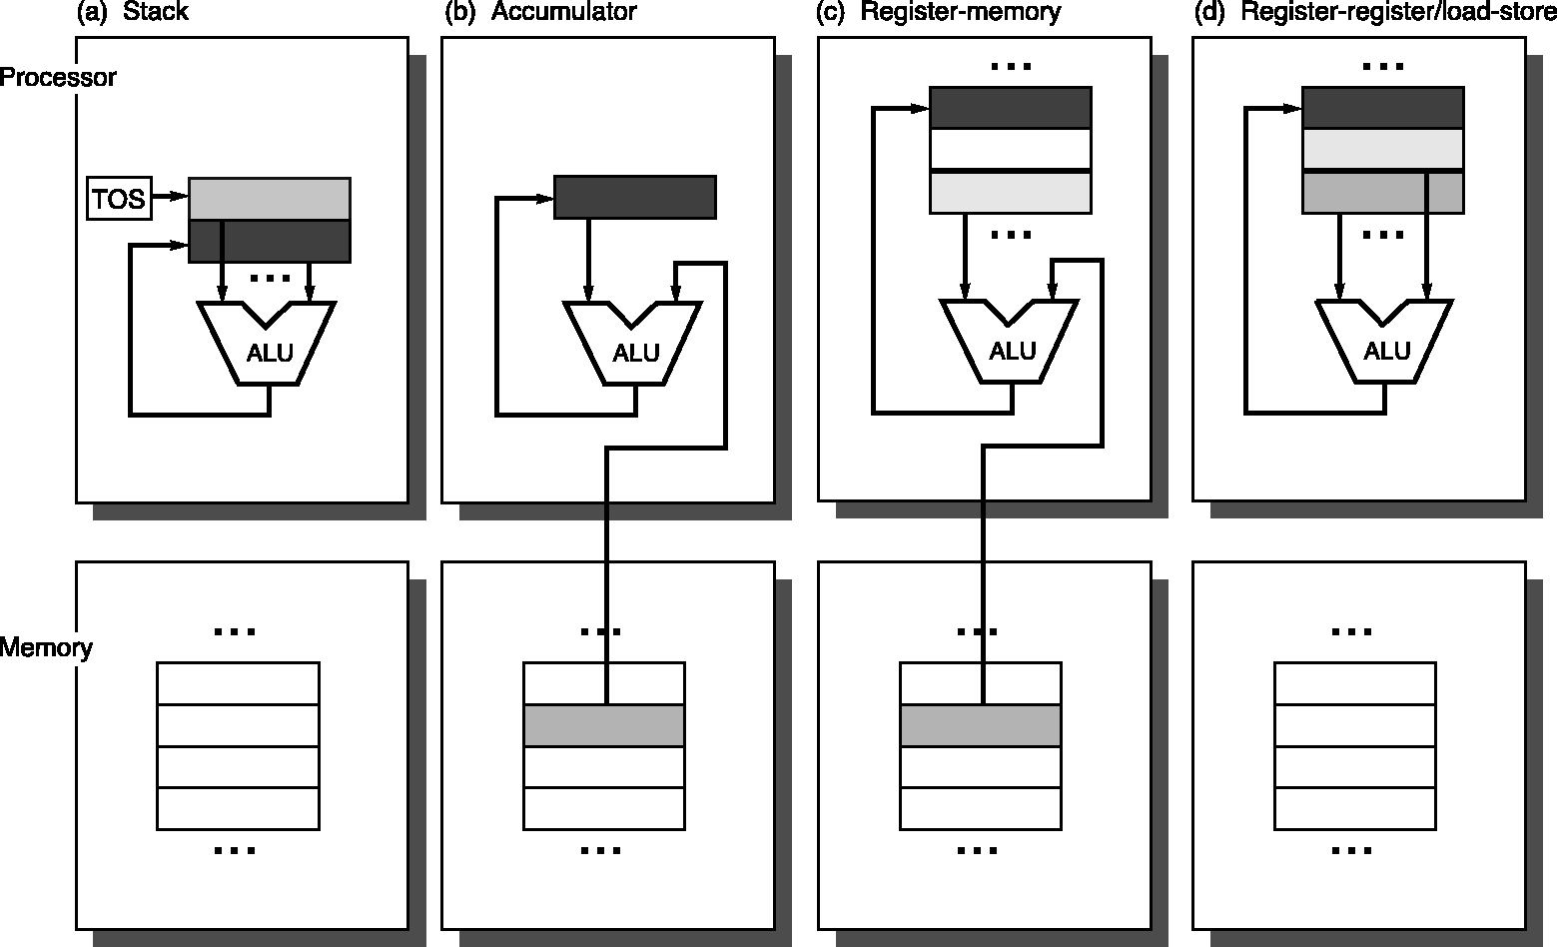
Illustrating Architecture Types
Assembly for C:=A+B:
A.2 ISA Classification

Slide 11
Number of Registers
Registers have advantages
  faster than memory, good for compiler optimization, hold variables
have as many as possible?
  No
One reason that registers are faster: there are
  fewer of them – small is fast (hardware truism)
Another: they are directly addressed
  More registers, means more bits per register in instruction
  Thus, fewer registers per instruction or larger instructions
More registers means more saving/restoring
  Across function calls, traps, and context switches
Trend toward more registers:
  8 (x86) → 16 (x86-64), 16 (ARM v7) → 32 (ARM v8)
A.2 ISA Classification

Slide 12
Number of Operands
A further classification is by the max. number of operands, and # of operands that can be memory: e.g.,
  2-operand (e.g. a += b)
    src/dest(reg), src(reg)
    src/dest(reg), src(mem) IBM 360, x86, 68k
    src/dest(mem), src(mem) VAX
  3-operand (e.g. a = b+c)
    dest(reg), src1(reg), src2(reg) MIPS, PPC, SPARC, &c.
    dest(reg), src1(reg), src2(mem)
    dest(mem), src1(mem), src2(mem) VAX
Classifications
  register-register (load-store)
  register-memory
  memory-memory
A.2 ISA Classification

Slide 13
Memory Addressing
Byte Addressing
  Each byte has a unique address
Other addressing units
  Half-word: 16-bit (or 2 bytes)
  Word: 32-bit (or 4 bytes)
  Double word : 64-bit (or 8 bytes)
  Quad word: 128-bit (or 16 bytes)
Two issues
  Alignment specifies whether there are any boundaries for word addressing
  Byte order (Big Endian vs. Little Endian)
    specifies how multiple bytes within a word are mapped to memory addresses
A.3 Memory Addressing
Notes:
memory addressing is about how memory addresses are specified, and how they are interpreted to find data.

Slide 14
Memory Addressing
Alignment
  Must half word, words, double words begin mod 2, mod 4, mod 8 boundaries
half word
#mod2
Word
#mod4
Double word
#mod8
Aligned if Addr mod size = 0
A.3 Memory Addressing

Slide 15
Memory Addressing
Alignment
  Or there no alignment restrictions
half word
Word
Double word
A.3 Memory Addressing
Notes:
how to access byte, half word and word in a 64-bit machine?

Slide 16
Memory Addressing
Non-aligned memory references may cause multiple memory accesses
Consider a system in which memory reads return 4 bytes and a reference to a word spans a 4-byte boundary: two memory accesses are required
Complicates memory and cache controller design
Assemblers typically force alignment for efficiency
A.3 Memory Addressing
Notes:
Modern memory accesses are aligned along word or double-word. To access misalighned word, it will take multiple aligned accesses.

Slide 17
Byte Ordering – Little Endian
The least significant byte within a word (or half word or double word) is stored in the smallest address
A.3 Memory Addressing

Slide 18
Byte Ordering – Big Endian
The most significant byte within a word (or half word or double word) is stored in the smallest address
A.3 Memory Addressing

Slide 19
Byte Order in Real Systems
Big Endian: Motorola 68000, Sun Sparc, PDP-11
Little Endian: VAX, Intel IA32
Configurable: MIPS, ARM
No difference within a single machine
A.3 Memory Addressing

Slide 20
Addressing Modes – How to Find Operands
A.3 Memory Addressing
Notes:
about specifying addresses of operands.
Operands can be constant, in registers, or n memory.
Define “effective address”

Slide 21
Addressing Modes
Addressing modes can reduce IC but at a cost of added CPU design complexity and/or increase average CPI
Example (usage of auto-increment mode):
  With auto-increment mode:
  Add R1, (R2)+
  Without auto-increment mode
  Add R1, (R2)
  Add R2, #1
Example (usage of displacement mode):
  With displacement mode:
  Add R4, 100(R1)
  Without displacement mode
  Add R1, #100
  Add R4, (R1)
  Sub R1, #100
A.3 Memory Addressing
Notes:
Some early instructions can perform array-array operations in a single instruction

Slide 22
Which Addressing Modes to Support
Support frequently used modes
  Make common case fast!
A.3 Memory Addressing

Slide 23
Displacement Value Distribution
add R4 100(R1) – 16 bits to be sufficient
SPEC CPU 2000 on Alpha
A.3 Memory Addressing

Slide 24
Popularity of Immediate Operands
add R4 #3
A.3 Memory Addressing

Slide 25
Distribution of Immediate Values
add R4 #3 – 16 bits to be sufficient
SPEC CPU 2000 on Alpha
A.3 Memory Addressing

Slide 26
Other Issues
How to specify type and size of operands (A.4)
  Mainly specified in opcode – no separate tags for operands
Operations to support (A.5)
  simple instructions are used the most
Control flow instructions (A.6)
  Branch, call/return more popular than jump
  Target address is typically PC-relative & register indirect
  Address displacements are usually <= 12 bits
  How to implement conditions for branches

Slide 27
Instruction Encoding
A.7 Instruction Encodings

Slide 28
Instruction Encoding
Affects code size and implementation
OpCode – Operation Code
  The instruction (e.g., “add”, “load”)
  Possible variants (e.g., “load byte”, “load word”…)
Oprands – source and destination
  Register, memory address, immediate
Addressing Modes
  Impacts code size
    Encode as part of opcode (common in load-store architectures which use a few number of addressing modes)
    Address specifier for each operand (common in architectures which support may different addressing modes)
A.7 Instruction Encodings

Slide 29
Fixed vs Variable Length Encoding
Fixed Length
  Simple, easily decoded
  Larger code size
Variable Length
  More complex, harder to decode
  More compact, efficient use of memory
    Fewer memory references
    Advantage possibly mitigated by use of cache
  Complex pipeline: instructions vary greatly in both size and amount of work to be performed
A.7 Instruction Encodings

Slide 30
Instruction Encoding
Tradeoff between variable and fixed encoding is size of program versus ease of decoding
Must balance the following competing requirements:
  Support as many registers and addressing modes as possible
  Impact of size of the # of registers and addressing mode fields on the average instruction size
  Desire to have instructions encoded into lengths that will be easy to handle in a pipelined implementation
    Multiple of bytes than arbitrary # of bits
Many desktop and server choose fixed-length instructions
  ?
A.7 Instruction Encodings

Slide 31
Putting it Together
Use general-purpose registers with load-store arch
Addressing modes: displacement, immediate, register indirect
Data size: 8-, 16-, 32-, and 64-bit integer, 64-bit floating
Simple instructions: load, store, add, subtract, …
Compare: =, /=, <
Fixed instruction for performance, variable instruction for code size
At least 16 registers
Read section A9 to get an idea of MIPS ISA.
  Useful for understanding following discussions on pipelining

Slide 32
Pitfalls
Designing “high-level” instruction set features to support a high-level language structure
  They do not match HL needs, or
  Too expensive to use
  Should provide primitives for compiler
Innovating at instruction set architecture alone without accounting for compiler support
  Often compiler can lead to larger improvement in performance or code size

Slide 33
Backup

Slide 34
Types of Instructions
Operations supported by most ISAs
A.4 Types of Instructions
A.5 Operations in the Instructions

Slide 35
Instruction Distribution
Simple instructions dominate!
A.5 Operations in the Instructions

Slide 36
Control Flow Instructions
Conditional branches dominate!
SPEC CPU 2000 on Alpha
A.6 Control Flow Instructions

Slide 37
Conditional Branch Distances
4-8 bits can encode 90% branches!
SPEC CPU 2000 on Alpha
A.6 Control Flow Instructions

Slide 38
Branch Condition Evaluation
A.6 Control Flow Instructions
Notes:
example: if (x==5) then ... else ...

Slide 39
Types of Comparisons
SPEC CPU 2000 on Alpha
A.6 Control Flow Instructions

