Slide 1
EEL 6764 Principles of Computer Architecture
Memory Hierarchy Design
Instructor: Hao Zheng
Department of Computer Science & Engineering
University of South Florida
Tampa, FL 33620
Email: haozheng@usf.edu
Phone: (813)974-4757
Fax: (813)974-5456

Slide 2
A Simplified View of Computers
CPU
Cache
Memory
Interconnect
HD
DISP
...
KB

Slide 3
Reading
Computer Architecture: A Quantitative Approach
  Chapter 2, Appendix B
Computer Organization and Design: The Hardware/Software Interface
  Chapter 5

Slide 4
Memory Technology – Overview
Static RAM (SRAM)
  0.5ns – 2ns, $2000 – $5000 per GB
Dynamic RAM (DRAM)
  20ns – 30ns, $10 – $50 per GB
Magnetic disk
  5ms – 20ms, $0.20 – $2 per GB
Ideal memory
  Access time of SRAM
  Capacity and cost/GB of disk

Slide 5
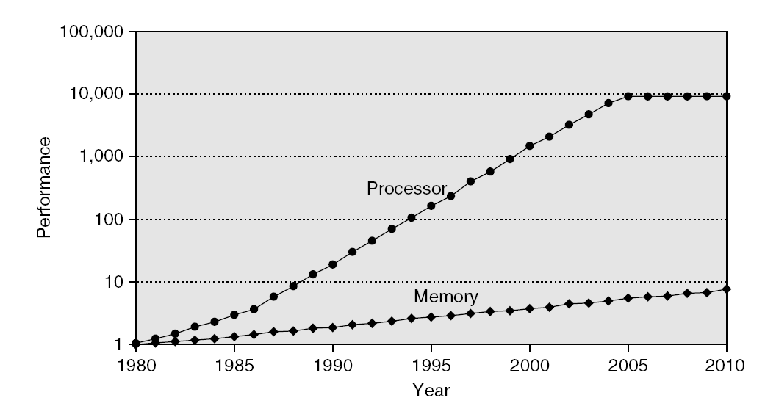
The “Memory Wall”
Processor mem accesses/sec vs DRAM accesses/sec
2.1 Introduction

Slide 6
The “Memory Wall” – A Multi-Core Case
Aggregate peak bandwidth grows with # cores:
  Intel Core i7 can generate two references per core per clock
  Four cores and 3.2 GHz clock
    25.6 billion 64-bit data references/second +
    12.8 billion 128-bit instruction references
    = 409.6 GB/s!
DRAM bandwidth is only 6% of this (25 GB/s)
Requires:
      Multi-port, pipelined caches
      Two levels of cache per core
      Shared third-level cache on chip
2.1 Introduction

Slide 7
Principle of Locality – Review
Programs often access a small proportion of their address space at any time
Temporal locality
  Items accessed recently are likely to be accessed again soon
  e.g., instructions in a loop, induction variables
Spatial locality
  Items near those accessed recently are likely to be accessed soon
  E.g., sequential instruction access, array data
B.1 Introduction

Slide 8
Principle of Locality – Review
Identify Temporal and spatial locality
int sum = 0;
int x[1000];
for (int c = 0; c < 1000; c++) {
sum += x[c];
x[c] = 0;
}
B.1 Introduction

Slide 9
Memory Hierarchy
Programmers want unlimited amounts of memory with low latency
Fast memory technology is more expensive per bit than slower memory
Solution: organize memory system into a hierarchy
  Entire addressable memory space available in largest, slowest memory
  Incrementally smaller and faster memories, each containing a subset of the memory below it, proceed in steps up toward the processor
Temporal and spatial locality insures that nearly all references can be found in smaller memories
  Gives the illusion of a large, fast memory being presented to the processor
2.1 Introduction

Slide 10
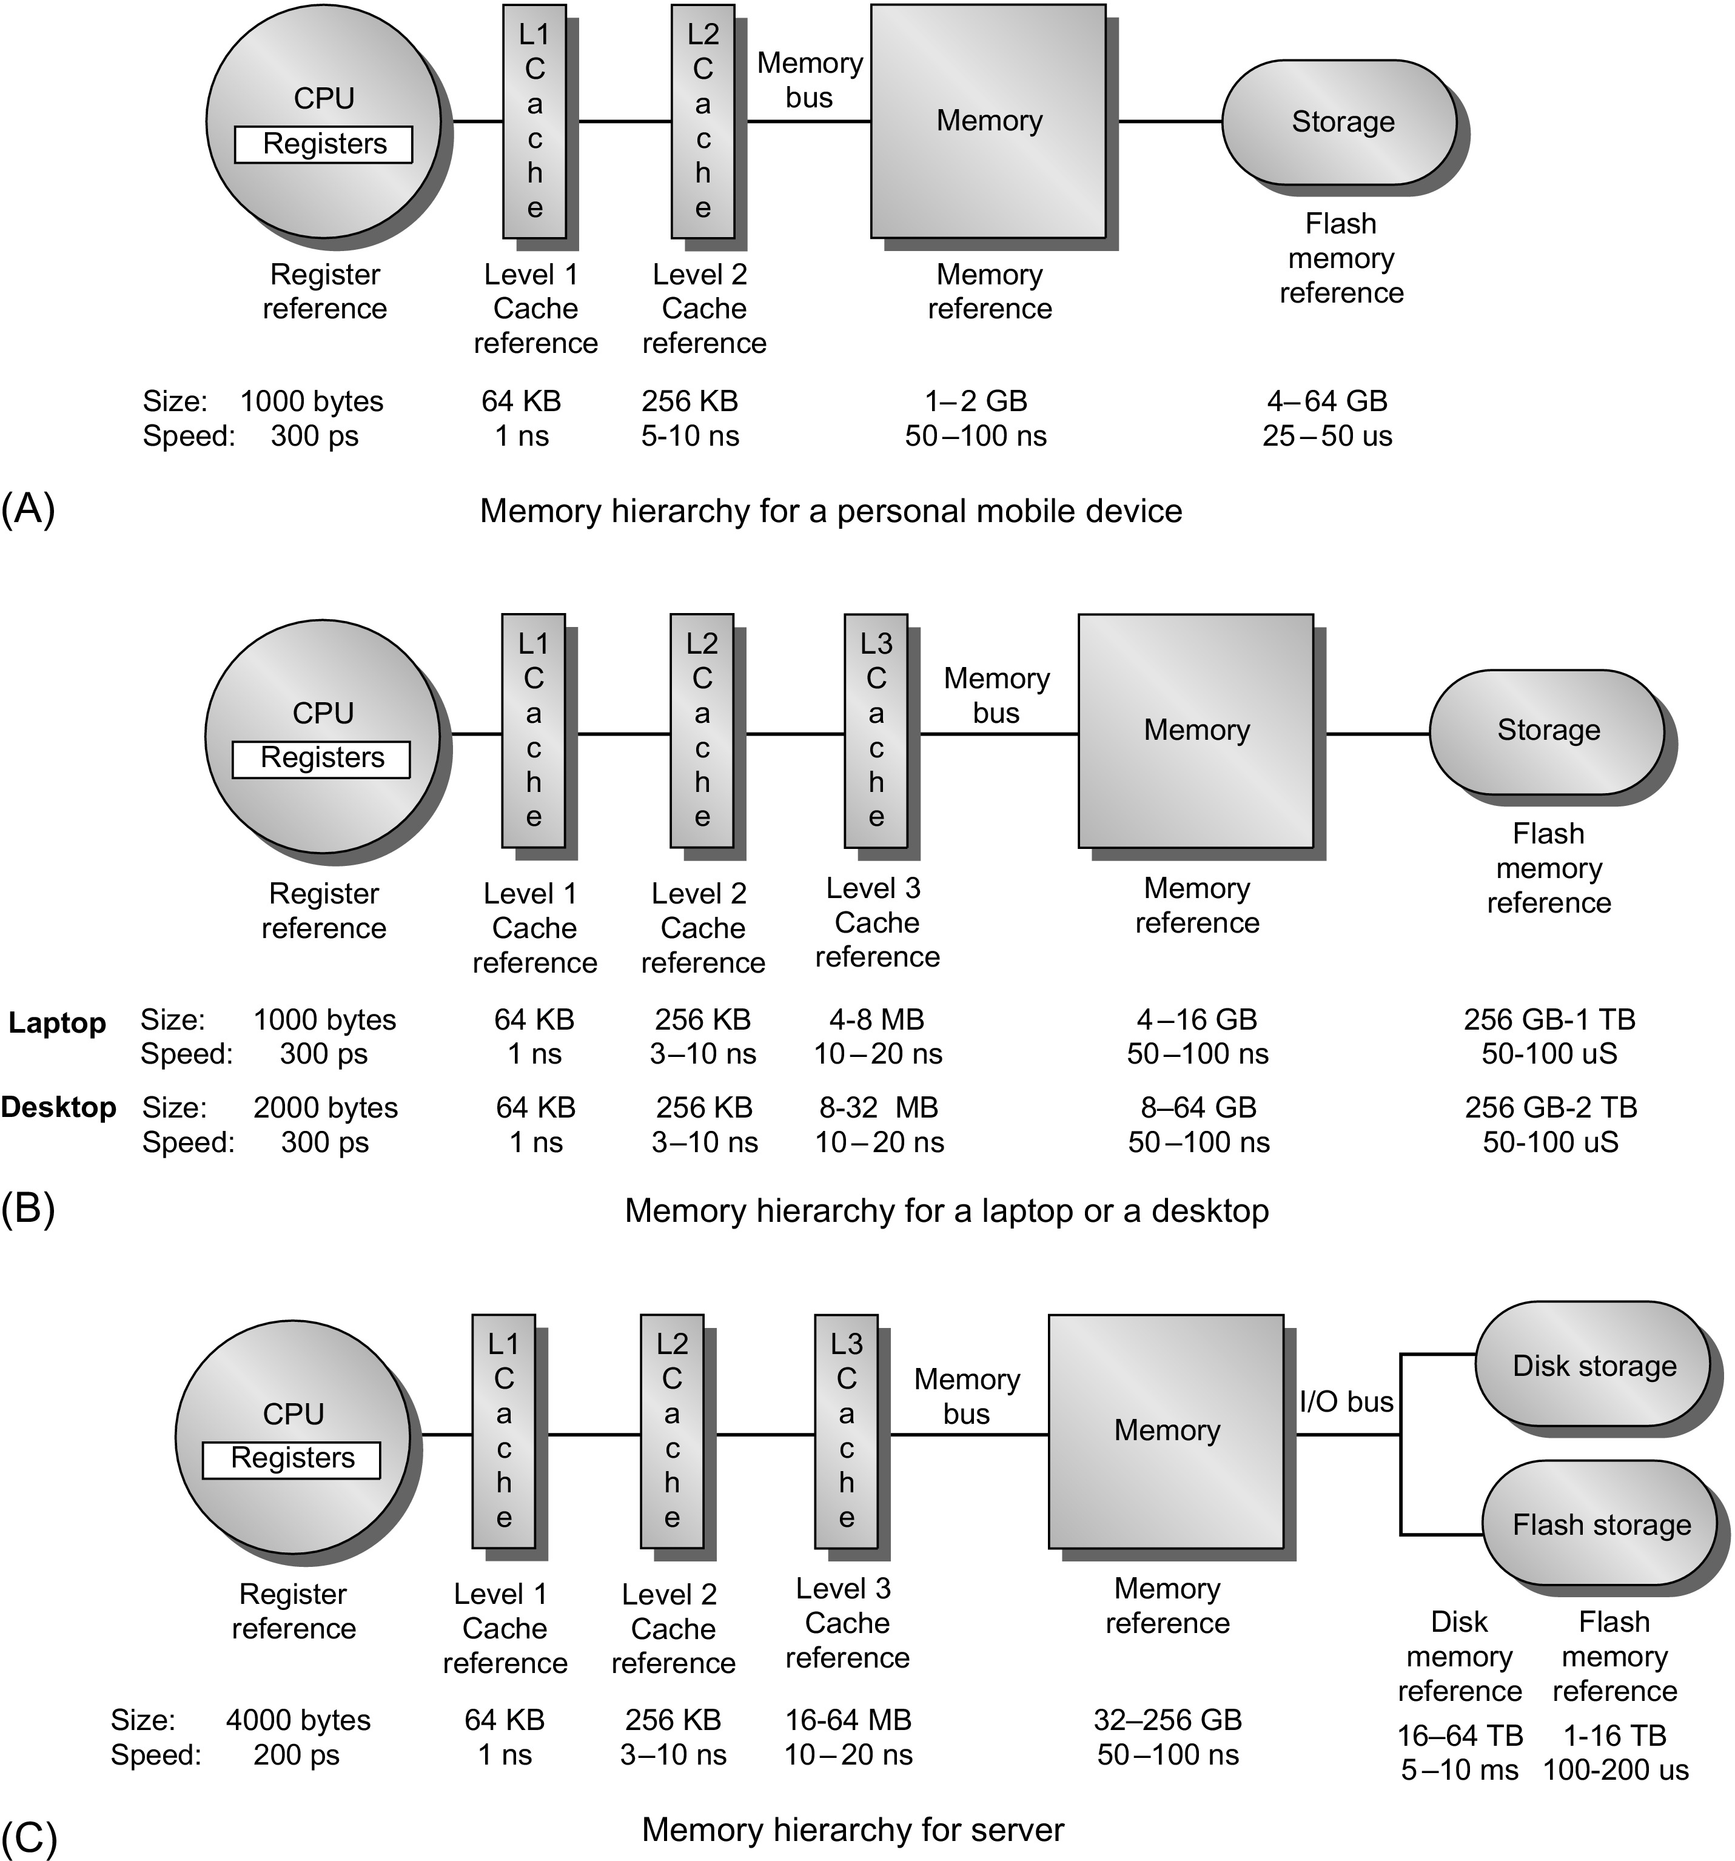
Memory Hierarchy
2.1 Introduction

Slide 11
Energy Consumptions
Song Han, FPGA’17 talk, “Deep Learning – Tutorial and Recent Trends”
2.1 Introduction

Slide 12
Memory Hierarchy Questions
Block placement - where Can a block be placed in the upper level?
Block identification – how to find a block in the upper level?
Block replacement - which block should be replaced on a miss?
Write strategy – how to handle writes?
B.1 Introduction

Slide 13
Basic Cache Organizations

Slide 14
Basics
When a word is found in cache --> cache hit.
When a word is not found in the cache, a miss occurs:
  Fetch word from lower level in hierarchy, requiring a higher latency reference
  Lower level may be another cache or the main memory
  Also fetch the other words contained within the block
    Takes advantage of spatial locality
  Place block into cache in any location within its set, determined by address
word
block
Memory
CPU
Cache
B.1 Introduction

Slide 15
Basics
Inclusive cache
Exclusive cache
L2$
L1$
CPU
L2$
L1$
CPU
B.1 Introduction
Notes:
Inclusive -- miss penalty is less
Exclusive – higher miss penalty, less memory waster

Slide 16
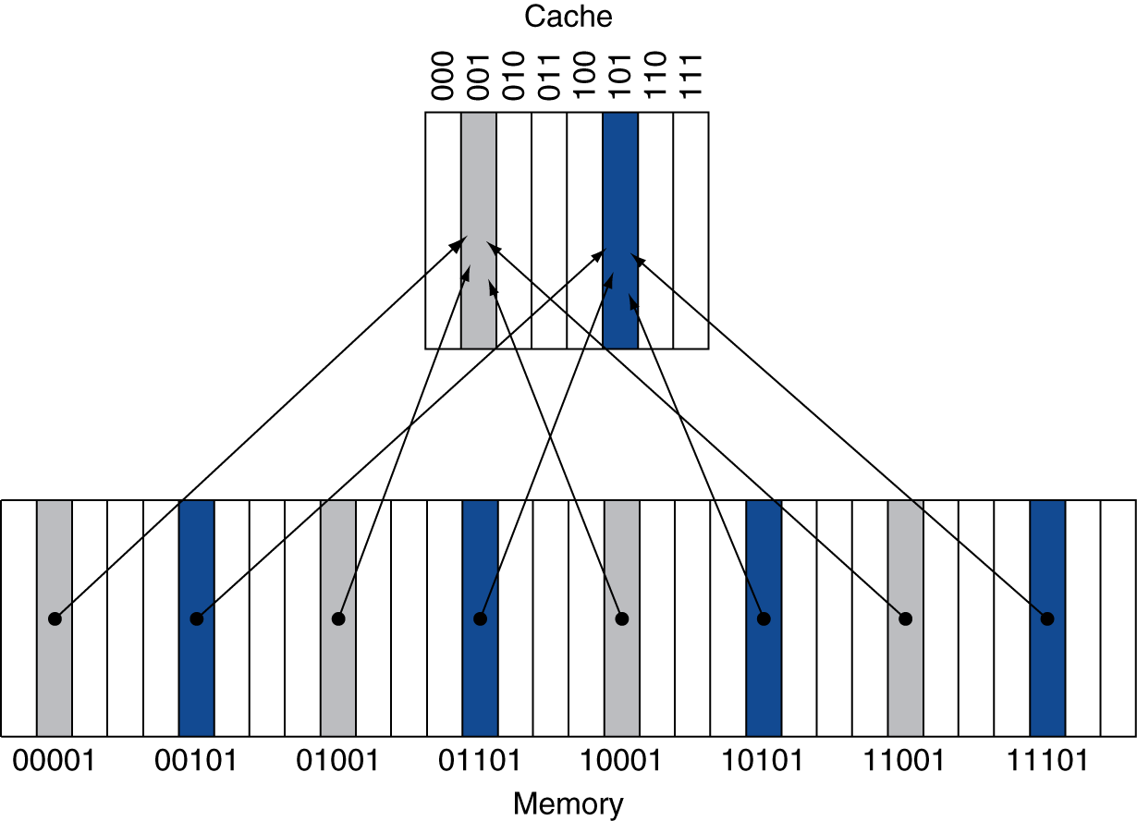
Direct Mapped Cache
Only one choice (Block address) MOD (#Blocks in cache)
#Blocks is a power of 2
Use low-order address bits to access bytes in a block
B.1 Introduction

Slide 17
Tags and Valid Bits
One cache line ←Multiple memory blocks
How do we know which particular memory block is stored in a cache location?
  Store tag as well as the data
  Tag is the high-order bits of a block address
What if there is no data in a location?
  Valid bit: 1 = present, 0 = not present
  Initially 0
B.1 Introduction

Slide 18
Example: Larger Block Size
Cache: 64 blocks, 16 bytes/block
  To what block number does address 1200 (decimal) map?
  Assume 32-bit address
B.1 Introduction

Slide 19
Example: Larger Block Size
Cache: 64 blocks, 16 bytes/block
  To what block number does address 1200 map?
Block address = ⎣1200/16⎦ = 75
Cache block index = 75 modulo 64 = 11
31
10
9
4
3
0
Tag
Index
Offset
22 bits
6 bits
4 bits
B.1 Introduction

Slide 20
Cache Example
8-blocks, 1 word/block, direct mapped
Initial state
Index | V | Tag | Data
000 | 0
001 | 0
010 | 0
011 | 0
100 | 0
101 | 0
110 | 0
111 | 0
Gray area is what’s actually included in cache
B.1 Introduction

Slide 21
Cache Example
Word addr | Binary addr | Hit/miss | Cache block
22 | 10 110 | Miss | 110
Index | V | Tag | Data
000 | 0
001 | 0
010 | 0
011 | 0
100 | 0
101 | 0
110 | 1 | 10 | Mem[10110]
111 | 0
B.1 Introduction

Slide 22
Cache Example
Word addr | Binary addr | Hit/miss | Cache block
26 | 11 010 | Miss | 010
Index | V | Tag | Data
000 | 0
001 | 0
010 | 1 | 11 | Mem[11010]
011 | 0
100 | 0
101 | 0
110 | 1 | 10 | Mem[10110]
111 | 0
B.1 Introduction

Slide 23
Cache Example
Word addr | Binary addr | Hit/miss | Cache block
16 | 10 000 | Miss | 000
3 | 00 011 | Miss | 011
16 | 10 000 | Hit | 000
Index | V | Tag | Data
000 | 1 | 10 | Mem[10000]
001 | 0
010 | 1 | 11 | Mem[11010]
011 | 1 | 00 | Mem[00011]
100 | 0
101 | 0
110 | 1 | 10 | Mem[10110]
111 | 0
B.1 Introduction

Slide 24
Cache Example
Word addr | Binary addr | Hit/miss | Cache block
18 | 10 010 | Miss | 010
Index | V | Tag | Data
000 | 1 | 10 | Mem[10000]
001 | 0
010 | 1 | 10 | Mem[10010]
011 | 1 | 00 | Mem[00011]
100 | 0
101 | 0
110 | 1 | 10 | Mem[10110]
111 | 0
B.1 Introduction

Slide 25
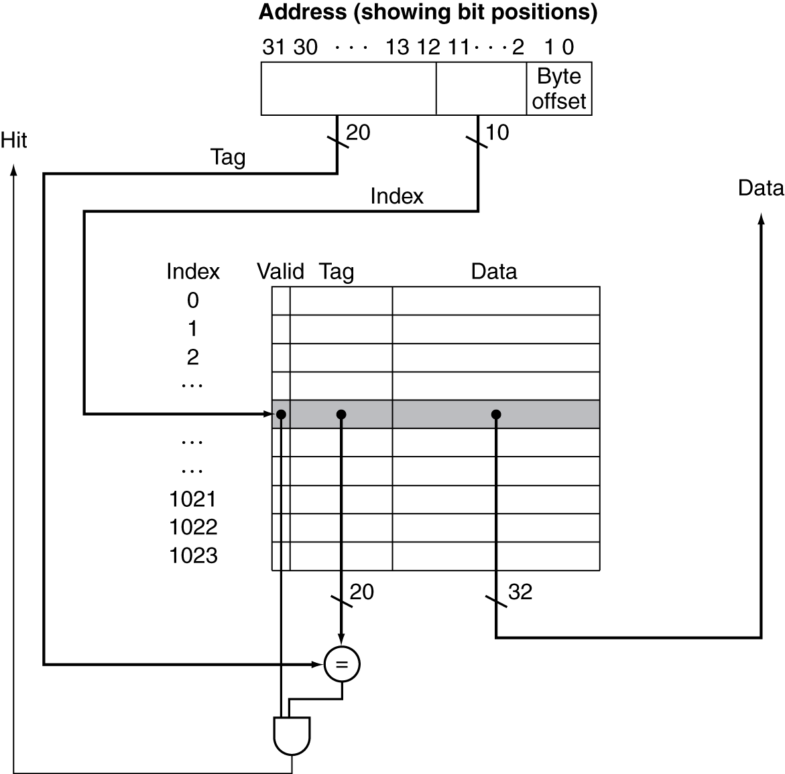
Address Subdivision
B.1 Introduction
Notes:
Operations for cache hit and miss

Slide 26
Cache Misses
On cache hit, CPU proceeds normally
On cache miss
  Stall the CPU
  Fetch a block from next level of mem. hierarchy
  Instruction cache miss
    Restart instruction fetch
  Data cache miss
    Complete data access
Note that speculative and multithreaded processors may execute other instructions during a miss
  Reduces performance impact of misses
B.1 Introduction

Slide 27
Cache Misses
Miss rate
  Fraction of cache access that result in a miss
Miss Penalty – time to access lower level memory
Causes of misses
  Compulsory
    First reference to a block
  Capacity
    Blocks discarded and later retrieved
  Conflict
    Program makes repeated references to multiple addresses from different blocks that map to the same location in the cache
    Only happen in direct-mapped or set associative caches
2.1 Introduction

Slide 28
Measuring Cache Performance
CPU time = (CPU cycles + mem stall cycles) * cycle time
CPU time = (CPU cycles + mem stall cycles) * cycle time
  CPU cycles = instruction cycles + cache hit time
  Memory stall cycles from cache misses
Stall cycles per instruction
B.1 Introduction

Slide 29
Cache Performance – Example
Given
  I-cache miss rate = 2%
  D-cache miss rate = 4%
  Miss penalty = 100 cycles
  Base CPI (ideal cache) = 2
  Load & stores are 36% of instructions
Miss cycles per instruction
  I-cache: 0.02 × 100 = 2
  D-cache: 0.36 × 0.04 × 100 = 1.44
Actual CPI = 2 + 2 + 1.44 = 5.44
  Ideal CPU is 5.44/2 =2.72 times faster
B.1 Introduction
Notes:
What about performance if there is no cache?

Slide 30
Cache Performance - Average Access Time
Hit time is also important for performance
Average memory access time (AMAT)
Example
  CPU with 1ns clock, hit time = 2 cycle, miss penalty = 20 cycles, I-cache miss rate = 5%
  AMAT = 2 + 0.05 × 20 = 3 cycles
AMAT = Hit time + Miss rate × Miss penalty
Question: why not AMAT = hit time * (1-Miss rate) + Miss rate * Miss penalty?
B.2 Cache Performance
Notes:
Time here can be clock cycles or physical time.

Slide 31
Performance Summary
As CPU performance increased
  Miss penalty becomes more significant
Increasing clock rate, and decreasing base CPI
  Memory stalls account for more CPU cycles
  Greater proportion of time spent on memory stalls
Can’t neglect cache behavior when evaluating system performance
  What does Amdahl’s law tell us?
B.2 Cache Performance

Slide 32
Associative Caches
Reduce conflict misses
Fully associative
  Allow a given block to go in any cache entry
  Requires all entries to be searched at once
  Comparator per entry – expensive (area)
n-way set associative
  Each set contains n entries
  Block number determines which set
    (Block address) MOD (#Sets in cache)
  Search all entries in a given set at once
  n comparators (less expensive)
  Direct-mapped = 1-way associative
B.1 Introduction

Slide 33
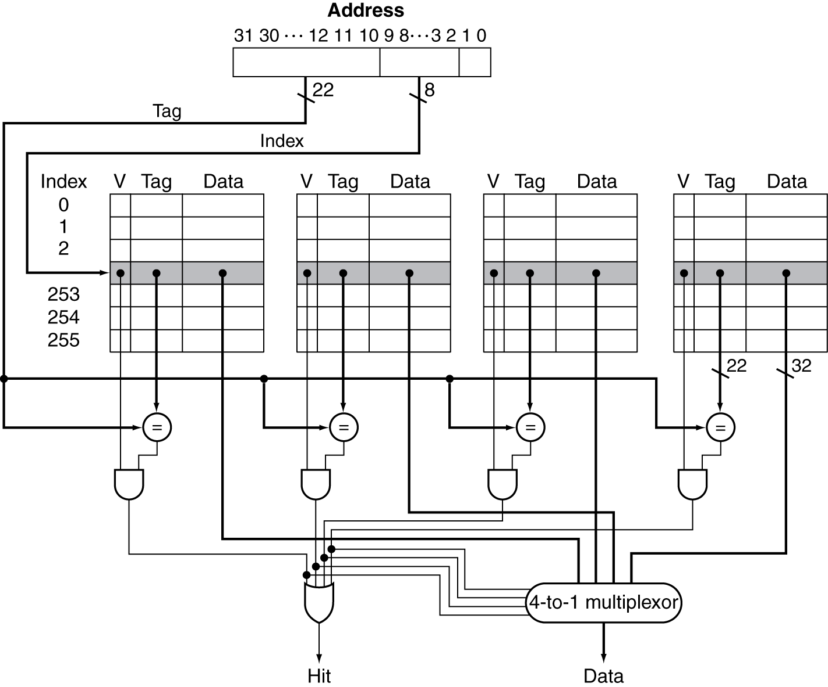
Set Associative Cache Organization

Slide 34
Associative Cache Example
B.1 Introduction

Slide 35
Associativity Example
Compare 4-block caches, block size = 1 byte
  Direct mapped, 2-way set associative, fully associative
  Block access sequence: 0, 8, 0, 6, 8
Direct mapped
Block address | Cache index | Hit/miss | Cache content after access
 |  |  | 0 | 1 | 2 | 3
0 | 0 | miss | Mem[0]
8 | 0 | miss | Mem[8]
0 | 0 | miss | Mem[0]
6 | 2 | miss | Mem[0] |  | Mem[6]
8 | 0 | miss | Mem[8] |  | Mem[6]
5 misses (their types?)
B.1 Introduction
Notes:
What types of misses can be found from the table?

Slide 36
Associativity Example
2-way set associative
Fully associative
Block address | Cache index | Hit/miss | Cache content after access
 |  |  | Set 0 |  | Set 1
0 | 0 | miss | Mem[0]
8 | 0 | miss | Mem[0] | Mem[8]
0 | 0 | hit | Mem[0] | Mem[8]
6 | 0 | miss | Mem[0] | Mem[6]
8 | 0 | miss | Mem[8] | Mem[6]
Block address |  | Hit/miss | Cache content after access
0 |  | miss | Mem[0]
8 |  | miss | Mem[0] | Mem[8]
0 |  | hit | Mem[0] | Mem[8]
6 |  | miss | Mem[0] | Mem[8] | Mem[6]
8 |  | hit | Mem[0] | Mem[8] | Mem[6]
B.1 Introduction

Slide 37
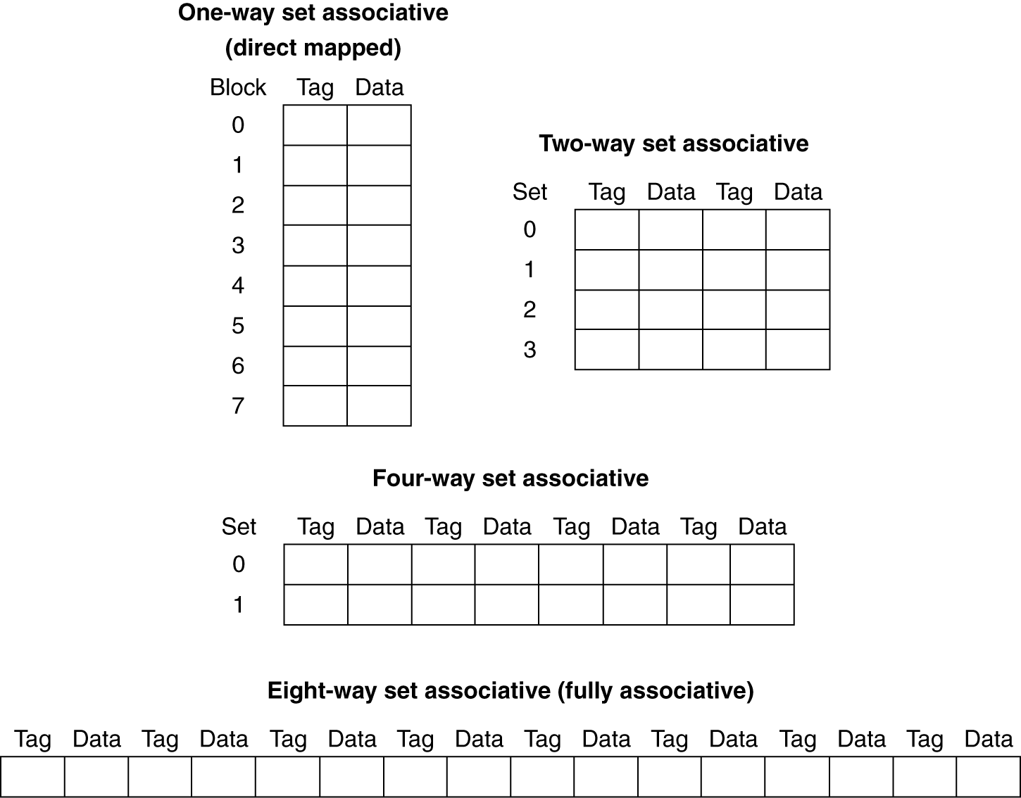
Spectrum of Associativity
For a cache with 8 entries
B.1 Introduction

Slide 38
Size of Tags vs Associativity
Address size = 32 bit
Data/word size = block size = 32 bit
Cache size = 16KB
Direct mapping
  Tag bits = 18x2¹²
  Comparators = 1
4-way set-associative
  Tag bits= 4x2¹⁰x20 = 20x2¹²
  Comparators = 4
Fully associative
  Tag bits = 30x2¹²
  Comparators = 2¹²
31 14
13 2
1 0
31 12
11 2
1 0
31 2
1 0
B.1 Introduction
Notes:
As the associativity increases, the number of tag bits stored in cache also increases
→ large circuit overhead,
→ longer latency,
→ higher energy consumption.

Slide 39
Size of Tags vs Associativity
Increasing associativity requires
  More tag bits per cache block
  More comparators, each of which is more complex
The choice among direct, set-associative and fully-associative mapping in any memory hierarchy will depend on
  Miss penalty vs cost of implementing associativity, both in time and in extra hardware
B.1 Introduction

Slide 40
Replacement Policy
Direct mapped: no choice
Set associative
  Prefer non-valid entry, if there is one
  Otherwise, choose among entries in the set
Least-recently used (LRU)
  Choose the one unused for the longest time
    Simple for 2-way, manageable for 4-way, too hard otherwise
    FIFO approximates LRU – replace the oldest block
Random
  Gives approximately the same performance as LRU for high associativity
B.1 Introduction

Slide 41
Write Policy – Write-Through
Update cache and memory
Easier to implement
Writes take longer – wait for mem update to complete
  e.g., if base CPI = 1, 10% of instructions are stores, write to memory takes 100 cycles
    Effective CPI = 1 + 0.1×100 = 11
Solution: write buffer
  Holds data waiting to be written to memory
  CPU continues immediately
    Only stalls on write if write buffer is already full
  Write buffer is freed when a write to memory is finished
B.1 Introduction

Slide 42
Write Policy – Write-Back
Just update the block in cache
  Keep track of whether each block is dirty - dirty bits
  Cache and memory would be inconsistent
When a dirty block is replaced
  Write it back to memory
Write speed is faster
  One low-level memory update for multiple cache writes.
  Power saving.
Write buffer can also be used
B.1 Introduction

Slide 43
Write Allocation
What should happen on a write miss?
  Write allocate
  No write allocate
Alternatives for write-through
  Allocate on miss: fetch the block
  Write around (no-write allocate): don’t fetch the block
For write-back
  Usually fetch the block
  Act like read misses
B.1 Introduction

Slide 44
Write Miss Policies – Example
write M[100]
write M[100]
read M[200]
write M[200]
write M[100]
Assume fully associative write-back cache
Number of misses if the following write policy is used.
  No-write-allocate
  Write-allocate
B.1 Introduction

Slide 45
Cache Performance – Example
Perfect CPI = 1,
cycle time = 0.35ns
Hit time(DM) = 1 cycle
Miss rate (DM) = 0.021
Hit time (2-way) = 1.35 cycles
Miss rate (2-way) = 0.019
Miss penalty = 65 ns
Avg mem. req/inst = 1.4
Which cache is faster?
B.1 Introduction
Notes:
amat is an indirect measure of system performance.
A better measure is CPU time considering memory stall cycles due to cache misses.

Slide 46
Cache Performance – Exercise
Perfect CPI = 1,
cycle time = 0.35ns
Hit time(DM) = 1 cycle
Miss rate (DM) = 0.021
Hit time (2-way) = 1.35 cycles
Miss rate (2-way) = 0.019
Miss penalty = 52 ns
Avg mem. req/inst = 1.4
Which cache is faster?
B.1 Introduction
Notes:
amat is an indirect measure of system performance.
A better measure is CPU time considering memory stall cycles due to cache misses.

Slide 47
Basic Cache Optimizations

Slide 48
Cache Performance – Review
Any optimization should consider its impact on all three factors
Hit time
Miss rate
Miss penalty
B.1 Introduction
Notes:
optimizing one parameter often has conflicting effects on the others.

Slide 49
Six Basic Cache Optimizations
Larger block size
  Reduces compulsory misses
  Increases capacity and conflict misses, increases miss penalty
Larger total cache capacity to reduce miss rate
  Increases hit time, increases power consumption
Higher associativity
  Reduces conflict misses
  Increases hit time, increases power consumption
Multi-level cache to reduce miss penalty
  Reduces overall memory access time
Giving priority to read misses over writes
  Reduces miss penalty
Avoiding address translation in cache indexing
  Reduces hit time
B.3 Six Basic Cache Optimizations

Slide 50
Optimization 1 – Larger Block Size
Reduce compulsory misses due to spatial locality
May increase conflict/capacity misses
Increase miss penalty
cache size
B.3 Six Basic Cache Optimizations

Slide 51
Optimization 1 – Larger Block Size
Reduce compulsory misses due to spatial locality
May increase conflict/capacity misses
Increase miss penalty
AMAT
B.3 Six Basic Cache Optimizations
Notes:
miss penalty depend on low-level mem.
high-latency high-BW -> larger block size

Slide 52
Optimization 1 – Block Size Selection
Determined by lower level memory
High latency and high bandwidth – larger block size
Low latency and low bandwidth – smaller block size
B.3 Six Basic Cache Optimizations

Slide 53
Optimization 2 – Larger Cache
Reduce capacity misses
Increases hit time
Increases power consumption
B.3 Six Basic Cache Optimizations

Slide 54
Optimization 3 – Higher Associativity
Reduces conflict misses
Increases hit time
Increases power consumption
AMAT
B.3 Six Basic Cache Optimizations
Notes:
8-way works effectively as fully associative!

Slide 55
Optimization 3 – Higher Associativity
Higher Associativity --> higher hit time
Larger miss penalty rewards higher associativity
Example:
Assume 4KB cache
AMAT(1-way) = 1 + 0.025 * miss penalty
AMAT(2-way) = 1.36 + 0.016 * miss penalty
Consider
1. miss penalty = 25 cycles
2. miss penalty = 100 cycles
B.3 Six Basic Cache Optimizations
Notes:
Case 1: amat_1w = 1.625, amat_2w = 1.36 + 0.4 = 1.76
Case 2: amat_1w = 3.5, amat_2w = 1.36 + 1.6 = 2.96

Slide 56
Optimization 4 – Multilevel Cache
L1 cache – small to keep hit time fast
L2 cache – capture as many L1 misses & lower miss penalty
Local miss rates – L1/L2 miss rates
Global miss rates – miss rate(L1) * miss rate(L2)
AMAT = hit(L1) + miss rate(L1) * miss penalty(L1)
  miss penalty(L1) = hit(L2) + miss rate(L2) * miss penalty(L2)
Mem Stall cycles/inst = miss/inst(L1) * hit(L2) +
misses/inst(L2) * miss penalty(L2)
B.3 Six Basic Cache Optimizations

Slide 57
Optimization 4 – Multilevel Cache
1000 mem accesses -> L1 misses = 40, L2 misses = 20
Q1: Local/global miss rates?
Hit(L1) = 1 cycle
Miss penalty(L2) = 200 cycles,
Hit(L2) = 10 cycles
Avg mem/inst = 1.5
Q2: AMAT?
Q3: Avg stalls/inst?
B.3 Six Basic Cache Optimizations

Slide 58
Optimization 4 – Multilevel Cache
L1 hit time affects CPU speed
  Prefers small and fast L1
Speed of L2 affects L1 miss penalty
  Prefers large L2 with higher associativity
  A little reduction in miss rate → big impacts on L2 speed due to large L2 miss penalty
See example in the book for the impact of higher associativity on miss penalty
B.3 Six Basic Cache Optimizations

Slide 59
Optimization 4 – Multilevel Cache
Impact of L2 cache size on execution speed
B.3 Six Basic Cache Optimizations

Slide 60
Optimization 5 – Giving Priority to Read Misses over Writes
Reduces miss penalty. See example below.
Write-through cache with write buffers suffers from RAW conflicts with main memory reads on cache misses:
  Write buffer holds updated data needed for the read.
  Alt #1 – wait for the write buffer to empty, increasing read miss penalty (in old MIPS 1000 by 50% ).
  Alt #2 – Check write buffer contents before a read; if no conflicts, let the memory read go first.
B.3 Six Basic Cache Optimizations
Notes:
. Mem read accesses happen more frequent than writes.
. Amdahl law says we should focus on optimizing common cases.

Slide 61
Optimization 5 – Giving Priority to Read Misses over Writes
Reduces miss penalty. See example below.
In a write-back cache, suppose a read miss causes a dirty block to be replaced
  Alt #1 – write the dirty block to memory first, then read memory.
  Alt #2 – copy the dirty block to a write buffer, read the new block, then write the dirty to memory.
B.3 Six Basic Cache Optimizations

Slide 62
Optimization 6 – Avoid Address Translation during Cache Indexing to Reduce Hit Time
CPU
word
Cache
block
Memory
page
Hard Disk
B.3 Six Basic Cache Optimizations
Notes:
when processor runs, programs or data that it requests may be in memory or hard disk.

Slide 63
Optimization 6 – Avoid Address Translation during Cache Indexing to Reduce Hit Time
CPU
CPU
CPU
Virtual address
(VA)
offset
VA
VA
TLB
Cache
TLB
L1 Cache
PA
VA
PA
Tag
=
Cache
TLB
L2 Cache
Hit?
PA
PA
PA
Mem
Mem
Mem
Conventional organization
Virtually addressed cache
Virtually addressed physically tagged
B.3 Six Basic Cache Optimizations
Notes:
virtual caches lead to a number of complications as explained in the book.

Slide 64
Optimization 6 – Avoid Address Translation during Cache Indexing to Reduce Hit Time
Cache size limited by the page size.
Increase size by higher associativity.
B.3 Six Basic Cache Optimizations

Slide 65
Advanced Cache Optimizations

Slide 66
Basic Ideas
Reduce hit time, miss rate, and miss penalty
Increase cache bandwidth
Reduce miss rate/penalty via parallelism
2.3 Advanced Cache Optimizations

Slide 67
Opt 1 – Small and Simple L1 Caches
Critical timing path in cache hit:
  addressing tag memory, then
  comparing tags, then
  selecting correct block
Direct-mapped caches can overlap tag comparison and transmission of data
Lower associativity reduces power because fewer cache lines are accessed. However,
  Associativity used to increase size of virtually indexed cache
  Higher associativity reduces conflict misses due to multithreading
2.3 Advanced Cache Optimizations

Slide 68
Opt 1 – L1 Size and Associativity
Access time increases as size & associativity increases
2.3 Advanced Cache Optimizations

Slide 69
Opt 1 – L1 Size and Associativity
Energy per read increases as size & associativity increases
2.3 Advanced Cache Optimizations
Notes:
- Increase associativity -> higher energy consumption
- Avoid 8-way associativity cache due to large jump in energy consumption
+ Higher associativity needed for larger L1 cache if virtually indexed physical tagger cache is used to avoid translation.
+ higher associativity -> reduced miss rate for multithreading

Slide 70
Opt 2 – Way Prediction
Way prediction set them before tag comparison is done.
2.3 Advanced Cache Optimizations

Slide 71
Opt 2 – Way Prediction
tag
2-bit index
offset
2-bit
Way
Predictor
2-bit
=
=
=
=
<<
=
data
hit
2.3 Advanced Cache Optimizations

Slide 72
Opt 2 – Way Prediction
Low order tag bits → prediction
  Predicts the next block to be accessed – what locality?
  Multiplexer could be set early to select the predicted block, only a single tag comparison
  A miss results in checking the other blocks
Prediction accuracy
  > 90% for two-way
  > 80% for four-way
  I-cache has better accuracy than D-cache
  First used on MIPS R10000 in mid-90s
Extend to decide which block to access using way selection
  Intends to save power consumption.
  Increases mis-prediction penalty
2.3 Advanced Cache Optimizations

Slide 73
Opt 3 – Pipelining Cache
Pipeline cache access to improve bandwidth
  Faster clock cycle, but slow hit time
  Cache hit handled in multiple cycles
  Examples – hit time in cycles
    Pentium: 1 cycle
    Pentium Pro – Pentium III: 2 cycles
    Pentium 4 – Core i7: 4 cycles
Increases branch mis-prediction penalty
Makes it easier to increase associativity
  In associative cache, tag compare and data output are serialized
2.3 Advanced Cache Optimizations

Slide 74
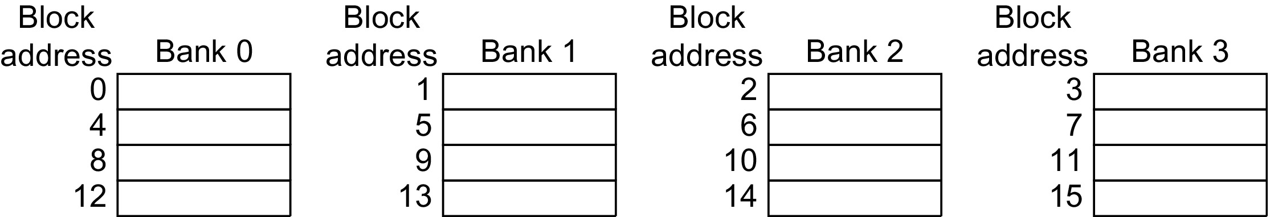
Opt 3 – Multibanked Caches
Organize cache as independent banks to support simultaneous access
  ARM Cortex-A8 supports 1-4 banks for L2
  Intel i7 supports 4 banks for L1 and 8 banks for L2
Interleave banks according to block address
  Mapping banks by index mod #banks
Figure 2.10 Four-way interleaved cache banks using block addressing. Assuming 64 bytes per block, each of these addresses would be multiplied by 64 to get byte addressing.
2.3 Advanced Cache Optimizations
Notes:
bank # = index mod #banks eg. index = 10, #banks = 4, so bank # = 10 mod 4 = 2.

Slide 75
Opt 4 – Nonblocking Caches
Allow data cache to service hits during a miss
  Reduces effective miss penalty
  “Hit under miss”
  Extended to “Hit under multiple miss”
  L2 must support this
2.3 Advanced Cache Optimizations
Notes:
Evaluation of CPU performance becomes more complicated as the miss penalty is harder to computer for individual misses as misses and hits can overlap.
It also depends on the number of instructions CPU can execute before it must stall waiting for a previous miss to resolve.

Slide 76
Opt 5 – Critical Word First, Early Restart
Processor needs one word in a block
Critical word first
  Request missed word from memory first
  Send it to the processor as soon as it arrives
Early restart
  Fetch the block in normal order
  Send missed word to the processor as soon as it arrives
Effectiveness of these strategies depends on block size and likelihood of another access to the portion of the block that has not yet been fetched
  More benefits if block size is larger
2.3 Advanced Cache Optimizations
Notes:
what cache performance factor does it optimize?

Slide 77
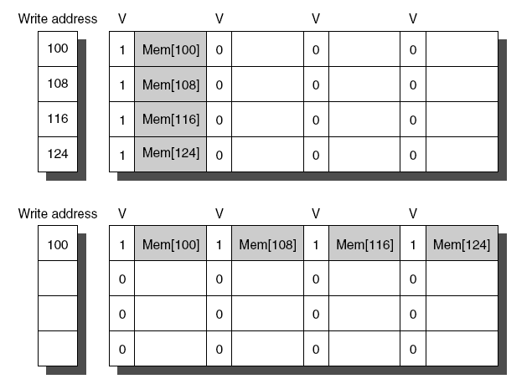
Opt 6 – Merging Write Buffer
When storing to a block that is already pending in the write buffer, update write buffer
Reduces stalls due to full write buffer
Do not apply to I/O addresses
w/o write merging
w write merging
2.3 Advanced Cache Optimizations

Slide 78
Victim Buffer
A small fully associative cache between L1 and L2
  Shared by all sets in L1
Reduce conflict misses
On L1 miss, check VB.
  Hit -> place block back in L1
Very effective in practice
L1
VB
L2

Slide 79
Opt 7 – Compiler Optimizations
Gap between CPU and memory requires SW developer to look at memory hierarchy
/* before */
for (j=0; j < 100; j++)
for (i=0; i < 100; i++)
x[i][j] = 2*x[i][j];
2.3 Advanced Cache Optimizations
Notes:
Increasing perf. gap between proc. and mem requires SW developers to pay attention to mem hierarchy

Slide 80
Opt 7 – Compiler Optimizations
Loop Interchange
  Swap nested loops to access memory in sequential order
  Expose spatial locality
/* after*/
for (i=0; i < 100; i++)
for (j=0; j < 100; j++)
x[i][j] = 2*x[i][j];
2.3 Advanced Cache Optimizations
Notes:
Increasing perf. gap between proc. and mem requires SW developers to pay attention to mem hierarchy

Slide 81
Opt 7 – Compiler Optimizations
Blocking
  Instead of accessing entire rows or columns, subdivide matrices into blocks
  Requires more memory accesses but improves temporal locality of accesses
2.3 Advanced Cache Optimizations
Notes:
Increasing perf. gap between proc. and mem requires SW developers to pay attention to mem hierarchy

Slide 82
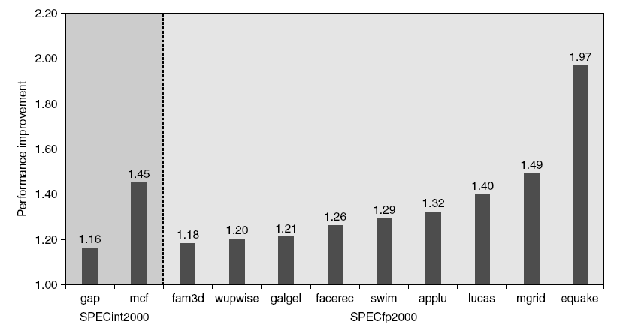
Opt 8 – Hardware Prefetching
Fetch two blocks on miss (include next sequential block)
Can hurt power if prefetched data are not used.
Some results obtained on Pentium 4 w. Pre-fetching
2.3 Advanced Cache Optimizations
Notes:
prefetched blocks are placed in stream buffer.
Prefetching improves performance by reducing miss penalty

Slide 83
Cache - Summary
A small and fast buffer between CPU and main memory
Direct mapped cache
  shorter hit time, higher miss rate, lower power consumption
Associative cache
  longer hit time, lower miss rate, higher power consumption
Performance evaluation
  AMAT – average memory access time: maybe misleading
  CPI with stall cycles due to cache misses: more accurate
2.3 Advanced Cache Optimizations

Slide 84
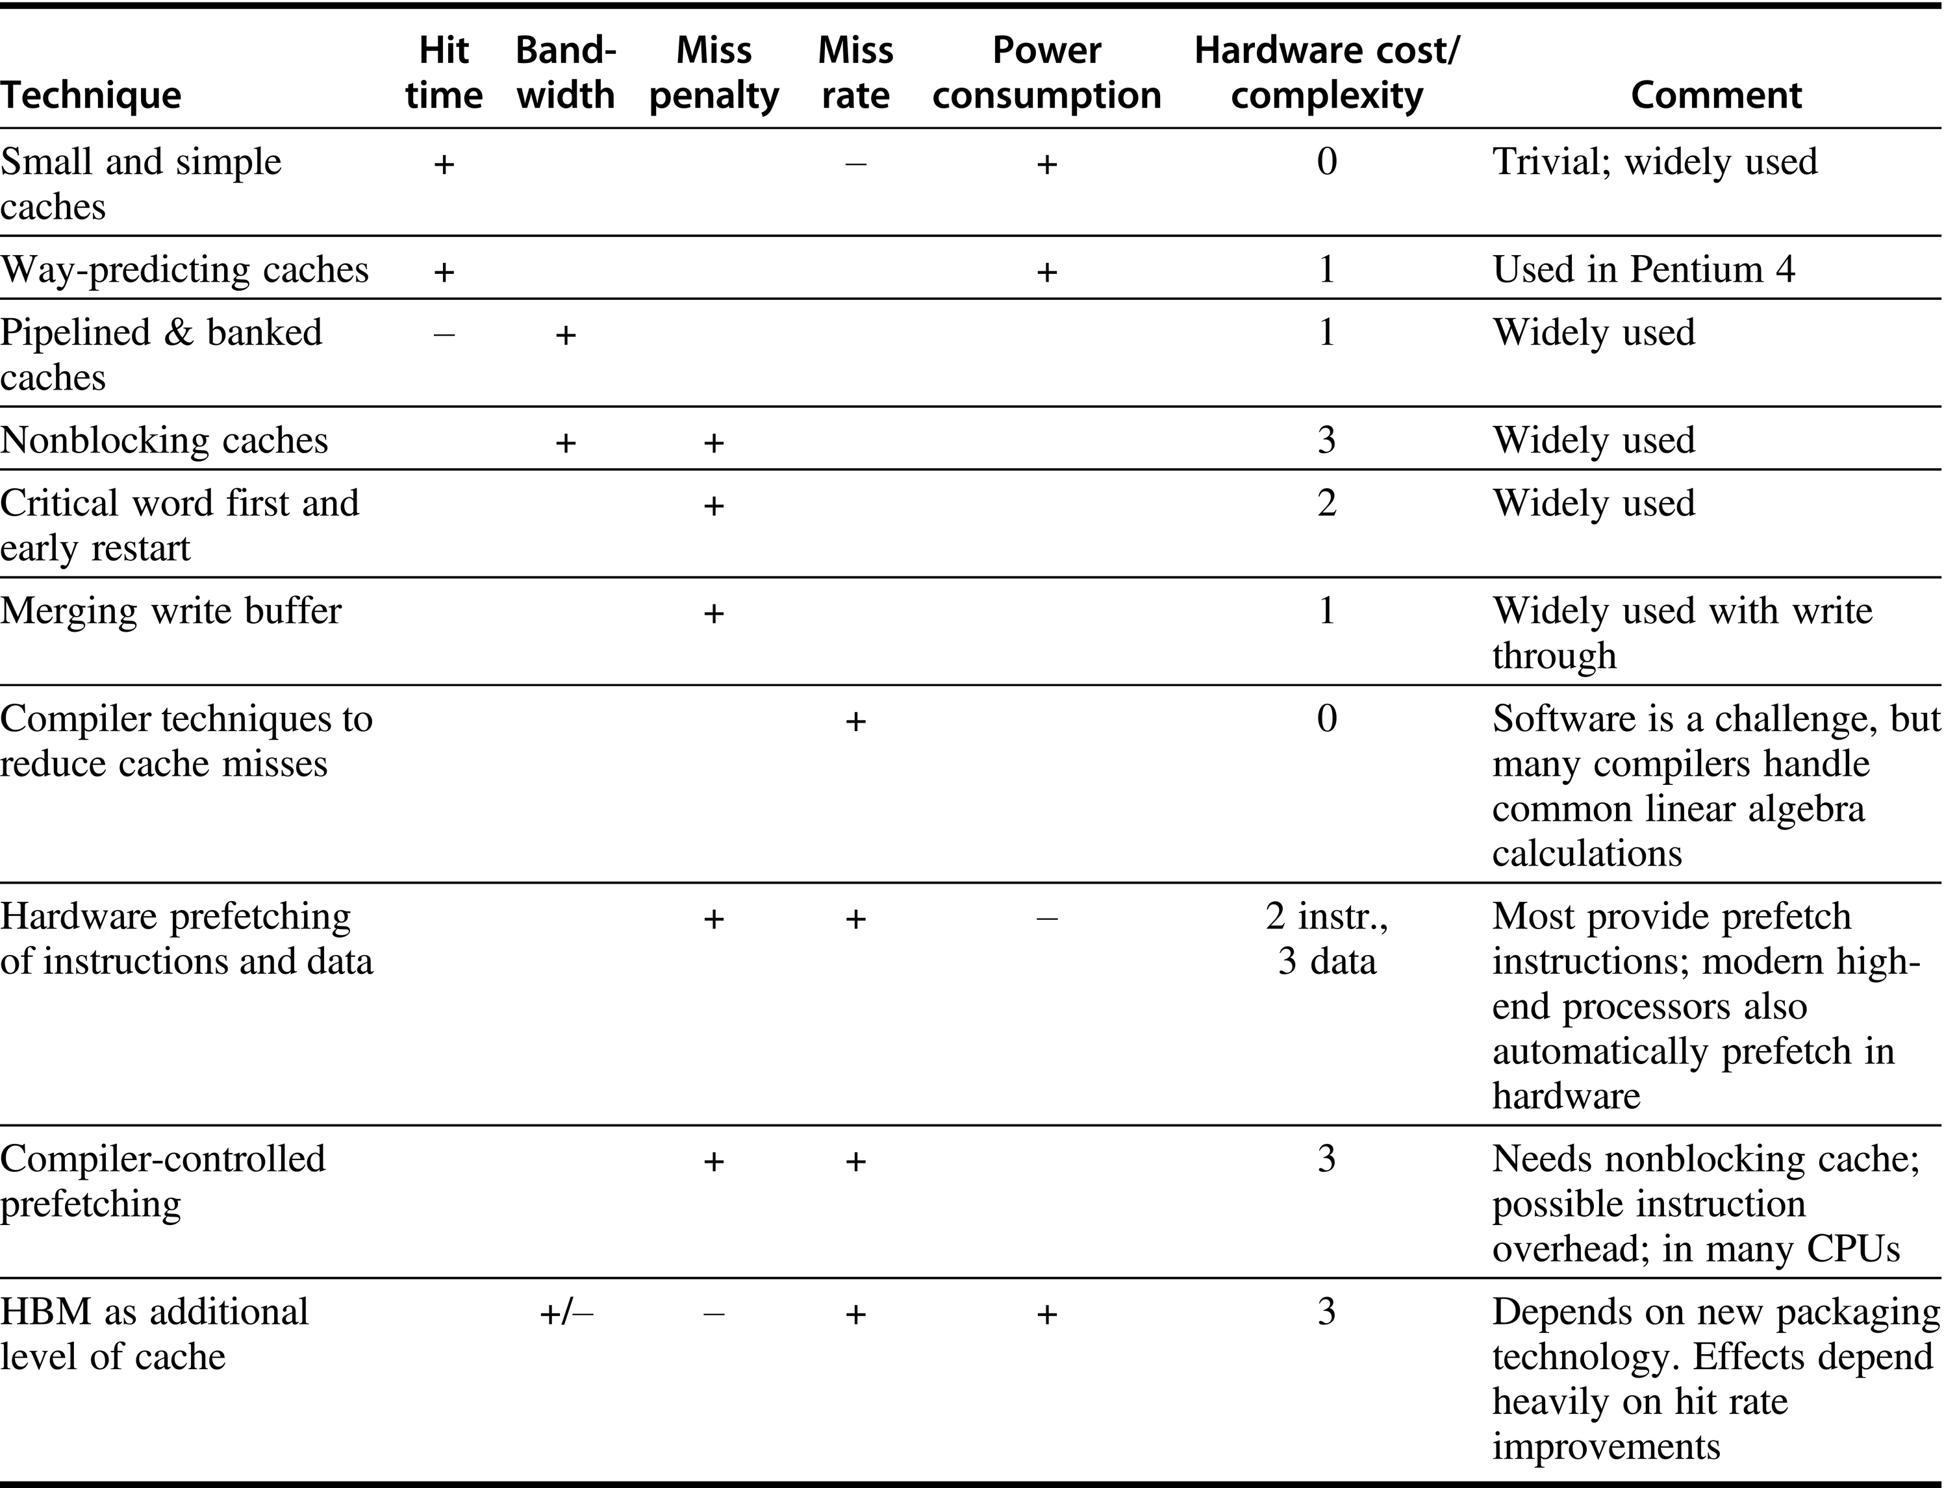

Slide 85
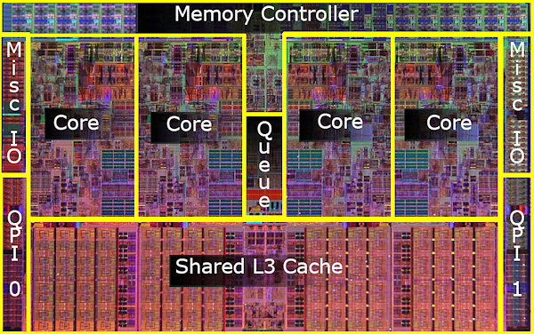
Example: Intel Core I7 Cache
L2
L1 I$ - 32 KB, L1 D$ - 32KB 8-way set associative, private
L2 – 256 KB, 8-way set associative, private
L3 – 8 MB, 16-way set associative, shared
Notes:
Pentium 4: 512 KB L2 cache, no L3.
High associativity in i7 is for multithreading, also pipelined cache reduces impact of high associativity

Slide 86
Virtual Memory

Slide 87
Why Virtual Memory
Limited physical memory leads to complications
Size of a program is larger than main memory size
Memory demand of multiple programs is larger than main memory size
Observation: a program often needs to small part of memory during its execution
  Load what is needed into main memory!
B.4 Virtual Memory
Notes:
IBM PC at 1980s only came with 64KB main memory.

Slide 88
Why Virtual Memory
Programs were divided into pieces and identified pieces that are mutually exclusive
These pieces were loaded and unloaded under user program control during execution
Calls between procedures in different modules lead to overlaying of one module with the other
Used to be done by hand
  Significant burden on programmers
B.4 Virtual Memory

Slide 89
Basics of Virtual Memory
Programs use virtual addresses (VA)
Memory uses physical addresses (PA)
VA -> PA at the page granularity
  pages can be anywhere in memory
  or in disk
OS
App1
App2
…
…
…
Disk
B.4 Virtual Memory

Slide 90
Basics of Virtual Memory
Use physical DRAM as cache for disk
  Address space of a process can exceed physical memory size
  Sum of address spaces of multiple processes can exceed physical memory
Simplify memory management
  Multiple processes resident in main memory
    Each process with its own address space
  Only “active” code and data is actually in memory
    Allocate more memory to process as needed
Provide protection
  One process can’t interfere with another
    Because they operate in different address spaces
  User process cannot access privileged information
    Different sections of address space have different permissions
B.4 Virtual Memory

Slide 91
Basic Issues
Shares same basic concepts of cache memory but different terminology
Issues
  Mapping: translation of virtual to physical address
  Management: controlled sharing and protection. Protection in multi-programming environment
Mapping techniques
  Paging (demand paging)
  Segmentation
B.4 Virtual Memory

Slide 92
A Simplified View of Virtual Memory
Memory
0:
Page Table
1:
Virtual
Addresses
Physical
Addresses
0:
1:
CPU
P-1:
N-1:
Disk
B.4 Virtual Memory
Notes:
page/segment is the base unit of data transferred between memory and disk

Slide 93
Cache vs Virtual Memory
B.4 Virtual Memory
Notes:
Note that miss penalty of VM is much larger than that of cache.
Note that in virtual memory, access time is much higher than transfer time

Slide 94
Cache vs Virtual Memory
Terminology
  Block → page
  Cache miss → page fault
Replacement on cache memory misses by hardware whereas virtual memory replacement is by OS
Size of processor address determines size of VM whereas cache size is independent of address size
VM can have fixed or variable size blocks
  page vs segmentation: they both have pros and cons
B.4 Virtual Memory

Slide 95
Virtual Memory Design Issues
Page size should be large enough to try to amortize high access time
  Typical size: 4KB – 16KB
Reducing page fault rate is important
  Fully associative placement of pages in memory
Page faults not handled by hardware
  OS can afford to use clever algorithm for page replacement to reduce page fault rate
Write through approach is too expensive
  Write back approach is always used
B.4 Virtual Memory
Notes:
note that disk access time is much higher than transfer time -> large page size.
But large page size can lead to waste of memory.

Slide 96
Virtual Memory Address Translation
From CPU
n–1
p
p–1
0
virtual address
virtual page number
page offset
Address Translation
m–1
p
p–1
0
physical address
physical page number
page offset
To memory
B.4 Virtual Memory
Notes:
size of page offset is determined by page size

Slide 97
Address Translation
page table base register
virtual address
n–1
p
p–1
0
virtual page number (VPN)
page offset
valid
access
physical page number (PPN)
if valid=0 then page is not in memory
m–1
p
p–1
0
physical page number (PPN)
page offset
physical address
Each process has its own page table.
B.4 Virtual Memory

Slide 98
Address Translation - Example
Page Table base register
0xFFFF87F8
Virtual Page Number
Page Offset
1111 1111 1010 1000
1010 1111 1101 1100
0
…
…
…
1111 1010 1111
1111 1111 1111 1111
…
Physical Address:
1111 1010 1111
1010 1111 1101 1100
Physical Page Number
Page Offset
B.4 Virtual Memory

Slide 99
Page Faults
What if object is on disk rather than in memory?
  Page table entry indicates virtual address not in memory
  OS exception handler invoked to move data from disk into memory
  Current process suspends, others can resume
    OS has full control over placement, etc.
Before fault
After fault
Memory
Memory
Page Table
Virtual
Addresses
Physical
Addresses
Page Table
Virtual
Addresses
Physical
Addresses
CPU
CPU
Disk
B.4 Virtual Memory
Disk

Slide 100
Servicing Page Faults
(1) Initiate Block Read
Processor signals controller
  Read block of length P starting at disk address X and store starting at memory address Y
Read occurs
  Direct Memory Access (DMA)
  Under control of I/O controller
I/O controller signals completion
  Interrupt processor
  OS resumes suspended process
Processor
Reg
(3) Read Done
Cache
Memory-I/O bus
(2) DMA Transfer
I/O
controller
Memory
disk
disk
Disk
Disk
B.4 Virtual Memory
Notes:
More on this in OS course.

Slide 101
Page Replacement
When there are no available free pages to handle a fault we must find a page to replace.
This is determined by the page replacement algorithm.
The goal of the replacement algorithm is to reduce the fault rate by selecting the best victim page to remove.
  Again, due to high access latency to disk
LRU is the most popular replacement policy.
  Each page is associated with a use/reference bit.
  It is set whenever a page is accessed.
  OS periodically clears these bits.
B.4 Virtual Memory

Slide 102
Fast Address Translation – TLB
tags from VAs
Physical page number
B.4 Virtual Memory
Notes:
Virtually addressed physically tagged L1 cache – parallel TLB and L1 access.
Explain what happens on TLB misses, L1/L2 misses.

Slide 103
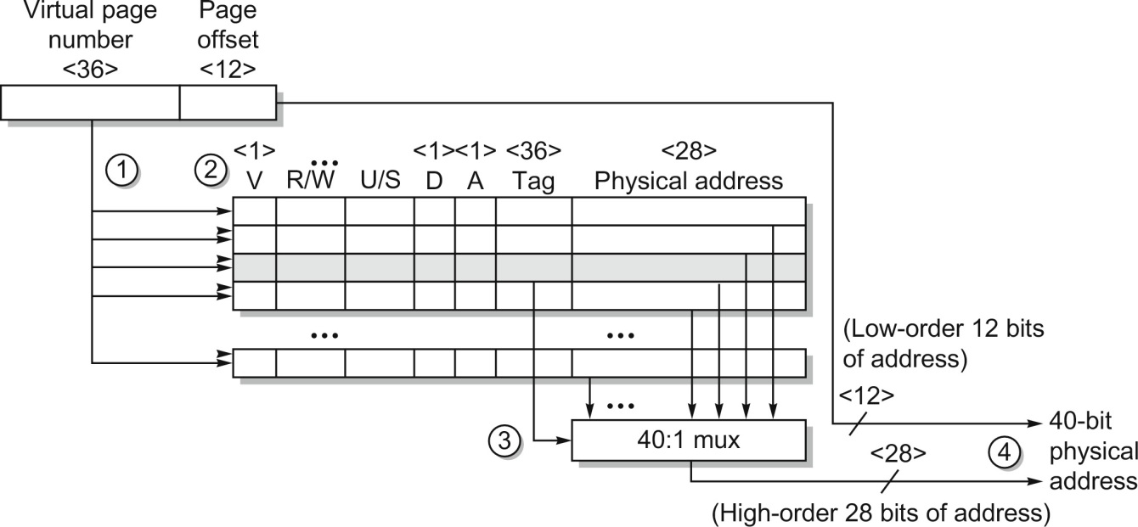
TLB in AMD Opteron
Figure B.24 Operation of the Opteron data TLB during address translation. The four steps of a TLB hit are shown as circled numbers. This TLB has 40 entries. Section B.5 describes the various protection and access fields of an Opteron page table entry.
B.4 Virtual Memory
Notes:
Virtually addressed physically tagged L1 cache – parallel TLB and L1 access.
Explain what happens on TLB misses, L1/L2 misses.

Slide 104
Question: Page size and Page Table Size
Assume 32-bit virtual address
  Page table size if page size is 4K?
  Page table size if page size is 16K?
What about 64-bit virtual address?
B.4 Virtual Memory

Slide 105
Multi-Level Page Table
Virtual address
Higher level PTEs point to lower level tables
PTEs at bottom level hold PPN
Different parts of VAs used to index tables at different levels

Slide 106
Multi-Level Page Table
Virtual address
Large VA space is unused
If a entry in level L is null, the table in level L+1 is not created.

Slide 107
Selecting Page Size
The larger the page size, the smaller page table
  A page table can occupy a lot of space
Larger page size -> larger L1 cache
Larger page size -> less TLB misses, faster xlation
More efficient to transfer larger pages from 2nd storage
Large page size
  Wasted memory usage
  Wasted IO bandwidth
  Slower process start up
B.4 Virtual Memory

Slide 108
Virtual Memory – Protection
Virtual memory and multiprogramming
  Multiple processes sharing processor and physical memory
Protection via virtual memory
  Keeps processes in their own memory space
Role of architecture:
  Provide user mode and supervisor mode
  Protect certain aspects of CPU state: PC, register, etc
  Provide mechanisms for switching between user mode and supervisor mode
  Provide mechanisms to limit memory accesses
  Provide TLB to translate addresses
B.5 Protection of Virtual Memory

Slide 109
Page Table Entries – Protection
Address – physical page number
Valid/present bit
Modified/dirty bit
Reference bit
  For LRU
  Protection bits – Access right field defining allowable accesses
    R/W: read only, read-write, execute only
    User/Supervisor

Slide 110
Summary
OS virtualizes memory and IO devices
  Each process has an illusion of private CPU and memory
Virtual memory
  Arbitrarily large memory, isolation/protection, inter-process communication
  Reduce page table size
  Translation buffers – cache for page table
  Manage TLB misses and page faults
  Protection

Slide 111
Memory Technology
Skip

Slide 112
Memory Technology
Performance metrics
  Latency is concern of cache
  Bandwidth is concern of multiprocessors and I/O
  Access time
    Time between read request and when desired word arrives
  Cycle time
    Minimum time between unrelated requests to memory
DRAM used for main memory, SRAM used for cache

Slide 113
Memory Technology
SRAM
  Requires low power to retain bit
  Requires 6 transistors/bit
DRAM
  Must be re-written after being read
  Must also be periodically refreshed
    Every ~ 8 ms
    Each row can be refreshed simultaneously
  One transistor + one capacitor/bit
  Address lines are multiplexed:
    Upper half of address: row access strobe (RAS)
    Lower half of address: column access strobe (CAS)

Slide 114
Organization of DRAM
Each DRAM organized row x column
Larger memory contains banks of DRAM chips

Slide 115
Memory Technology
Amdahl:
  Memory capacity should grow linearly with processor speed
  Unfortunately, memory capacity and speed has not kept pace with processors
Some optimizations:
  Multiple accesses to same row
  Synchronous DRAM
    Added clock to DRAM interface
    Burst mode with critical word first
  Wider interfaces
  Double data rate (DDR)
  Multiple banks on each DRAM device

Slide 116
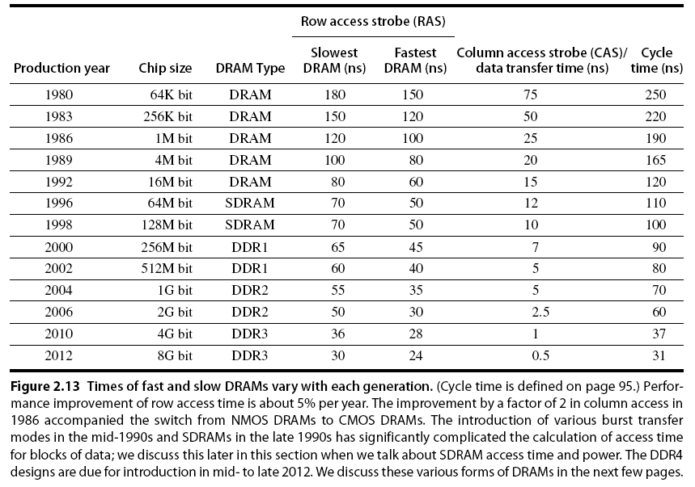
Memory Optimizations

Slide 117
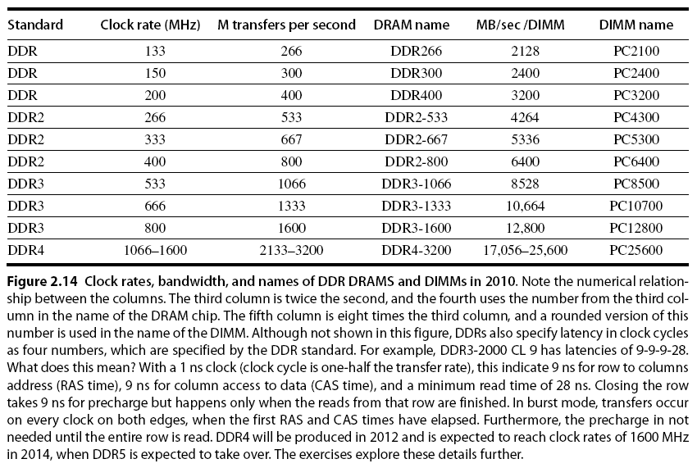
Memory Optimizations

Slide 118
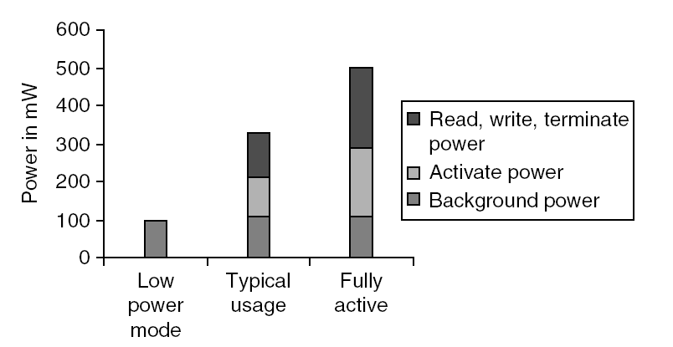
Memory Power Consumption
Reducing power in SDRAMs:
  Lower voltage 1.8v@DDR2 -> 1.2v@DDR4
  Low power mode (ignores clock, continues to refresh)

Slide 119
Flash Memory
Type of EEPROM
Must be erased (in blocks) before being overwritten
Non volatile
Limited number of write cycles
Cheaper than SDRAM, more expensive than disk
Slower than SRAM, faster than disk
No moving parts – ideal for PMD

Slide 120
Memory Dependability
Memory is susceptible to cosmic rays
Soft errors: dynamic errors
  Detected and fixed by error correcting codes (ECC)
Hard errors: permanent errors
  Use sparse rows to replace defective rows
Solutions:
  Error correcting code – correct signal error
  Chipkill: a RAID-like error recovery technique using redundancy

Slide 121
Backup

Slide 122
Virtual Machines
Supports isolation and security
Sharing a computer among many unrelated users
Enabled by raw speed of processors, making the overhead more acceptable
Allows different ISAs and operating systems to be presented to user programs
  “System Virtual Machines”
  SVM software is called “virtual machine monitor” or “hypervisor”
  Individual virtual machines run under the monitor are called “guest VMs”

Slide 123
Impact of VMs on Virtual Memory
Each guest OS maintains its own set of page tables
  VMM adds a level of memory between physical and virtual memory called “real memory”
  VMM maintains shadow page table that maps guest virtual addresses to physical addresses
    Requires VMM to detect guest’s changes to its own page table
    Occurs naturally if accessing the page table pointer is a privileged operation

Slide 124
Opt 9 – Compiler Prefetching
Insert prefetch instructions before data is needed
Non-faulting: prefetch doesn’t cause exceptions
Register prefetch
  Loads data into register
Cache prefetch
  Loads data into cache
Combine with loop unrolling and software pipelining
2.3 Advanced Cache Optimizations
Notes:
skip

