Slide 1
EEL 6764 Principles of Computer Architecture
Dr Hao Zheng
Computer Sci. & Eng.
U of South Florida

Slide 2
About This Course
Principles of modern computer architectures
  All the “things” behind modern computers
Quantitative analysis approaches to design tradeoffs in terms of
  Cost, performance, power/energy efficiency etc.
Why this course?
  Have better sense of future by learning from the past
  Design better computers to solve real-world problems
  Write better software
  Get a good grade in order to continue your grad. study
    A more tangible motivation
Notes:
Functions of a computer are the results of organic composition of SW and HW.

Slide 3
Course Objectives
Understand various aspects of modern computer architecture design
  Instruction set design, mem hierarchy, pipelining, multi-processing, etc
Understand quantitative approaches to analysis and evaluation of design tradeoffs
  Cost, performance, power/energy, etc
Understand the interplays between the computer architecture & software
  How they affect each other
Notes:
Functions of a computer are the results of organic composition of SW and HW.
Understand the interactions between the computer’s architecture & its software so that
Future software designers (compiler writers, operating system designers, database programmers, …) can achieve the best cost-performance trade-offs.
Future architects understand the effects of their design choices on software applications.

Slide 4
Instructor
Dr. Hao Zheng
  Office: ENB 312
  Office Hours: 10-11:30 and 2:00 – 3:30 pm, Wed
  Drop email for appointment
  Phone: 974-4757
  Email: haozheng@usf.edu
Research interests – design of STAR systems
  Secure
  Trustworthy
  Autonomous
  Resilient
Notes:
Functions of a computer are the results of organic composition of SW and HW.
Understand the interactions between the computer’s architecture & its software so that
Future software designers (compiler writers, operating system designers, database programmers, …) can achieve the best cost-performance trade-offs.
Future architects understand the effects of their design choices on software applications.

Slide 5
Course Administration
TA/Grader: Shamaria Engram
Email: sengram@mail.usf.edu
Office: ENB 327
  Office Hours: 4-6pm Tue. & Thr

Slide 6
Course Material
Text:
  Computer Architecture: A Quantitative Approach by Hennessy & Patterson, 6th Edition, Morgan Kaufmann (Required).
  Computer Organization and Design, 5th Edition: The Hardware/Software Interface, Morgan Kaufmann by Hennessy & Patterson (Recommended)
Additional material will be posted
Partial lectures and reading material will be posted before class

Slide 7
Evaluation and Grading Information
October 1st, 2018
Dec. 3, 3 – 5pm
TBD
Let me know about midterm exam conflicts ASAP
For homework/quiz grades talk to the TA.
  All HW must be submitted electronically to Canvas.
Other queries: TA and Instructor

Slide 8
Final Grading Scale
No curves!
Notes:
Note: evening midterm exam

Slide 9
What You Should Know
Course prerequisites
  CDA 3201 Logic Design
  CDA 4205 Computer Architecture
Basic logic design & computer organization
  Information representation, Boolean logic
  Logic building blocks: flip-flops, multiplexers, decoders, shift registers
  Datapaths, register transfer level design
  Knowledge of digital systems in terms of computer organization and logic level design
  Instruction sets: opcodes, operands, memory addressing, etc
  Input/output and communication; memory hierarchy.
Basic knowledge of assembly programming.

Slide 10
Expectations from You
Do all homeworks (start early!),
Do not miss quizzes
Attend lectures (come on time),
Take notes whenever necessary.
Prepare for classes/quizzes.
Ask questions, participate in class.
For exams, read notes, book and supplementary materials.
This will be a heavy course – work hard!
Be honest to yourselves!

Slide 11
More on Homework Assignments
Do them to truly understand the material, not just to get the grade.
Content from lectures, readings, discussions.
All homework write-ups must be your own work, written up individually and independently.
  Peer discussions are encouraged.
  Copying each others’ work or from previous work is strictly forbidden!
There is a fine line between plagiarism and collaboration.
No late homework submissions are accepted.

Slide 12
Cheating and Academic Dishonesty
Absolutely no form of cheating will be tolerated
You are all adults and we will treat you so
See syllabus, USF Policy, and CSE Academic Integrity Policy
Cheating → failing grade (no exceptions)
  You may get FF, resulting in dismissal from the program.

Slide 13
Course Content
Other current topics may be introduced if time permits.

Slide 14
Reading
Chapter 1

Slide 15
How Do the Pieces Fit Together?
Algorithms, programming
Application
Operating
Operating system
System
Compiler
Firmware
Compilers
Instruction Set
Architecture
Memory
system
Instr. Set Proc.
I/O system
This course
Datapath & Control
CSD
Digital Design
Logic design
Circuit Design
CMOS VLSI, low-power
Coordination of many levels of abstraction
Under a rapidly changing set of forces
Design, measurement, and evaluation
Notes:
A computing system is very complex, and its functioning under certain metrics requires coordination of efforts at diff abstraction levels.

Slide 16
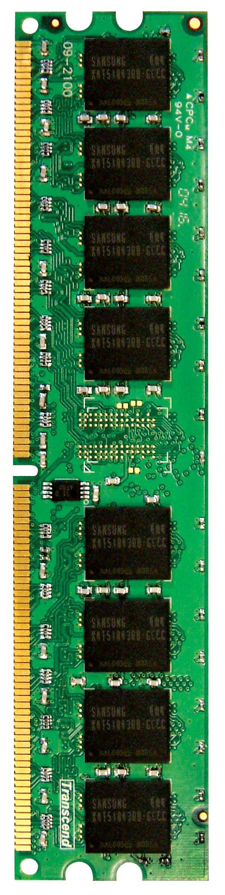
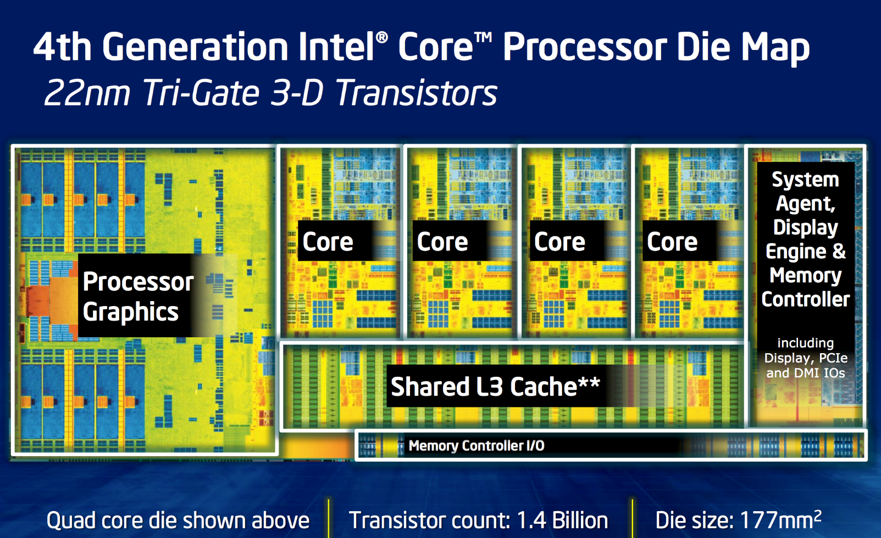
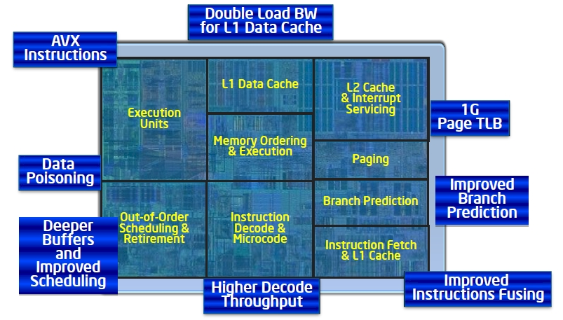
An Example
DRAM BANKS
The objective of this course is to touch each of these components

Slide 17
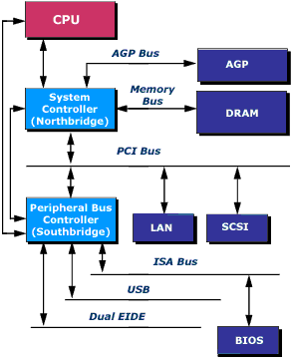
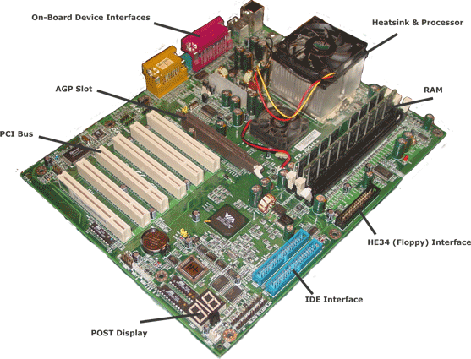
A System-Level View
Processor
Graphics
Memory
IO Bus
Processor Interface
Disk/USB Interface
Notes:
Processor is only one component of an entire system, which includes other components like memory, storage, buses, etc
Processor chip is hidden under the heat sink
DRAM memories are on DIMMS (dual in-line memory modules)

Slide 18
Computer Architecture
What is it?
Why is it important?

Slide 19
What is Computer Architecture?
“Computer architecture is the science and art of selecting and interconnecting hardware components to create a computer that meets functional, performance, and cost goals.” *
* G. Sohi, UW
Think about architecture of buildings!
Notes:
Does not concern the detailed implementations of those compnents.

Slide 20
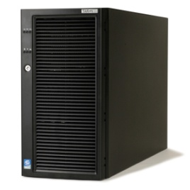
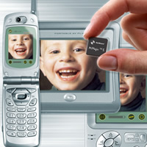
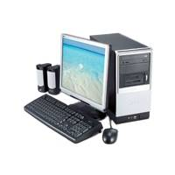

Ubiquitous Usage of Computers
Embedded applications
General purpose computing
~2%
~98%
Today’s high-end computers have
  Billions of transistors in a chip
  Tera-flops (10^12 FPOS) processing power
Notes:
Why is it important – computers are everywhere, with diverse characteristics and requirements!
Wrong arch design --> failed products and loss of markets!
explain general-purpose computers and special purpose natures of embedded computers.

Slide 21
Where is the Market?
It is estimated that there will be between 15 and 20 billion devices (small embedded devices) with a $900 Billion USD market, which is growing twice as fast as the PC market.
Millions of Computers
Embedded applications: mobile electronics, automobile electronics, home electronics, communications and networking, healthcare products, sensor networks, gaming hardware, defense applications and many others!

Slide 22
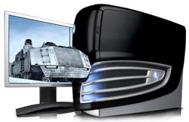
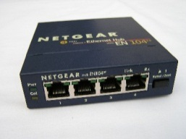

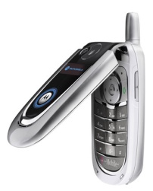
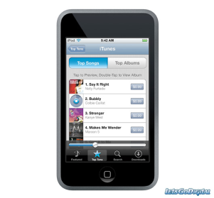
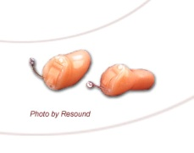
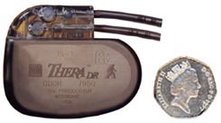
Computer Applications
General purpose computing: internet server, database server, real-time jobs etc.
Ultralow power applications: medical, space, specific sensor network etc.
POWER
Portable applications: mobile computing, wireless, multimedia etc.
PERFORMANCE
Different applications have different power-performance demands
Notes:
EE695KR -- Adv. VLSI Design
K. Roy
22

Slide 23
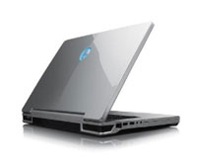
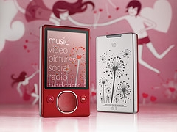
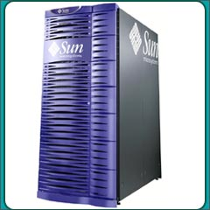
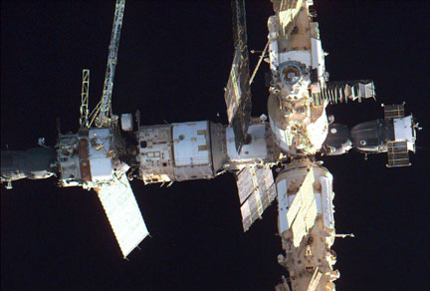
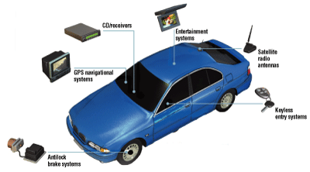
System Design Parameters
Performance (Speed)
Cost
Power (static + dynamic)
  Peak power
  Average power
Robustness
  Noise-tolerance
  Radiation-hardness
Testability
Reconfigurability
Time-to-market etc.
Notes:
EE695KR -- Adv. VLSI Design
K. Roy
23
Security is gaining tractions recently.

Slide 24
Classes of Computers
Shipments: 1.9B PMD, 350M Desktop, 19B Embedded.
Desktop has largest $ market share.
1.2 Classes of Computers
Notes:
Cluster/WSC = many servers connected by LAN acting as one.
Supercomputer = a kind of WSC with a focus on float point perf.
Embedded vs PMD : PMD can run external SW while embedded cannot.

Slide 25
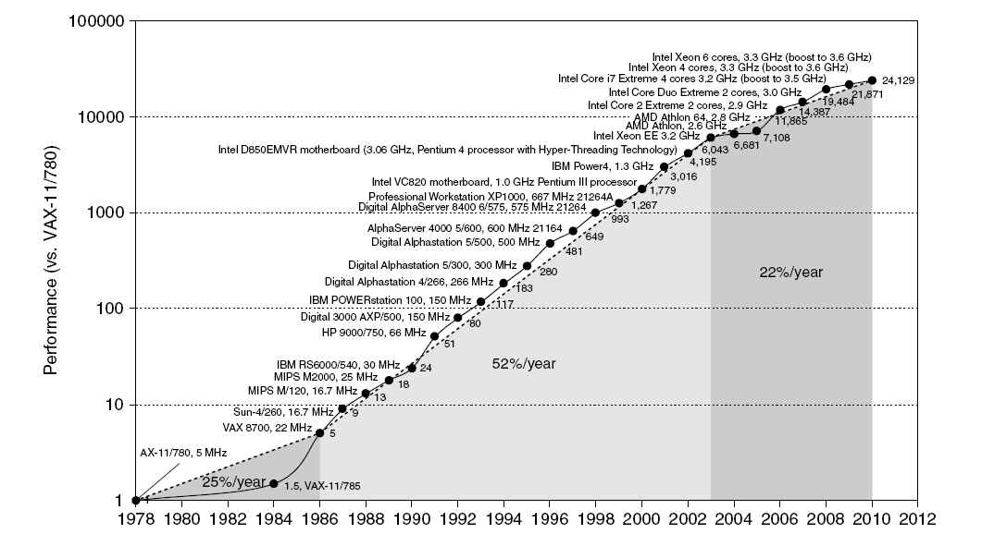
Single Processor Performance
Move to multi-processor
RISC
1.1 Introduction
Notes:
The great improvements are the results of advances in
implementation technologies + how computers are designed.

Slide 26
Computer Technology Driving Forces
Improvements in semiconductor technology
  Feature size, clock speed, cost
Improvements in computer architectures
  Enabled by high-level language compilers, UNIX
  Lead to RISC architectures
Together have enabled:
  More powerful and efficient computers.
  New classes of computers, i.e. mobile devices, etc.
  Penetration of GP CPUs into many applications.
  Tradeoff between performance and productivity in SW development.
1.1 Introduction

Slide 27
Current Trends in Architecture
Power Wall
Memory Wall
Lack of Instruction-Level parallelism (ILP) to exploit
  Single processor performance improvement ended in 2003
New models for performance:
  Data-level parallelism (DLP)
  Thread-level parallelism (TLP)
  Request-level parallelism (RLP)
These require explicit restructuring of the applications
  Applications must expose parallelism explicitly.
1.1 Introduction
Notes:
Exploiting ILP cannot continue without enormous power consumption overhead.

Slide 28
Classes of Parallelism
Exploitation of parallelism --> performance
Classes of parallelism in applications:
  Data-Level Parallelism (DLP)
  Task-Level Parallelism (TLP)
Classes of architectural parallelism:
  Instruction-Level Parallelism (ILP)
  Vector architectures/Graphic Processor Units (GPUs)
  Thread-Level Parallelism (TLP)
  Request-Level Parallelism (RLP)
1.2 Classes of Computers

Slide 29
Flynn’s Taxonomy
Single instruction stream, single data stream (SISD)
  Exploit ILP and TLP in some degree
Single instruction stream, multiple data streams (SIMD)
  Targets DLP
  Vector architectures
  Multimedia extensions
  Graphics processor units
Multiple instruction streams, single data stream (MISD)
  No commercial implementation
Multiple instruction streams, multiple data streams (MIMD)
  Targets TLP and RLP
  Tightly-coupled MIMD - TLP
  Loosely-coupled MIMD - RLP
SD
MD
SI
SISD | SIMD
X | MIMD
MI
1.2 Classes of Computers

Slide 30
Computer Architecture – Past and Now
“Old” view of computer architecture:
  Instruction Set Architecture (ISA) design
  i.e. decisions regarding:
    registers, memory addressing, addressing modes, instruction operands, available operations, control flow instructions, instruction encoding
“Real” computer architecture:
  ISA design is less of a focus
  Meet specific requirements of the target machine
  Design to find a best tradeoff among performance, cost, power, and availability, etc, optimized for target applications
  Consider ISA, microarchitecture, logic/circuit design, implementation, etc.
Impacts from requirements of applications and technology.
1.3 Defining Computer Architecture
Notes:
Modern computer arch design is much broader:
Design requirements that stem from the target applications a new computer tries to solve.

Slide 31
Technology Trends
Integrated circuit technology
  Transistor density: +35%/year
  Die size: +10-20%/year
  Integration overall: +40-55%/year
DRAM capacity: +25-40%/year (slowing)
  Foundation of main memory.
Flash capacity: +50-60%/year
  8-10X cheaper/bit than DRAM
  An order of magnitude slower than DRAM
Magnetic disk technology: +40% -> 5%/yr
  15-25X cheaper/bit then Flash
  300-500X cheaper/bit than DRAM
  Main storage for server or WSC.
Important to design for the next generation of technology!
Current technologies approaching their limits; new technologies being researched
1.4 Trends in Technology
Notes:
Section 1.4

Slide 32
First Microprocessor
1.4 Trends in Technology
Notes:
Section 1.4

Slide 33
Height of Single-Core Processor
1.4 Trends in Technology
Notes:
Section 1.4

Slide 34
Transistors and Wires
Transistor feature size
  Minimum size of transistor or wire in x or y dimension
  10 microns in 1971 to .032 microns in 2011
  Now in 2017/2018, seeing 10nm – 7nm.
Transistor density grows exponentially.
  Moore’s law – has been slowing down
Transistor performance scales linearly
Wire delay does not improve with feature size!
  In fact, it is getting worse!
  Make on-chip interconnect design an important task!
1.4 Trends in Technology

Slide 35
Bandwidth and Latency
Bandwidth or throughput
  Total work done in a given time
  Important for servers and data center operators
Latency or response time
  Time between start and completion of an event
  Important for individual users
1.4 Trends in Technology

Slide 36
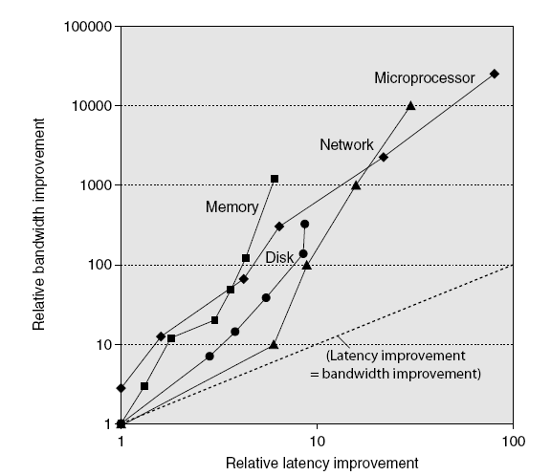
Bandwidth and Latency
Bandwidth
  10,000-25,000X improvement for processors
  300-1200X improvement for memory and disks
Latency
  30-80X improvement for processors
  6-8X improvement for memory and disks
Improvement in Bandwidth = square of improvement in latency
Log-log plot of bandwidth and latency milestones
1.4 Trends in Technology

Slide 37
Power and Energy
Problem: Get power in, distribute it, get it out
Thermal Design Power (TDP)
  Characterizes sustained power consumption
  Used as target for power supply and cooling system
  Lower than peak power, higher than average power consumption
Clock frequency can be reduced dynamically to limit power consumption
Energy efficiency is often a better measurement
  Power = a design constraint
1.5 Trends in Power and Energy
Notes:
Heat dissipation is the major block from increasing frequency.
TDP is the power designed such that the generated heat can be dissipated without causing slowdown or damage of chips

Slide 38

Dynamic Energy and Power
Dynamic energy
  Transistor switch from 0 -> 1 or 1 -> 0
  E = ½ x Capacitive load x Voltage²
Dynamic power
  P = ½ x Capacitive load x Voltage² x Frequency switched
Relation between energy and power consumption
  P: power, E: energy, f: switching frequency
Reducing clock frequency reduces power, not energy
1.5 Trends in Power and Energy

Slide 39
Power and Energy
Suppose two designs have the same clock frequency. Design 1 consumes, on average, 20% less than energy per operation than Design 2.
  Design 1’s power is 20% less than design 2.
  Design 1 dissipates less heat with the same performance of design 2.
  Or, design 1’s clock frequency can be improved by 25% while consuming the same power as design 2.
1.5 Trends in Power and Energy
Notes:
Heat dissipation is the major block from increasing frequency.
Energy efficiency helps increase performance.

Slide 40
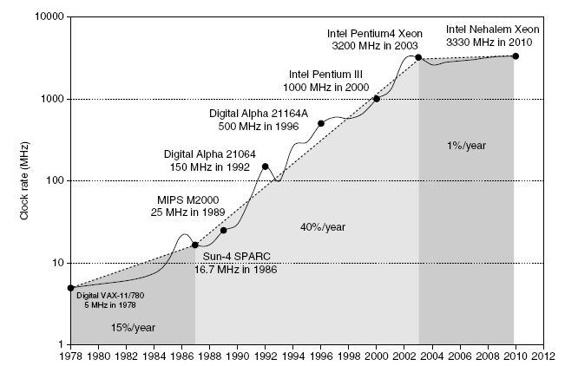
Power
Intel 80386 consumed ~2 W
3.3 GHz Intel Core i7 consumes 130 W
Heat must be dissipated from 1.5 x 1.5 cm chip
This is the limit of what can be cooled by air.
Performance improvement by increasing f is over!
1.5 Trends in Power and Energy

Slide 41
Reducing Power
Techniques for reducing power:
  Turn off components not being used
  Dynamic Voltage-Frequency Scaling
  Low power state for DRAM, disks
  Overclocking, turning off all but one core
Energy efficiency has become a critical quality metric
Measured by tasks/joule or performance/watt
1.5 Trends in Power and Energy

Slide 42
Static Power
Transistors are not perfect switches
  leakage current even when no switching
Static power consumption
  Current_{static} x Voltage
  Scales with number of transistors
  To reduce: power gating
Static power
  Increasing share of overall system power.
1.5 Trends in Power and Energy

Slide 43
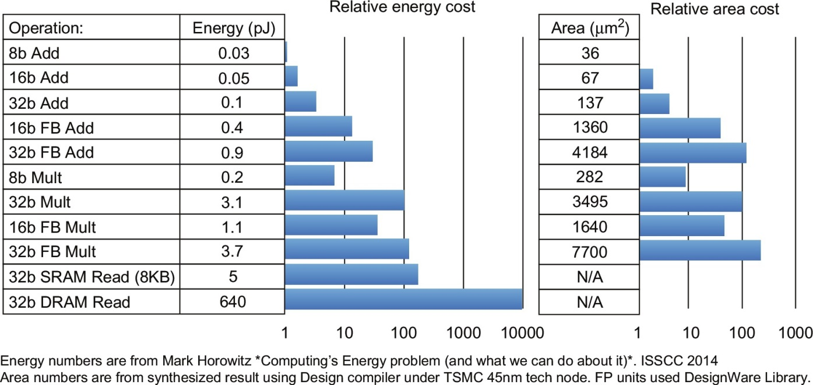
Where are Energy/Area Consumed?

Slide 44
Factors Affecting Cost
Cost: design, manufacturing, material, etc.
  Design – one time cost
  Manufacturing ... – recurring cost
Cost driven down by learning curve
  Yield: ratio between good products among all.
Increase in volume -> reduced unit cost
    10% less for each doubling of volume
    Design cost amortized over volume
    Material cost lower on large volume
1.6 Trends in Cost
Notes:
Cost = design + testing + material + production
------ --------------------------------
OTC recurring cost

Slide 45
Integrated Circuit: Wafer and Die
die
wafer
1.6 Trends in Cost

Slide 46



Cost of Integrated Circuit Cost
Cost of Integrated circuit
Bose-Einstein formula:
  Defects per unit area = 0.016-0.057 defects per square cm (2010)
  N = process-complexity factor = 11.5-15.5 (40 nm, 2010)
1.6 Trends in Cost
Notes:
Yield improves by following the learning curves.

Slide 47
Dependability
As feature size shrinks, computers fail more often.
Module reliability
  Mean time to failure (MTTF)
  Mean time to repair (MTTR)
  Mean time between failures (MTBF) = MTTF + MTTR
  Availability = MTTF / MTBF
  = a ratio between service time and total life span
To improve reliability: redundancy.
1.7 Dependability
Notes:
Analogy: a car w or w/o a spare tire.

Slide 48
Measuring Performance
Typical performance metrics:
  Response (execution) time & throughput
Speedup of X relative to Y
  Execution time_{Y} / Execution time_{X}
Execution time
  Wall clock time: includes all system overheads
  CPU time: only computation time
Benchmarks
  Kernels (e.g. matrix multiply)
  Toy programs (e.g. sorting)
  Synthetic benchmarks (e.g. Dhrystone)
  Benchmark suites (e.g. SPEC06fp, TPC-C)
Can be mis-leading
1.8 Measuring Performance
Notes:
CPU time: measure the efficiency of processors.
Wall clock time: measure overall system efficiency.

Slide 49

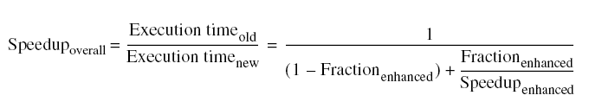
Principles of Computer Design
Take Advantage of Parallelism
  e.g. multiple processors, disks, memory banks, pipelining, multiple functional units
Principle of Locality
  A property of programs: data and instructions typical reused
Focus on the Common Case
  Amdahl’s Law
1.9 Quantitative Principles of Computer Design
Notes:
Locality: foundation of cache concept, critical for HW prediction
Temporal and spatial locality
Focus on common case: 90% time spent in 10% of the code, then optimize the 90% case.

Slide 50
Amdahl’s Law - Example
Suppose a new processor is 10 times faster than the current one. Assume that the current processor is 40% time busy with computation and 60% of the time idle waiting for IO. What is the overall speedup with the new processor?
1.9 Quantitative Principles of Computer Design
Notes:
Locality: foundation of cache concept, critical for HW prediction
Temporal and spatial locality
Focus on common case: 90% time spent in 10% of the code, then optimize the 90% case.

Slide 51


Principles of Computer Design
The Processor Performance Equation
ISA
compiler
ISA
arch
technology
arch
1.9 Quantitative Principles of Computer Design

Slide 52
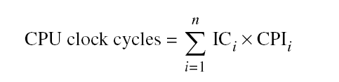
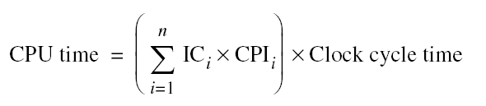
Principles of Computer Design
Different instruction types having different CPIs
  IC_{i} : count of instruction i in a program.
  CPI_{i} : average cycle count for instruction i
1.9 Quantitative Principles of Computer Design

Slide 53
Suppose the following measurements
freq of FP ops = 25%
Average CPI of FP ops = 4 cycles
freq of FPSQR = 2%
Average CPI of FPSQR = 20 cycles
Average CPI of other inst = 1.33 cycles
Design #1: decrease CPI of FPSQR to 2
Design #2: decrease CPI of all FP to 2.5
Compare these two design alternatives.
1.9 Quantitative Principles of Computer Design
Notes:
Different from the similar example in the book.

Slide 54
Summary
Computer architecture involves ISA, microarchitecture, HW technologies.
  Is about making tradeoffs among design parameters optimized for target applications.
  Should be mindful about technology trends, and their impacts on comp. design.
Classification of comp. arch. wrt different types of parallelism they exploit.
Reviews of trends of various system parameters.
Overviews of computer design principles
  Exploitation of parallelism, locality, optimization for common cases, etc.

