Slide 1
CDA 4253 FPGA System Design
PicoBlaze Instruction Set
Hao Zheng
Comp Sci & Eng
U of South Florida

Slide 2
Required reading
P. Chu, FPGA Prototyping by VHDL Examples
Chapter 15 PicoBlaze Assembly Code Development
Recommended reading
K. Chapman, PicoBlaze for Spartan-6, Virtex-6, and 7-Series (KCPSM6)

Slide 3
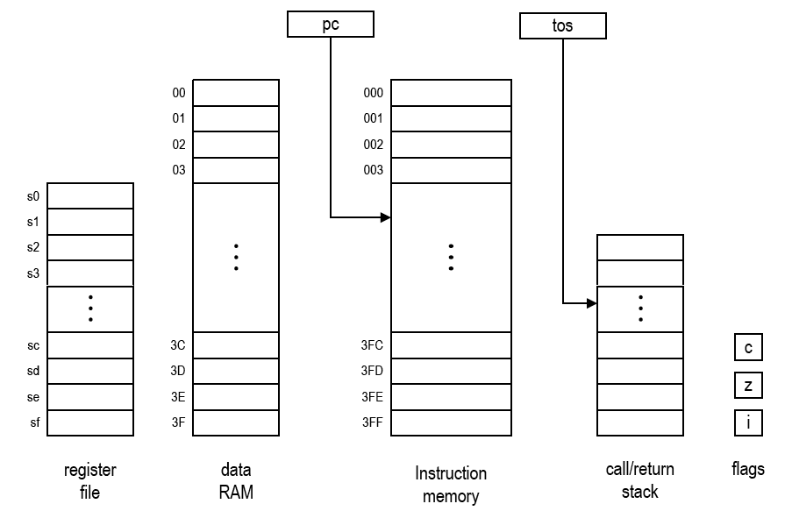
PicoBlaze-6 Programming Model
Bank B
Bank A
FFC
FFD
FFE
FFF

Slide 4
Addressing modes
Immediate mode
SUB s7, 0x07
ADDC s2, 0x08
s7 <= s7 – 0x07
s2 <= s2 + 0x08 + C
Direct mode
ADD sa, sf
IN s5, 0x2a
sa <= sa + sf
s5 <= PORT(0x2a)
Indirect mode
STORE s3, (sa)
IN s9, (s2)
RAM((sa)) <= s3
s9 <= PORT((s2))

Slide 5
PicoBlaze Development Environments
 | Xilinx KCPSM3/6 | FIDEx IDE
Platform support | Windows | Windows XP, Windows 7 and 8
Assembler | Command-line in DOS window | Graphical
Instruction Syntax | KCPSM3/6 | FIDEx IDE
Instruction Set Simulator | Facilities provided for VHDL simulation | Graphical/ Interactive
Simulator Breakpoints | N/A | Yes
Register Viewer | N/A | Yes
Memory Viewer | N/A | Yes
FIDEx IDE is available at http://www.fautronix.com/en/fidex

Slide 6
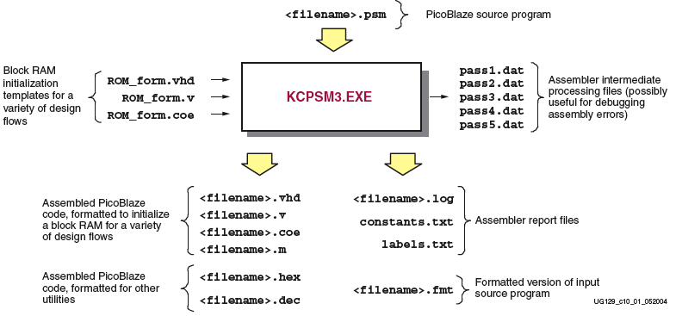
KCPSM6 Assembler Files
KCPSM6.EXE

Slide 7
Directives of Assembly Language
Function | KCPSM3/6 Directive | FIDEx IDE Directive
Locating Code | ADDRESS 3FF | ORG 0x3FF
Aliasing Register Names | NAMEREG s5, myregname | myregname EQU s5
Declaring Constants | CONSTANT myconstant, 80 | myconstant EQU 0x80
Naming the program ROM file | Name using the same base filename as the assembler source file | Specify the VHDL template file in the project settings under processor tab and compiler options
Equating symbolic name for an I/O port ID | N/A | sw_port EQU 0x01 ; 8-bit switches sw_in EQU sf IN sw_in, sw_port ; read switch input data EQU s0 ; reg for tmp data led_port EQU 0x05 OUT data, led_port

Slide 8
Differences between Mnemonics of Instructions
KCPSM3/ 6 Mnemonic | FIDEx IDE Mnemonic
RETURN | RET
RETURN C | RET C
RETURN NC | RET NC
RETURN Z | RET Z
RETURN NZ | RET NZ
RETURNI ENABLE | RETI ENABLE
RETURNI DISABLE | RETI DISABLE
ENABLE INTERRUPT | EINT
DISABLE INTERRUPT | DINT

Slide 9
Differences between Mnemonics of Instructions
ADDCY sX, sY | ADDC sX, sY
SUBCY sX, sY | SUBC sX, sY
INPUT sX, (sY) | IN sX, (sY)
INPUT sX, kk | IN sX, kk
OUTPUT sX, (sY) | OUT sX, (sY)
OUTPUT sX, (sY) | OUT sX, (sY)
COMPARE sX, sY | COMP sX, sY

Slide 10
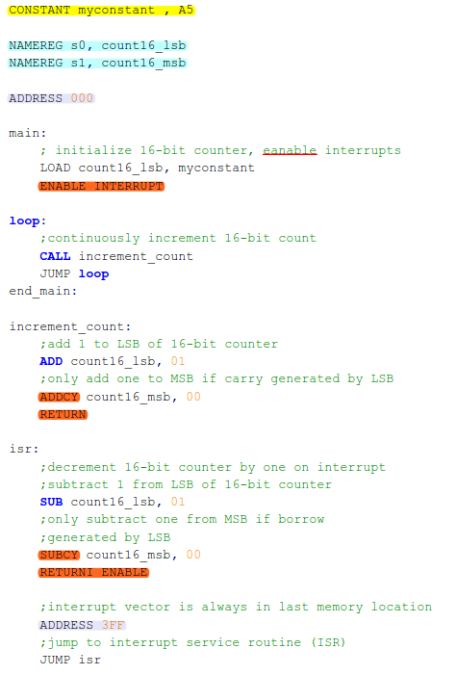
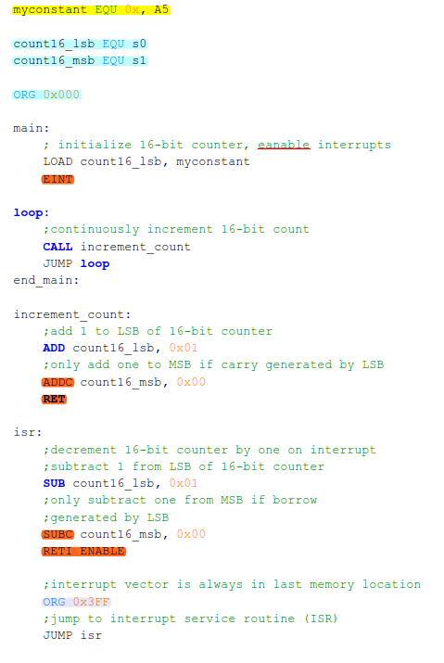
Differences between Programs
A5
0xA5

Slide 11
An Example in KCPSM Convention

Slide 12
Data Movement Instructions (1)
Move data to/from registers
LOAD sX, sY ; direct addressing
sX <= sY
LOAD sX, 0F ; immediate addressing
sX <= 0F

Slide 13
Data Movement Instructions (2)
Move data to/from scratch pad memory
fectch sX, (sY) ; indirect addressing
sX <= RAM[(sY)]
fectch sX, KK ; immediate addressing
sX <= RAM[KK]
store sX, (sY) ; indirect addressing
RAM[(sY)] <= sX
store sX, KK ; immediate addressing
RAM[KK] <= sX

Slide 14
Example: Clear Scratch Pad RAM
constant RAM_SIZE 40 ; size of RAM = 64
clr_data_mem:
load s2, RAM_SIZE ; unitize loop index to 64
load s0, 00
clr_mem_loop:
sub s2, 01 ; dec loop index
store s0, (s2)
jump nz, clr_mem_loop ; repeat until s2=0
return ; return from this sub-routine

Slide 15
Logic/Bit Manipulation Instructions
AND sX, sY ; direct addressing,
sX <= sX and sY
AND sX, 0F ; immediate addressing
sX <= sX and KK
OR sX, sY ; direct addressing
sX <= sX or sY
OR sX, 0F ; immediate addressing
sX <= sX or KK
XOR sX, sY ; direct addressing
sX <= sX xor sY
XOR sX, FF ; immediate addressing
sX <= sX xor FF

Slide 16
Questions
Perform the following operations
in the assembly language of PicoBlaze
Set the most significant bit of the register s0 to 1
Clear two middle bits of the register s1
Toggle the least significant bit of the register s2

Slide 17
Answers
Set the most significant bit of the register s0 to 1
  constant BIT7, 80 ; create a symbolic constant
  or s0, BIT7
Clear two middle bits of the register s1
  constant BITS43C, E7
  AND s1, BITS43C
Toggle the least significant bit of the register s2
  constant BIT0, 01
  XOR s2, BIT0

Slide 18
Arithmetic/Multi-Byte Manipulation Instructions
ADD sX, sY ; direct addressing
sX <= sX + sY
ADD sX, 0F ; immediate addressing
sX <= sX + 0F

Slide 19
Arithmetic/Multi-Byte Manipulation Instructions
ADDC sX, sY ; direct addressing
sX <= sX + sY + CARRY
ADDC sX, 0F ; immediate addressing
sX <= sX + 0F + CARRY

Slide 20
Questions
Perform the following operation
in the assembly language of PicoBlaze
Add two 3-byte numbers X=(x2, x1, x0) and Y=(y2, y1, y0),
stored originally in registers (s2, s1, s0) and (s5, s4, s3),
accordingly.

Slide 21
Answer

Slide 22
Another Example

Slide 23
Arithmetic/Multi-Byte Manipulation Instructions
SUB sX, sY ; direct addressing
sX <= sX – sY
SUB sX, 0F ; immediate addressing
sX <= sX – 0F
SUBC sX, sY ; direct addressing
sX <= sX – sY – CARRY
SUBC sX, 0F ; immediate addressing
sX <= sX – 0F – CARRY

Slide 24
Questions
Perform the following operation
in the assembly language of PicoBlaze
Perform the subtraction X = X - Y, where X=(x2, x1, x0) and Y=(y2, y1, y0), and these variables are originally stored in registers (s2, s1, s0) and (s5, s4, s3), accordingly.

Slide 25
Multi-Byte Subtraction Example

Slide 26
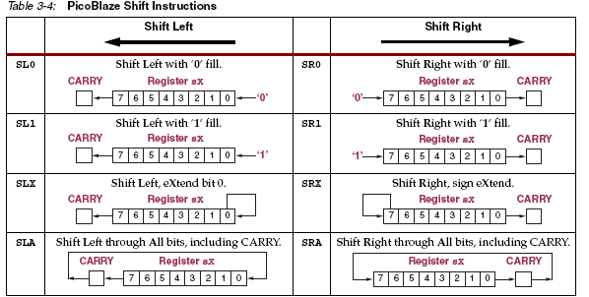
Edit instructions - Shifts
*All shift instructions affect Zero and Carry flags

Slide 27
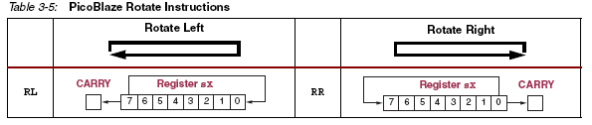
Edit instructions - Rotations
*All rotate instructions affect Zero and Carry flags

Slide 28
Questions
Perform the following operation
in the assembly language of PicoBlaze
Perform the left shift (C, X) <= X << 1,
where X = (x2, x1, x0) is stored in registers (s2, s1, s0),
and the most significant bit of X is shifted into the carry flag.

Slide 29
A Shift Example

Slide 30
Control Structures

Slide 31
Control Structures in High Level Language
if (s0 == s1) {
/* then branch statements */
}
else {
/* else branch statements */
}

Slide 32
Control Structures in High Level Language
switch (s0) {
case value1 :
/* then branch statements */
break;
case value1 :
/* then branch statements */
break;
    default :
/* default statements */
}

Slide 33
Test Instructions
TEST sX, sY
TEST sX, KK

Slide 34
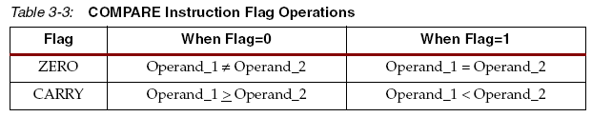
Compare Instructions
COMP sX, sY
COMP sX, KK
Question: How to detect if sX > sY?

Slide 35
Program Flow Control Instructions (1)
JUMP AAA
PC <= AAA
JUMP C, AAA
if C=1 then PC <= AAA else PC <= PC + 1
JUMP NC, AAA
if C=0 then PC <= AAA else PC <= PC + 1
JUMP Z, AAA
if Z=1 then PC <= AAA else PC <= PC + 1
JUMP NZ, AAA
if Z=0 then PC <= AAA else PC <= PC + 1

Slide 36
If-Else Statement
C
Assembly language
if (s0 == s1) {
……….
}
else {
………..
}

Slide 37
If-Else Statement
C
Assembly language
if (s0 == s1) {
… ; if branch
}
else {
… ; else branch
}
  compare s0, s1
  jump nz, else_branch
… ; code for if brnach
jump if_done
else_branch:
… ; code for else branch
if_done:
… ; code following the if stmt

Slide 38
If-Else Statement
C
Assembly language
if (s0 > s1) {
… ; if branch
}
else {
… ; else branch
}
  compare s0, s1
  jump z, else_branch
  jump c, else_branch
… ; code for if brnach
jump if_done
else_branch:
… ; code for else branch
if_done:
… ; code following the if stmt

Slide 39
Switch Statement
C
Assembly language
switch (s0) {
case value_1:
……….
break;
case value_2:
……….
break;
case value_3:
……….
break;
default:
……….
}

Slide 40
Switch Statement
C
Assembly language
compare s0, value_1
jump nz, case_2
… ; code for case 1
jump case_done
case_2:
compare s0, value_2
jump nz, case_3
… ; code for case 2
jump case_done
case_3:
compare s0, value_3
jump nz, default
… ; code for case 3
jump case_done
default:
… ; code for the default case
case_done: ; code following the case stmy
switch (s0) {
case value_1:
……….
break;
case value_2:
……….
break;
case value_3:
……….
break;
default:
……….
}

Slide 41
For Loop
C
Assembly language
for(i=MAX, i>=0, i--) {
… ; loop body
}

Slide 42
For Loop
C
Assembly language
for(i=MAX; i>0; i--) {
… ; loop body
}
load s0, MAX
for_loop:
… ; code for loop body
sub s0, 1
jump nz, for_loop
for(i=MAX; i>=0; i--) {
… ; loop body
}
load s0, MAX
for_loop:
… ; code for loop body
sub s0, 1
jump nc, for_loop

Slide 43
Subroutines

Slide 44
Subroutine-Related Instructions
CALL AAA
TOS <= TOS+1; STACK[TOS] <= PC; PC <= AAA
CALL C | Z , AAA
if C | Z =1 then
TOS <= TOS+1; STACK[TOS] <= PC; PC <= AAA
else
PC <= PC + 1
CALL NC | NZ , AAA
if C | Z =0 then
TOS <= TOS+1; STACK[TOS] <= PC; PC <= AAA
else
PC <= PC + 1
Register/scratch pad RAM must be saved manually

Slide 45
Subroutine-Related Instructions
RETURN
PC <= STACK[TOS] + 1; TOS <= TOS - 1
RETURN C | Z
if C | Z =1 then
PC <= STACK[TOS] + 1; TOS <= TOS – 1
else
PC <= PC + 1
RETURN NC | NZ
if C | Z =0 then
PC <= STACK[TOS] + 1; TOS <= TOS – 1
else
PC <= PC + 1

Slide 46
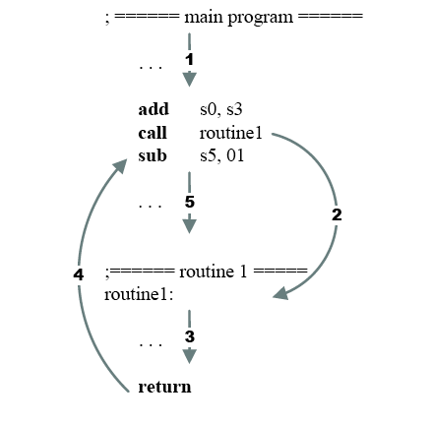
Subroutine Call Flow

Slide 47
Subroutine Example
mult_soft: ; (s5, s6) <= s3 * s4
load s5, 00 ; clear s5
load s0, 08 ; initialize loop index
mult_loop:
sr0 s4 ; shoft LSB to carry
jump nc, shift_prod ; LSB = 0
add s5, s3 ; LSB = 1
shift_prod:
sra s5 ; right shift upper byte
sra s6 ; right shift lower byte
sub s0, 01 ; dec loop index
jump nz, mult_loop ; repeat until s0=0
return

Slide 48
Program Development
Derive the pseudo code
Identify subroutines
Determine register/RAM uses
Derive assembly code for the subroutines.
Embedded SW template

Slide 49
Program Development: Example
read a and b from switches
compute a²+b²
display result on LEDs

